Slide 1
On Domination of Nonlinear Wave Interaction
in the Energy Balance of Wind-Driven Sea
V.E. Zakharov
Department of Mathematics,
University of Arizona, Tucson, USA

Slide 2
The Hasselmann kinetic equation

Slide 4
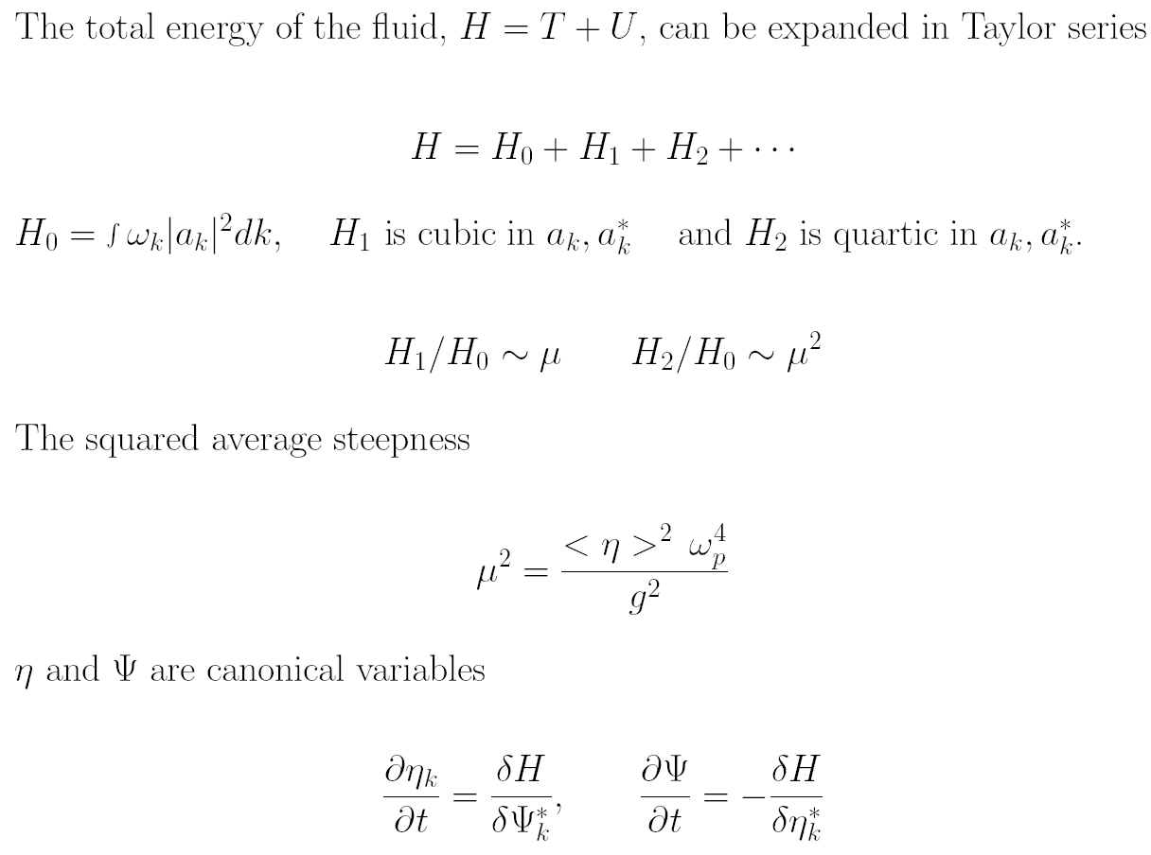

Slide 7
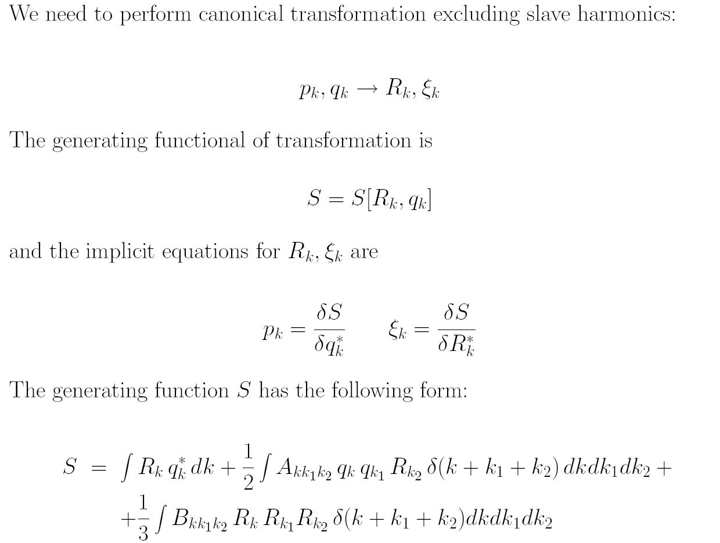

Slide 9
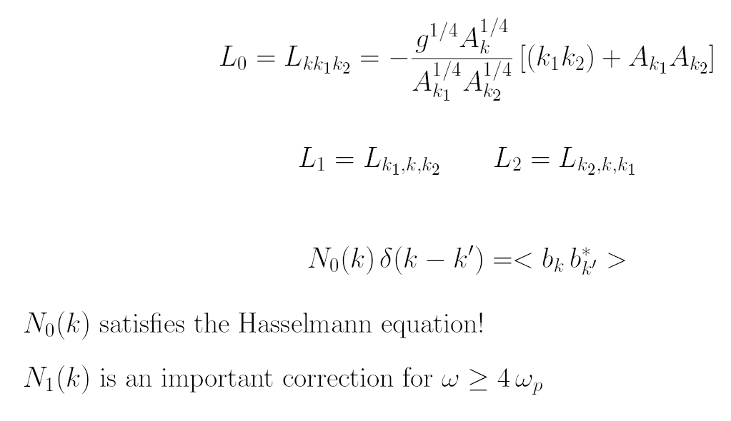

Slide 20
