Slide 1
Analysis of a water drop on a hydrophobic surface
Jordan Allen-Flowers
Mitch Wilson
Graduate Program in Applied Mathematics
University of Arizona
December 9,2009
Advisors: Dr. Alain Goriely, Robert Reinking

Slide 2
Outline
Introduction
Methods
Theory
Results
  Horizontal deformation
  Contact time
Discussions
Conclusions/Future Work

Slide 3
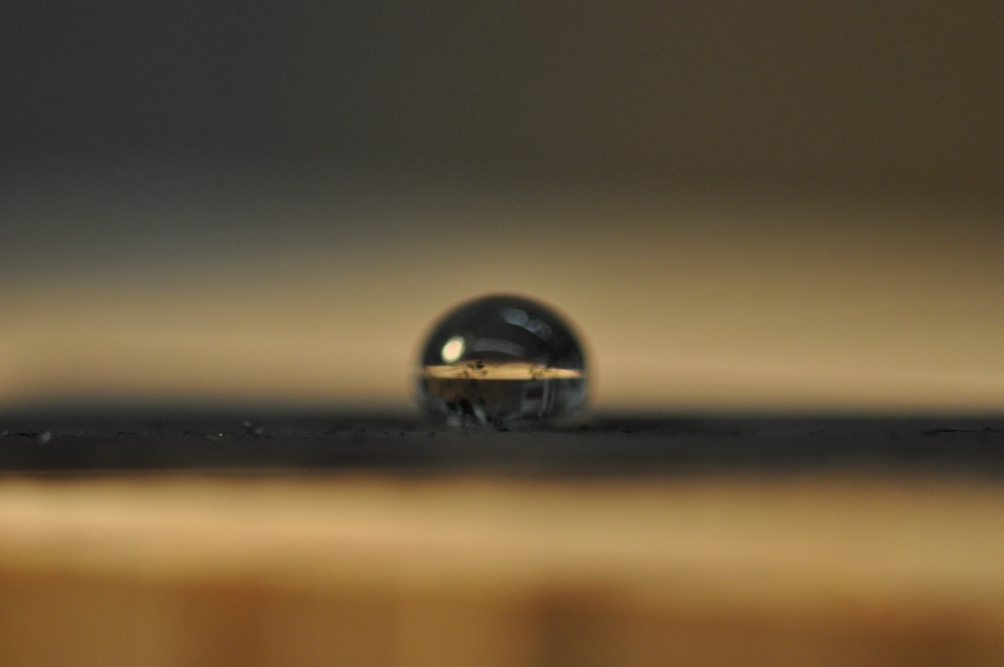
Introduction
Water-drop phenomena
Hydrophobic surface
Three behaviors:
  Bouncing
  Crowning
  Splashing

Slide 4

Research Goals
Discover relationships between different parameters
  Horizontal deformation
  Contact time
Compare to published results
Notes:
Bouncing: use 26_3; crowning: 130_3; splashing: 150_2

Slide 5
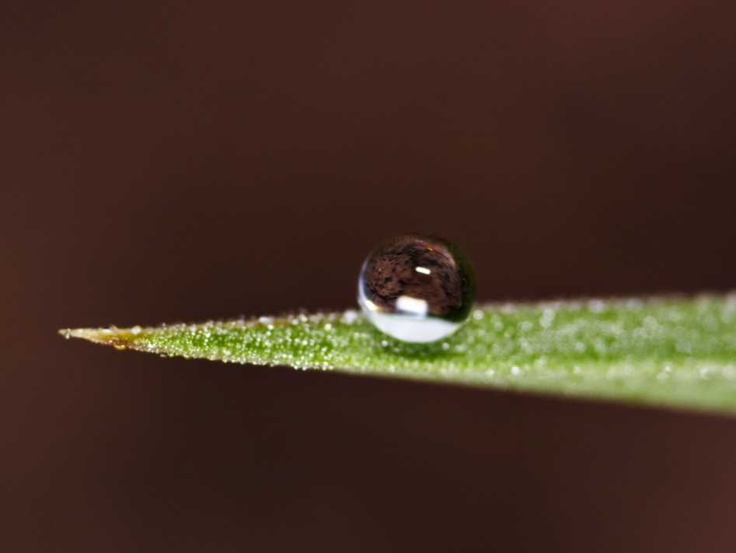
Applications
Inkjet printing
Fluid transport
Blood spatter at a crime scene
Water removal on leaves

Slide 6
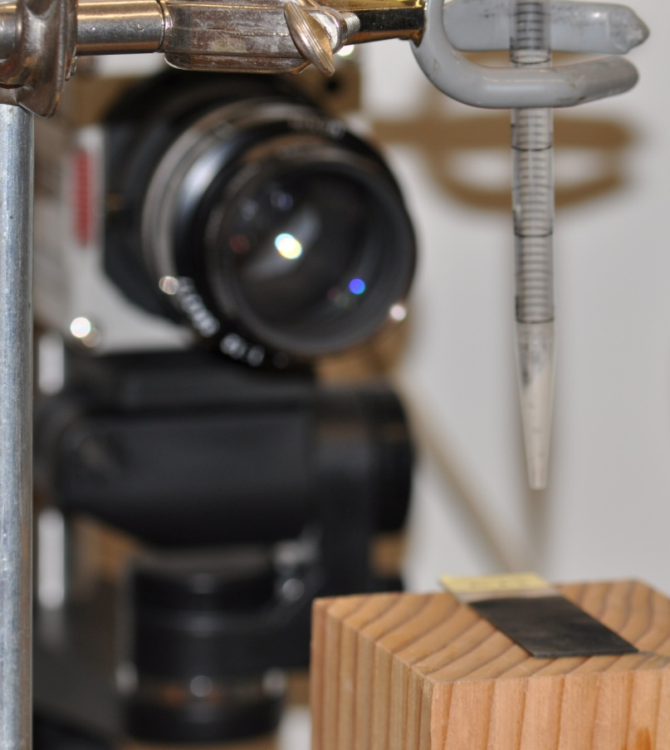
Methods
Water-drop system
  Pipettes and syringes
  Test slides
  Pressure bulbs
Camera and software
  High-speed camera
  Photron Motion Tools, ImageJ software
  1000W lamp

Slide 7
Theory: Maximum deformation
Weber number:
  U is impact velocity
  D is drop diameter
  ρ, σ are density and surface tension
  Ratio of kinetic energy to surface energy
  Ranges from ~1 to ~50

Slide 8
Three different scaling laws for maximal deformation:
All kinetic energy is transformed to surface energy
Kinetic energy is dissipated by viscosity
Gravity puddle approach

Slide 9
Theory: Contact time
Balancing inertia and capillarity yields:
This can also be rewritten as:
  But implies that τ is independent of U

Slide 10
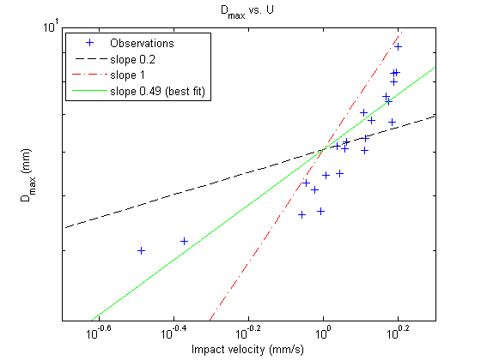
Results- Horizontal Deformation

Slide 11
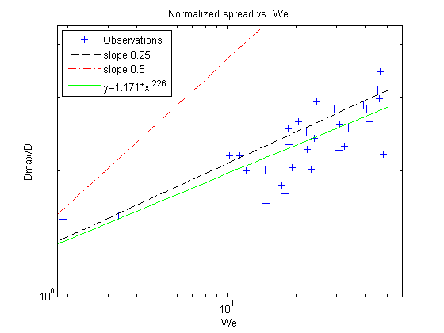
More results for max deformation

Slide 12
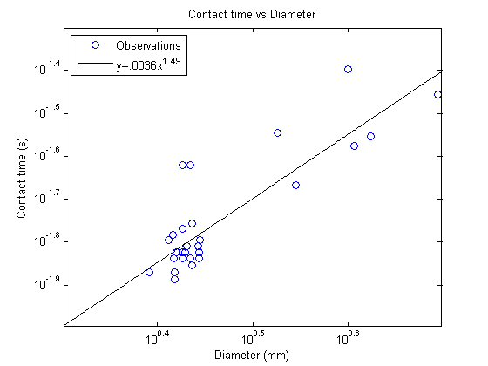
Results- Contact Time

Slide 13
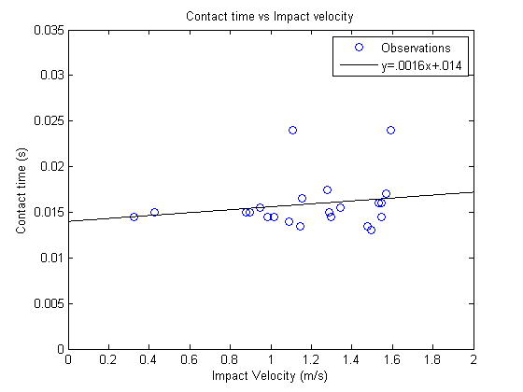
More results for contact time

Slide 14
Conclusions
The water-drop phenomena- quick, but intricate
Our data was consistent with the theory of some authors
Future work
  Surface analysis
  Different liquids
  Pinch-off phenomenon
We would like to thank Dr. Alain Goriely and Rob Reinking, who made this research possible.

Slide 15
References
Rein, M. 1993. "Phenomena of liquid drop impact on solid and liquid surfaces" Fluid Dyn. Res. 12, 61-93.
Okumura, K., Chevy F., Richard, D., Quere, D., Clanet, C. 2003. "Water spring: A model for bouncing drops" Europhys. Let. 62, 237-243.
Clanet, C., Beguin, C., Richard, D., Quere, D. 2004. "Maximal deformation of an impacting drop" J. Fluid Mech. 517, 199-208.
Richard, D., Clanet, C., Quere, D. 2002. "Contact time of a bouncing drop" Nature 417, 811.
Chandra, S., Avedisian, C.T. 1991. "On the collision of a droplet with a solid surface" Proc. Royal Soc. London A 432, 13.

