Slide 1

Meteorology Presentation
Willard Clark
Haley Cica
Nicholas Scaturo

Slide 2

Key Points of Paper
Weather prediction used to be highly inaccurate.
Richardson’s primitive equations:
  Impractical in the pre-computer era
The beginning of modern NWP:
  John von Neumann made important contributions
  The Development of The Electronic Computer
ENIAC integrations a breakthrough:
  - 24 hours for 24 hours
  Mathematical and Computer Advancements made weather prediction much more accurate

Slide 3
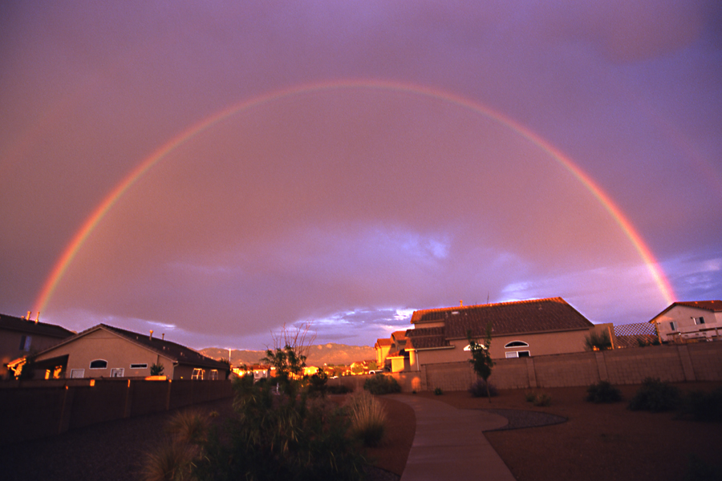
Obstacles to Overcome
  Weather prediction required better understanding of the complex aspects of the earth.
  Mathematical equations to deal with these complexities had to be developed.
  Instrumentation was needed to take accurate measurements efficiently.
  Powerful computer systems were needed to do the complex calculations.

Slide 4
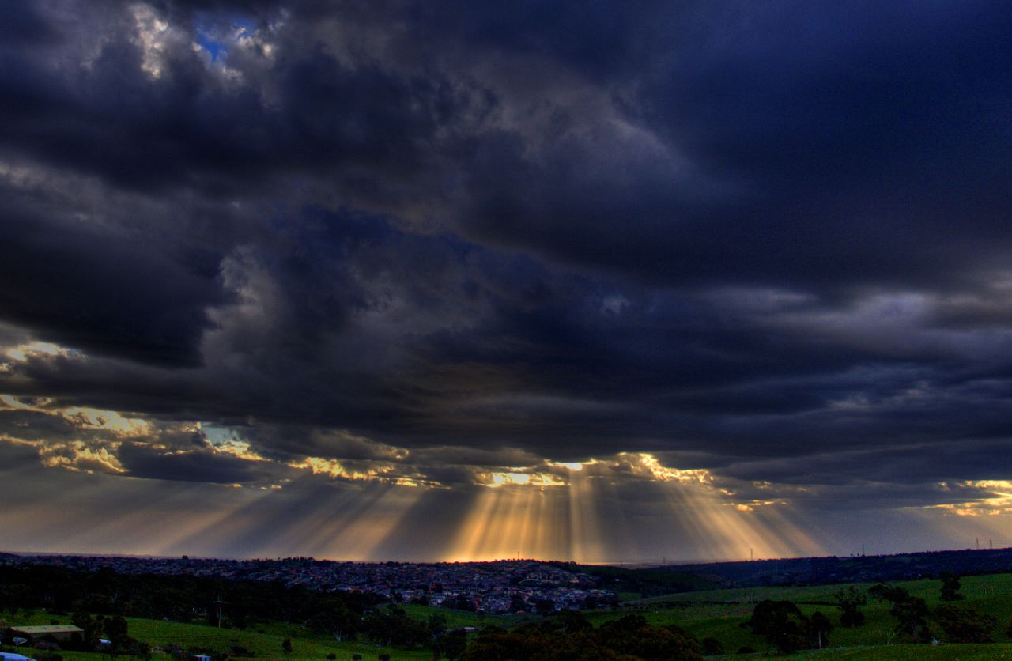
Who did what &
What problems were solved
Abbe wrote “The physical basis of long-range weather forecasting” gaining scientific attention.
Bjerknes developed a two step plan.
-Observation
- Using laws of motion to predict movement
Richardson developed a mathematical solution to forecasting that was to complex for the time.

Slide 5
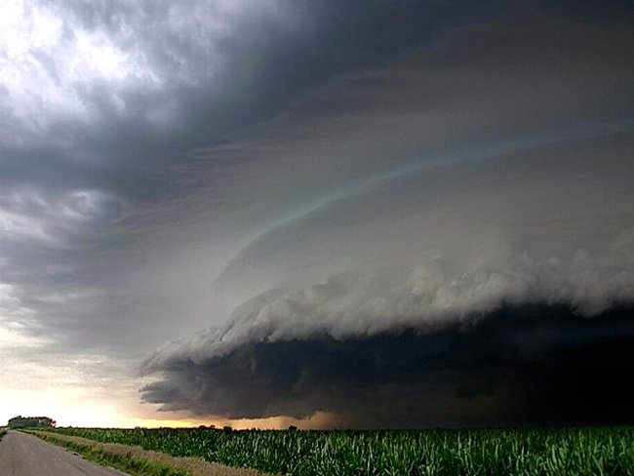
Who did what &
What problems were solved Part 2
John von Neumann pioneered mathematical solutions, and built the Electronic Computer.
Charney developed the quasi-geostropic system and a mathematical algorithm to implement it on the ENIAC.
Phillips carried out the first long range atmospheric simulation.

Slide 6
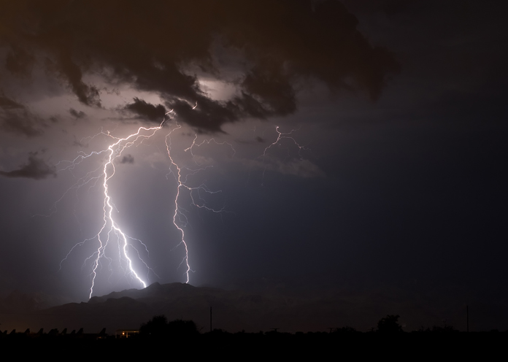
Different Science Involved in Meteorology
Physics
Mathematics
Computer Technology
Chemistry
Numerical Analysis
Engineering
?

Slide 7
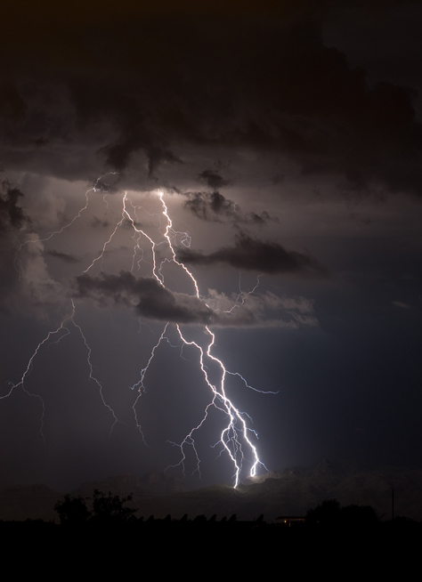
E-mail from Peter Lynch
Dear Haley,
I am glad that you enjoyed the article on computing the weather.
I am not an expert in computers, but I think that John von Neumann
was really a key figure in their development. He was a genius.
As regards computer weather forecasting, there is no doubt in my
mind that the most important contributions were made by Jule Charney.
He explained the way that storms form in middle latitudes (we call
the process "baroclinic instability" but don't worry about that).
He also worked out how to make weather forecasts by changing the
mathematical equations to a simpler form. And he did many other
brilliant things in meteorology.
If you are interested in going into meteorology as a career, then
you should do as much mathematics and physics as you can. Also,
chemistry is very important for some areas of meteorology).
The mathematics you need is not really all that difficult, but
it takes time and effort to learn, and the earlier you start the
easier it is.
I hope you do choose meteorology as a career. It is a wonderful
way to spend your life. There are many excellent schools of meteorology
in USA. I think that the University of Washington in Seattle is one
of the best, if not the best. You can look at their website.
Best wishes,
Peter Lynch

Slide 8
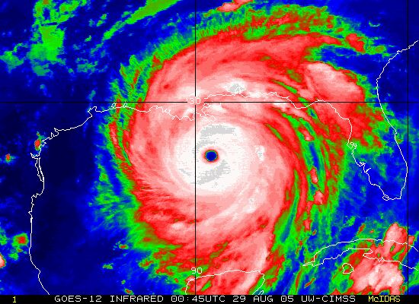
How Scientific Progress Is Made
Multiple disciplines of science are needed to work together to achieve a common goal, and people build off each other’s discoveries to make real progress in science.
Questions or opinions?

