Slide 1
Class 21: Bidding Strategy and Simulation
What is a “bidding strategy”?
  System of determining what to bid
  For example: signal with winner’s curse subtracted
How do we determine what is a good strategy?
  Do simulation and see what would happen in the long run

Slide 2
Bidding Strategies We May Consider
Bid our signal
Bid our signal minus Winner’s Curse
Bid our signal minus both the Winner’s Curse and the Winner’s Blessing
Optimize our bid if all others subtract WC + WB
Optimize our bid if all others subtract WC
Find stable equilibrium
Today: Strategy 2 and 3: Simulation to estimate the Winner’s Curse and Winner’s Blessing

Slide 3
Strategy 1-Bid $264.9M
-Bid your signal. What will happen? Give reasoning for your analysis
Had all companies bid their signals, the losses would have been huge, ranging from 14.1 to 37.3 million dollars! Evidently, bidding one’s signal is a disastrous strategy. Strategy 1 not optimal because the extra profit values for the historic auctions are all negative, indicating that each winner paid more for the lease than it was worth to the company.

Slide 4
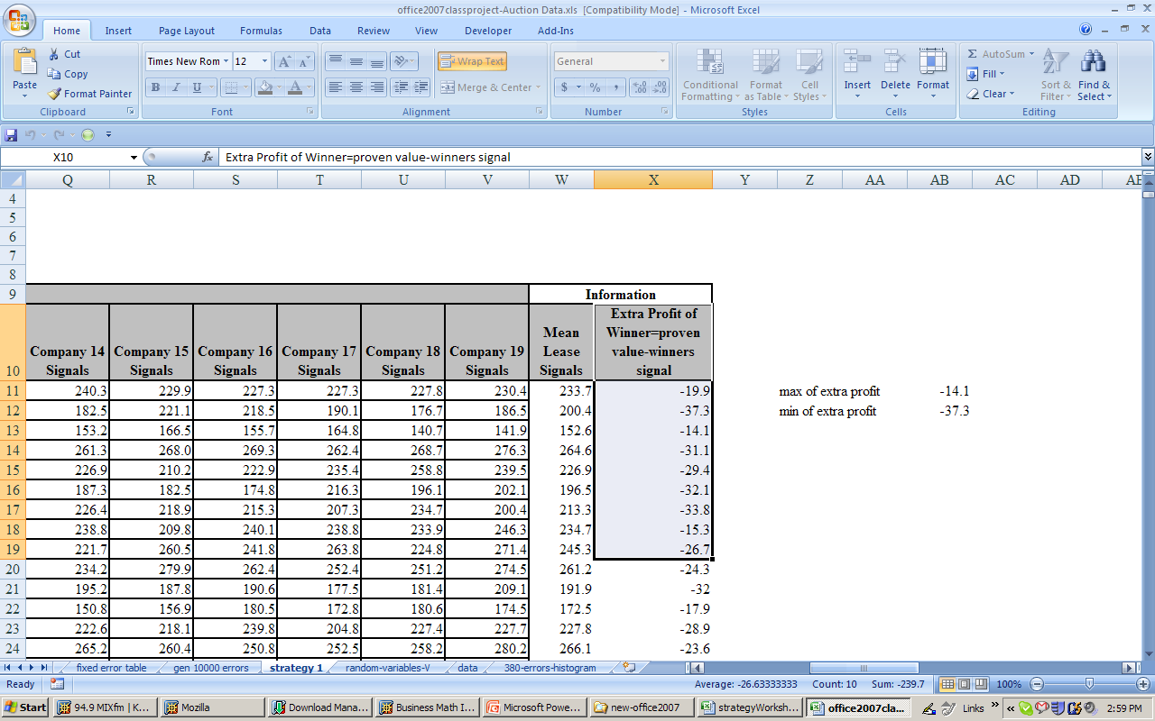
Strategy 1-Bid $264.9M

Slide 5
Strategy 1-Bid $264.9M
“Winner’s Extra Profit” is almost always negative. That is, the winning company will not get its needed fair return on the lease.
Strategy 1 is not optimal because,
the highest signal will almost always be well above the value of the lease and the winning company will have paid too much for the drilling rights. This is called the winner’s curse(we will learn how to calculate after simulation of Normal Errors).

Slide 6
Winner’s Curse
Average amount of money lost by the company that wins the bid if all companies bid their signals
Estimate the winner’s curse by finding the average amount by which the highest signal exceeds the proven value
Winner’s curse is the average maximum error

Slide 7
Strategy 2: Remove Winner’s Curse
Strategy: All companies bid their signal reduced by winner’s curse
Company with highest signal wins
On average, winner does not loose money
But on average winner does not make money

Slide 8
Winner’s Blessing
Average amount paid by winner above the second highest bid; this money is wasted
Estimate the winner’s blessing as the difference between the highest and second highest signals
Winner’s blessing is the difference between the largest and second largest errors

Slide 9
Strategy 3: Remove Winner’s Curse AND Winner’s Blessing
Strategy: All companies bid their signal reduced by the winner’s curse plus the winner’s blessing
Company with the highest signal wins
On average, the winner makes an amount equal to the winner’s blessing

Slide 10
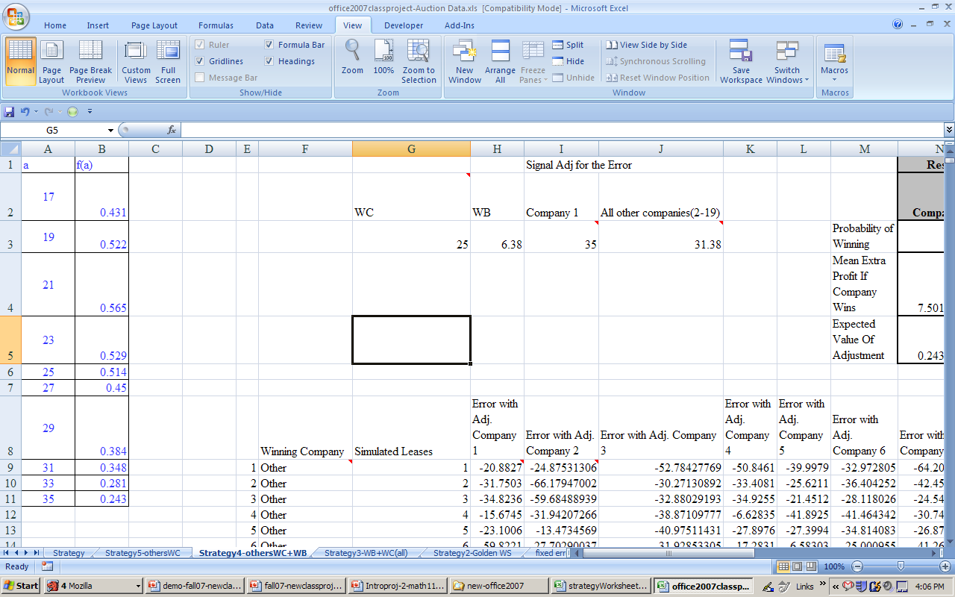
Strategy 4- Find a optimal adjustment for company 1. Assume all other companies Subtract Winner’s curse and Winner’s blessing from their signals to obtain their bids.

Slide 11
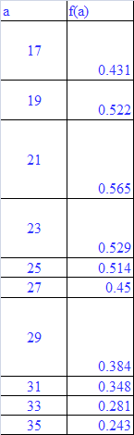
Strategy 4-Constructing f(a) function
Probability, Mathematics, Tests, Homework, Computers
Bidding on
an Oil Lease
on the project
for Company 1 must find the maximum expected value of adjustment(assuming that all other companies subtract both the curse and blessing)
this best adjustment, a_{cb}

Slide 12

f(a) function
Strategy 4-
copy from the sheet Strategy in Auction Focus.xls to a new book
Let f(a) be the expected value for Company 1 for subtracting a million dollars from its signal, assuming that all other companies adjust their signals by both the curse and blessing.
Fit a 4th degree polynomial trend line, which we will use as an approximate formula for the unknown function f.
Use solver to find the best adjustment

Slide 13
Strategy 4- Company 1 will
Bid=$264.9M-$21.28M=$243.62M

Slide 14
Is Strategy 4 optimal ?
No
This is the real world of business, where we expect our competitors to be well-managed companies
other 18 companies are sitting in their offices and boardrooms making the same calculations that we have just performed. Given the results, other companies will also elect to subtract less than 31.38million dollars from their signals.
It is worth noting that the 21.28million dollar adjustment that is our appropriate response to a larger reduction by the other companies, is not itself a stable strategy. Since this is less than the winner’s curse of 25 million dollars, there would be a negative expected value for extra profit if all companies adjusted downward by 21.28million dollars.

Slide 15
Strategy 5
-Find a optimal adjustment for company 1. Assume all other companies Subtract Winner’s curse from their signals to obtain their bids.

Slide 16

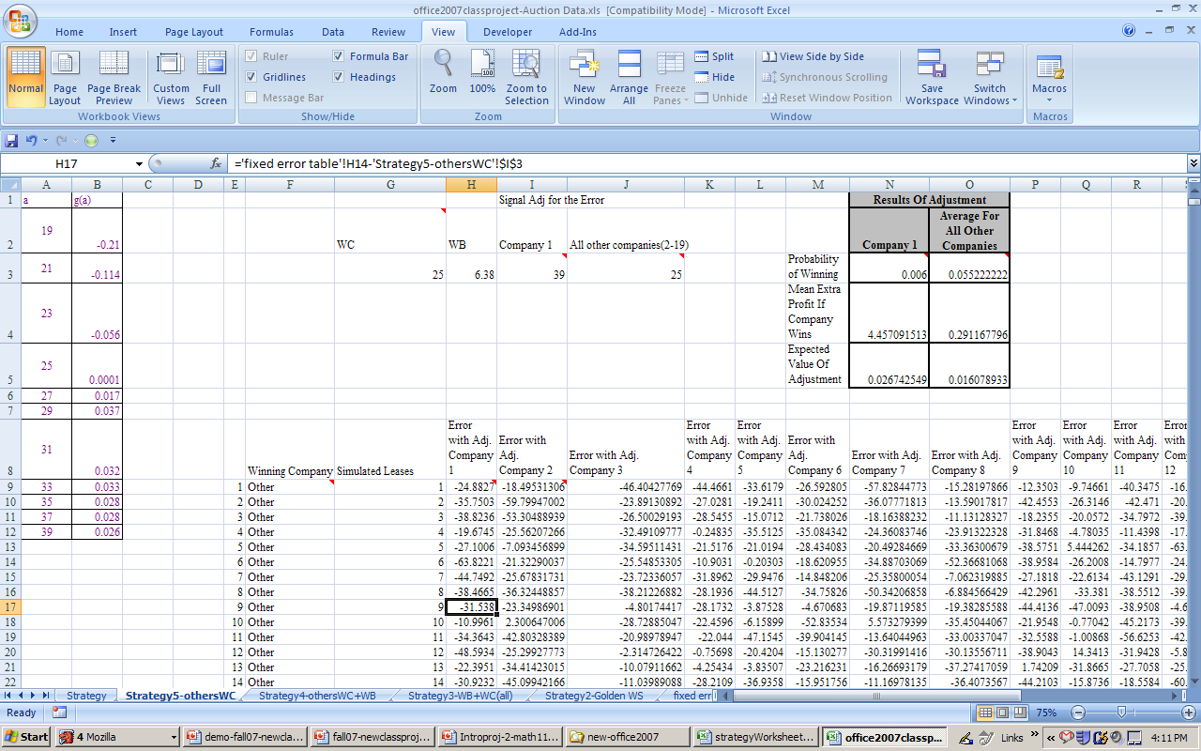
Strategy 5- Company 1 will
Bid=$264.9M-$30.81M=$234.09M

Slide 17
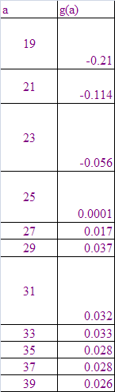
Simulating, Focus
Strategy 5- Constructing g(a) function
Probability, Mathematics, Tests, Homework, Computers
Bidding on
an Oil Lease
on the project
for Company 1 must find the maximum expected value of adjustment(assuming that all other companies subtract both the curse and blessing)
this best adjustment, a_{c}
Auction Focus.xls
Class Project
⬅
T
C
I
➔
(material continues)

Slide 18
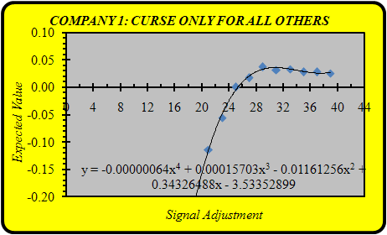
Strategy 5 -g(a) function
USE the sheet Strategy in Auction Focus.xls.
Let g(a) be the expected value for Company 1 for subtracting a million dollars from its signal, assuming that all other companies adjust their signals by curse.
Fit a 4th degree polynomial trend line, which we will use as an approximate formula for the unknown function g.
Use solver to find the best adjustment
the use of Solver in Strategy shows that g′(30.8) = 0. Hence, ac = 30.8 million dollars.
Company 1’s best response to an adjustment of 25 million dollars by all other companies is to lower its signal by the considerably larger amount of $30.8M

Slide 19
Is Strategy 5 optimal?
if we know what all other companies plan to do. Moreover, this same information is available to all of the bidders.
Need a stable strategy???
If all companies made such a stable adjustment to their signals, then there would be no incentive for anyone to alter the strategy. A stable bidding strategy is also called a Nash equilibrium

Slide 20
Strategy 6
Finally, each team should experiment with Auction Equilibrium.xls to determine a stable Nash equilibrium bidding strategy for its auction scenario. This will lead to a modification of your team’s signal and a specific bid in the upcoming auction.
Need to enter different values for the blue cell and experiment until the two cells are equal(this will take a LONG time. We will use 10 iterations and get the average
$27.031M
$27.031M

Slide 21
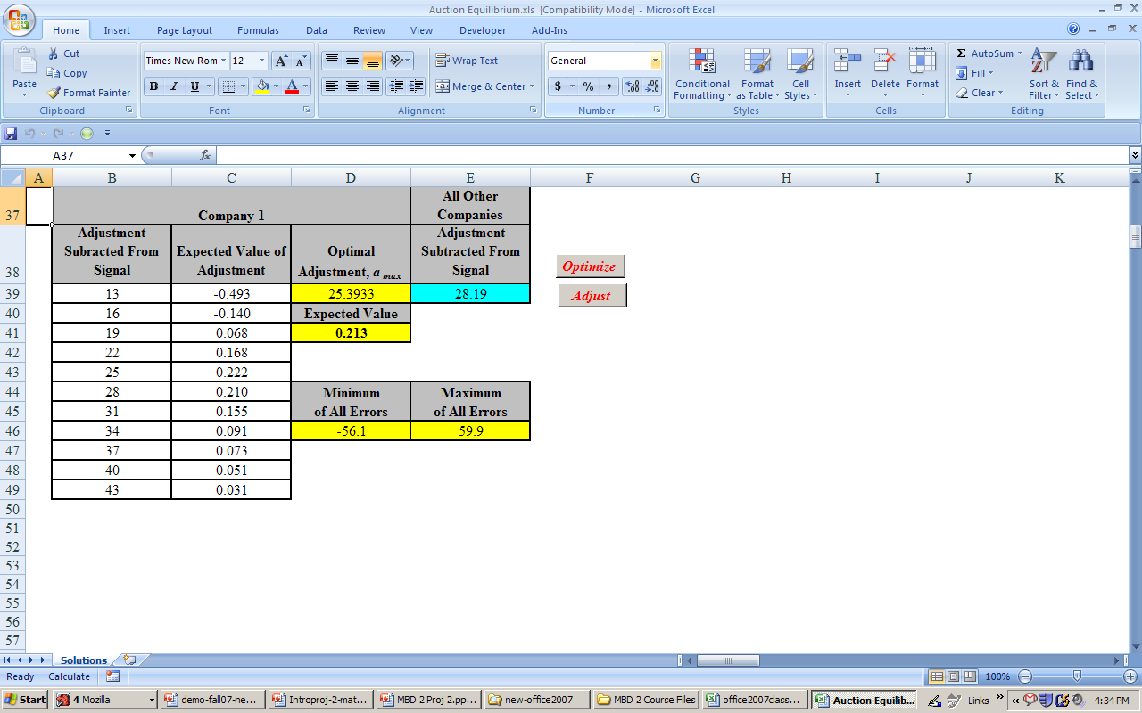
Strategy 6

Slide 22
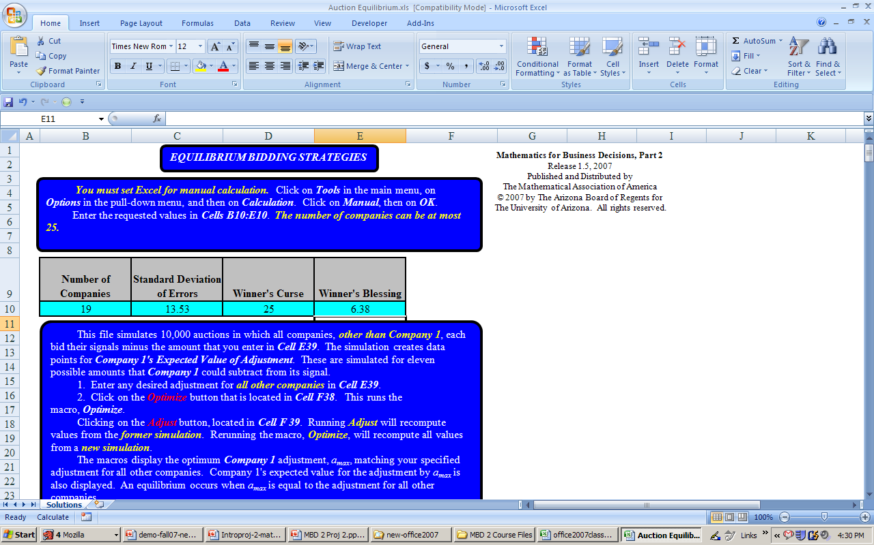
Strategy 6

Slide 23
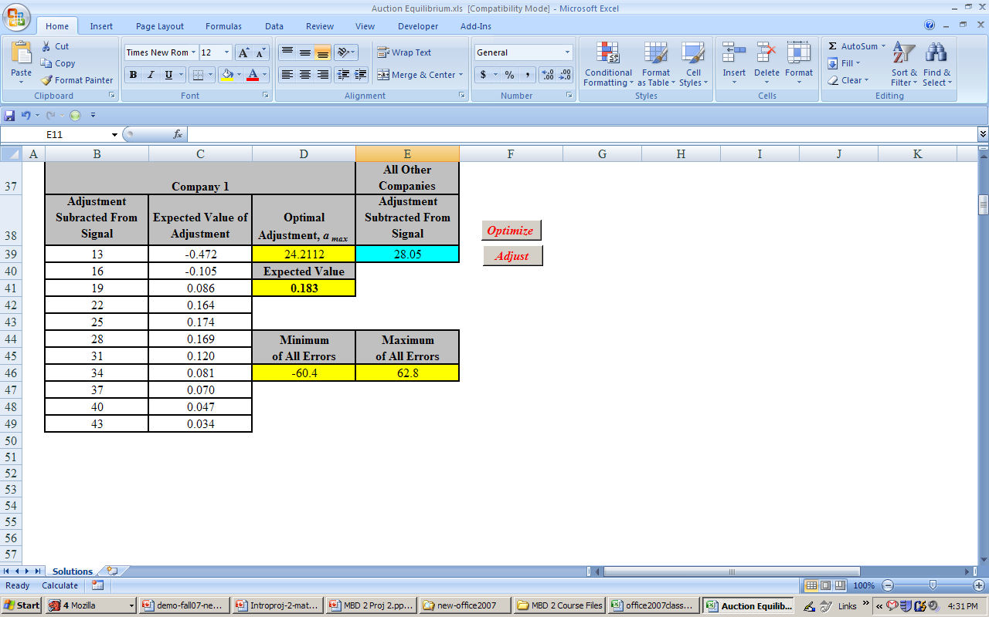
Strategy 6
(2wc+wb)/2

Slide 24
Excel method for Strategy 6
How?
(a) Use Auction Equilibrium.xls(.
(b) FOLLOW THE INSTRUCTIONS IN THIS FILE!
(c) Enter appropriate values in cells B10 through E10.
Enter a logical value in cell E39. Run the macro Optimize.
(the first logical value to use- (2wc+wb)/2
Enter another logical value in cell E39 and press the key F9.. record numbers in a table.
See table
Find the stable adj for strategy 6

Slide 25
Excel method for Strategy 6
 | Company 1 Optimal Adjustment, a_{max} (use 4 decimals) | All Other Companies Adjustment Subtracted From Signal | New logical value
1 | 25.3933 | 28.19 | (25.3933+28.19)/2= 26.7916
2 |  | 26.7916
.
.
10
 | Avg of a_{max}=final stable adj for strategy 6
first logical value to use for class project- (2wc+wb)/2=28.19

Slide 26
Strategy 6- Company 1 will
Bid=$264.9M-$27.031M=$237.869M
Using Auction Equilibrium.xls to determine 10 stable strategy values, and averaging the results, we find a signal adjustment of 27.031 million dollars. This provides our Nash equilibrium and is the final answer to our bidding strategy problem. If each company reduced its signal by $27,031,000 then there would be no expected gain for any one company, if it deviated from this plan.
Specifically, we will reduce our signal of $264,900,000 by $27,031,000 and submit a bid of $237,869,000.

Slide 27
Strategy 6-Stable because it uses Nash Concept
 |  | Signal Adj for the Error |  |  |  |  | Results Of Adjustment
WC | WB | Company 1 | All other companies(2-19) |  |  |  | Company 1 | Average For All Other Companies
25.003 | 6.382 | 27.031 | 27.031 |  |  | Probability of Winning | 0.0542 | 0.052544444
 |  |  |  |  |  | Mean Extra Profit If Company Wins | 2.033550547 | 2.027167495
 |  |  |  |  |  | Expected Value Of Adjustment | 0.11021844 | 0.1065164

Slide 28
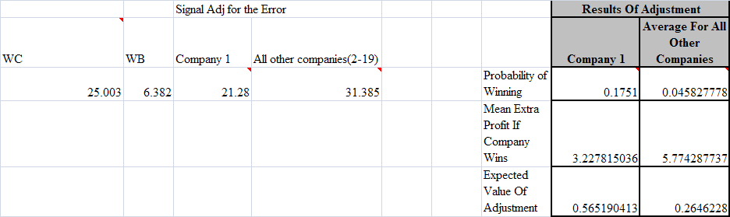
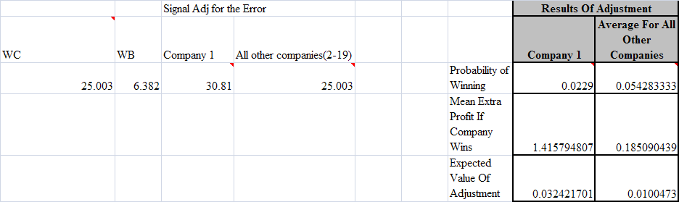
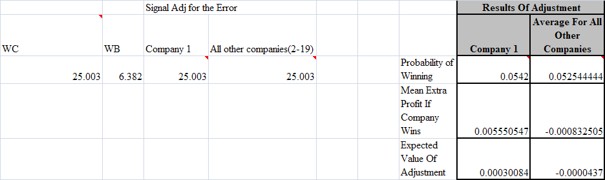
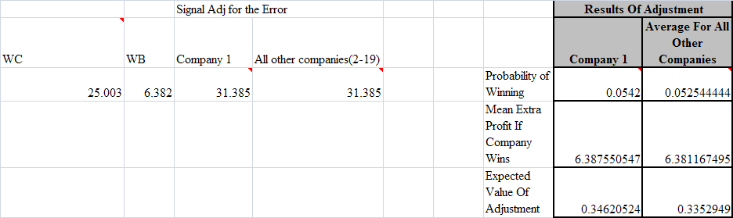
Summary of other Strategies
Strategy 4
Strategy 5
Strategy 2
Strategy 3

Slide 29
Recall-Project Assumptions
Assumption 1.
The same 19 companies
will each bid on future similar leases
only bidders for the tracts(This assumption is important for the Nash concept)
Assumption 2.
The geologists employed by companies
equally expert (evidence- the Mean of errors of all historical leases is 0)
on average, they can estimate the correct
values of leases.
evidence
each signal for the value of an undeveloped tract is an observation of a continuous random variable, S_{v},

Slide 30
Recall-Project Assumptions
Assumption 3. Except for their means, the distributions of the S_{v}’s are all identical
(The shape /The Spread)-This allows us to treat all the 20 historical leases as one sample -> We use the sample to show that mean of errors is 0 & find the standard deviation of errors)
Assumption 4.
All of the companies act in their own best interests, have the same profit margins, and have the same needs for business. Thus, the fair value of a lease is the same for all 19 companies.

Slide 31
Simulation: Why?
To estimate Winner’s Curse, why not just look at historical data? We could, but get a better estimate with more data
We need more error data!
We can do Monte Carlo simulation if we know the distribution of errors
Plot normal distribution (with mean 0 and standard deviation you found) alongside your errors

Slide 32
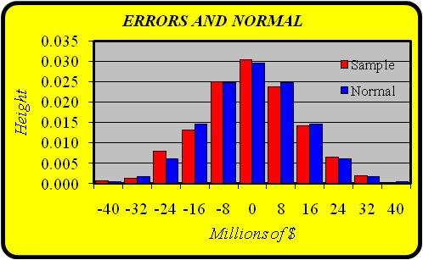
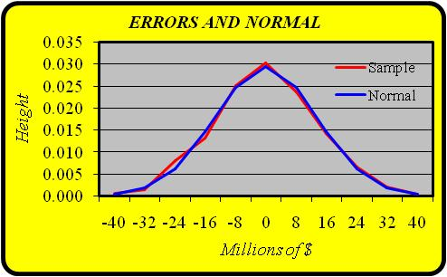
How We Know the Errors are Approximately Normally Distributed: Graphs from Class Project
Make similar graphs for your errors; use mean 0 and your standard deviation (see Normal page of Auction Focus)

Slide 33
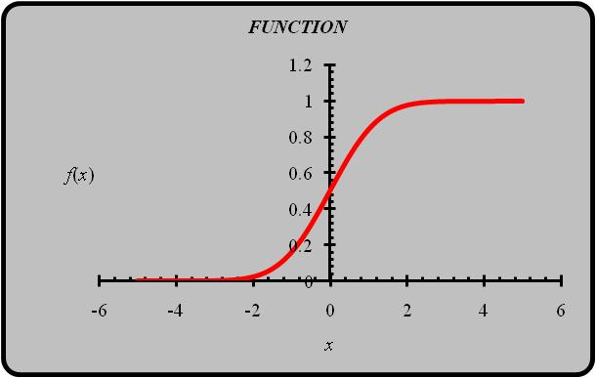
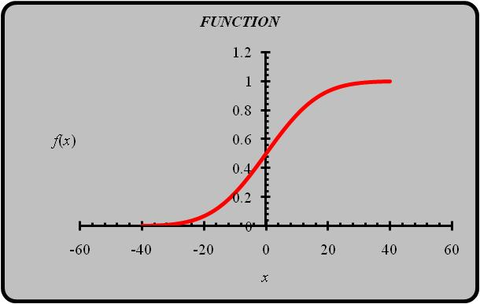
Simulation: Use Normal CDF
The simulation creates a large number of errors, coming from the same normal distribution as the ones in our historical data
CDF standard normal
CDF normal mean = 0, st dev =13.5
Use = NORMINV(Rand(), 0, StDev).
Gives a random value from a normal distribution with mean of 0 and your team’s standard deviation

Slide 34
Doing the Simulation for Your Team’s Data
Redo the graphs using a mean of 0 and your standard deviation; check that your errors are approximately normal
Make new simulation of errors for the Error Simulation page. You should have 10,000 sets of as many companies as you have.
Each entry should be = NORMINV(Rand(), µ, σ)
Check that the maximum and minimum errors are reasonable; if not press F9
“Freeze” by doing Copy and Paste Special

