Slide 1
Technology & Mathematics
Michael Herzog
Qiyam Tung
Notes:
As michael said, my name is qiyam tung and I’m a computer science student studying computer vision and machine learning at the university of arizona. Most of the work I’m doing is quite constrained, such as identifying laser gestures in a video. But it can also be more general and difficult such as trying to find similarities between texts.

Slide 2
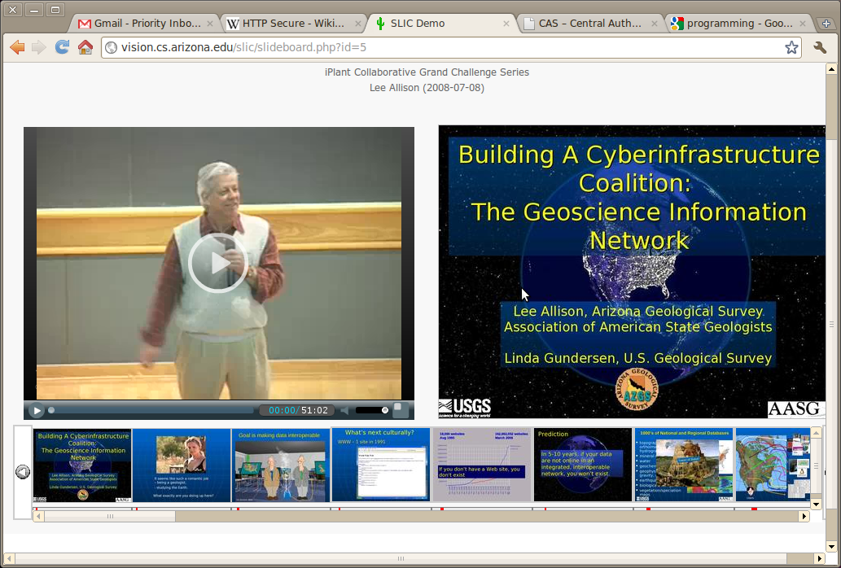
Notes:
The of the project that I and others are working on is called SLIC (semantically linked instructional content). Basically, it is a system that makes watching and browsing lecture videos easier. For example, using computer vision, the system is able to let the user browse by slide. My work is in augmenting some of these features. Trying to talk about my research specifically is a difficult thing to do. Instead, my contributions have been more along the lines of bringing some general ideas of computer science and computer vision into the classroom.

Slide 3
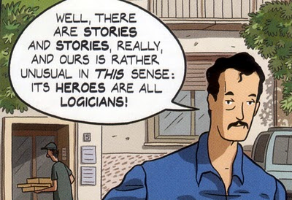

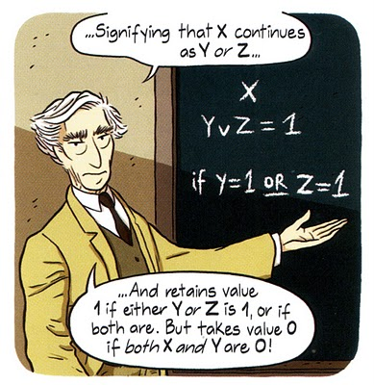
Logicomix
Notes:
At the beginning of the semester, we spent some time with the Geometry students talking just about mathematics and logic in general. For example, what are the limits of logic? What can we prove and what can’t we prove? There’s this great comic called Logicomix which came out about two years ago. In it, we go through the life of Bertrand Russell and see the foundations of mathematics being built, all the way up to Godel’s Incompleteness Theorem. This book talks about many things, including the philosophies of mathematics. As a researcher, I’m curious as to what the limits of a computer are, such as whether we will ever have computers that can “see” as well as humans or can understand language as well as humans. For that reason, I made them read this comic book, which is entertaining and does not require a background in mathematics.

Slide 4
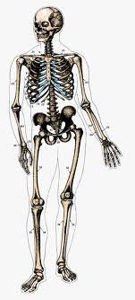


Simple Classification
Height
Width
Pictorial Explanation
What creatures fall between the lines?
Notes:
http://www.wolframalpha.com/input/?i=plot+Piecewise[{{2x+%2B+3,+0%3C%3Dx%3C%3D1.5},{+6,+1.5%3Cx%3C%3D2.2}}]
4

Slide 5
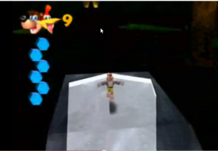
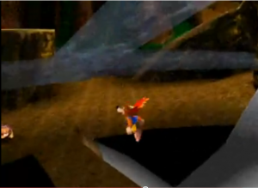
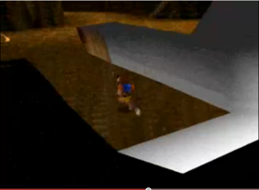
Modeling Videogames and Mathematics
3D Games and Hit Detection

Slide 6


Video Games and Mathematics
Pictorial Explanation
Banjo “switches gears” once he touches the surface of the water.
Notes:
http://www.wolframalpha.com/input/?i=plot+Piecewise[{{2x+%2B+3,+0%3C%3Dx%3C%3D1.5},{+6,+1.5%3Cx%3C%3D2.2}}]
6

Slide 7

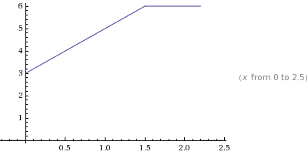
Video Games and Mathematics
(0.5,6)
(1,5)
(2,1)
  y1=2x1+3, y1 = 6
  6=2(0.5)+3 = 4
  False!
  5=2(1)+3 = 5
  True!
  1=2(2)+3 =7
  False!

Slide 8
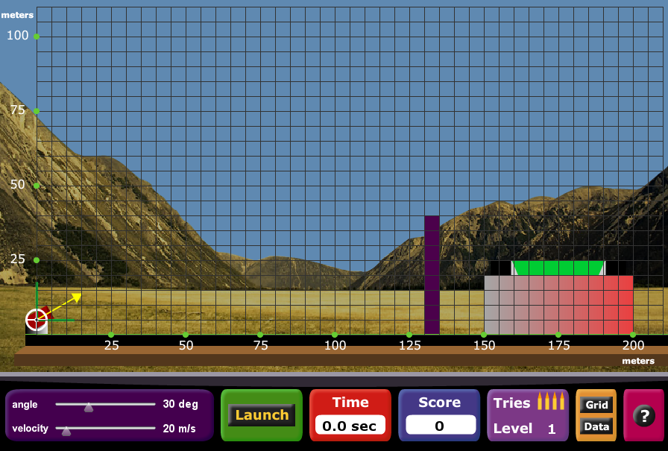
Projectile Motion

Slide 9


Simulating Jumping with Quadratics
Task: decide which model is better for simulating a jump and find their coefficients.

Slide 10
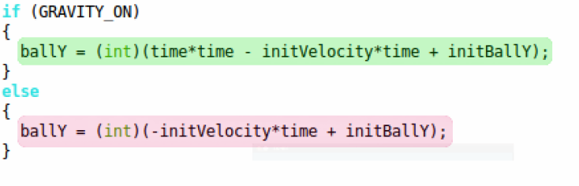
Simulating Jumping with Quadratics
The actual code for the two models

Slide 11

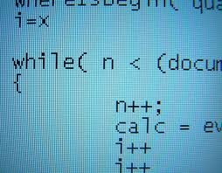
Programming
Synthetic Division
Notes:
In my field, you can have tons of ideas of how to approach a problem. However, part of the challenge is expressing that as a mathematical expression.
Because ultimately, your program has to work and has to know how to work the problem with extreme precision. That’s why we decided to take a leap of faith and teach our students some programming. It’s a great way to teach them how to create models and test them for themselves.
Nevertheless, the class is about math and not programming, so we tried to keep the unnecessary facts out. To that end, we’ve taught them a little bit of Python coding.
We’ve just got started, and one of the programs we’ve had them work on is synthetic division, which is a very mechanical process and therefore not that hard to write. It’s not mindblowing, but it is quite useful as the students now have a quick way of checking to see which numbers are roots of a polynomial. We hope that if we get the chance, they’ll be able to do more creative projects.

Slide 12

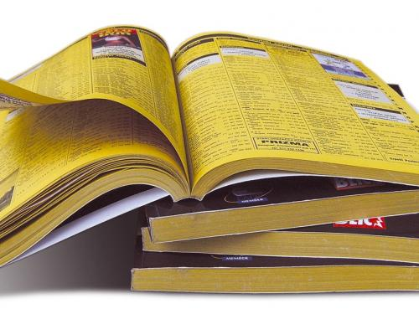
Algorithm Analysis
  How long would it take to find any name in a phonebook in the worst case scenario?
Notes:
Traditionally, students seem to have a problem intuitively understanding logarithms. It kind of surprised me because it’s been years since I’ve learned of binary search, which lends itself to being described as a logarithm. In particular, a logarithm describes how long it takes to search for an item, such as a name in a phone book, in the worst case scenario.
In any field of computer science where there is an algorithm, it is important to know how efficient it is.

Slide 13
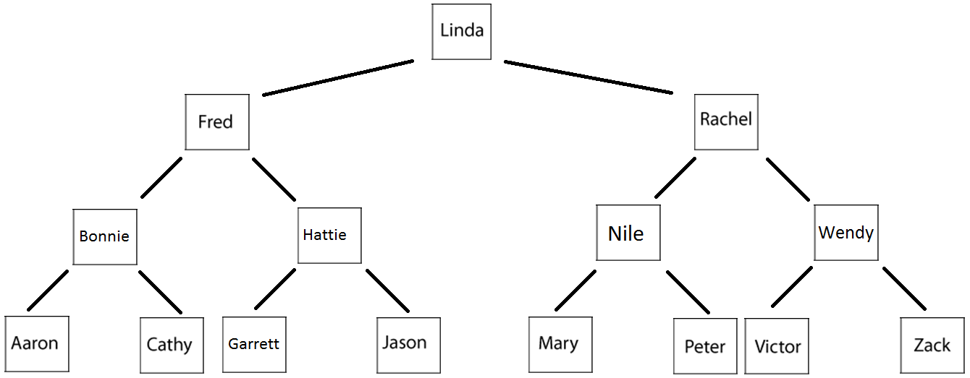
Search Time
1
2
3
4
height =log2 (n)
2 (base) = number of children per node
height = seconds it will take to search
n = the number of names.
Notes:
Being short on time, I’ll be brief. Notice that in this tree we have names from the phonebook in alphabetical order. To the left of a node is a name that is alphabetically before it and to the right is a name that is alphabetically after it.
The basic idea of binary search is to divide the number of potential answers in half every time we look at a name.

Slide 14
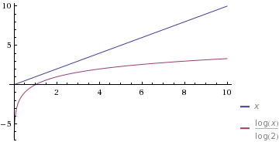
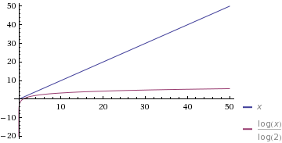
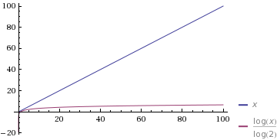
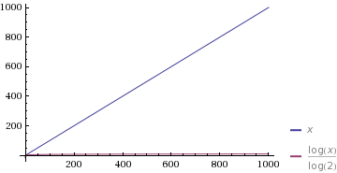
Comparing Linear and Binary Searches
y = time
x = number of names

