Slide 1
Hydrocephalus

Slide 2
Background
What is hydrocephalus?
  Abnormal accumulation of cerebrospinal fluid in the ventricles of the brain
  Results in elevated intracranial pressure and compression of the brain
  Caused by impaired cerebrospinal fluid (CSF) production, flow or re-absorption.
Earliest description:
  Hippocrates (466-377 BC)
Pressure range
  Normal range: 9-14 mmHg
  Dangerous range: > 20 mmHg

Slide 3
Background
Affects 1 in 1000 people
Invented by John D. Holter for his hydrocephalic son
Mostly congenital
  Particularly in premature children
Non-communicating (CSF blocked inside ventricles)
  Communicating (Not enough CSF absorbed)
Procedure:
  Drill hole/make small cut in brain’s
  outer membrane for drainage
  Place valve
  Tunnel drainage tube
L. Momani, Recent Advances in Biomedical Engineering, INTECHWEB, 2009.

Slide 4

Current treatment
What is VP shunt?
  Relieves increased pressure inside the skull due to excess CSF on the brain.
Consists of three components:
  Ventricular catheter in the brain.
  Valve device that regulates the fluid drainage rate attached to the outside of the skull.
  Distal catheter where fluid exits (peritoneal cavity).
Adapted from the Wikimedia Commons file " Hydrocephalus_Awareness_Ribbon.jpg “http://upload.wikimedia.org/wikipedia/commons/3/37/Hydrocephalus_Awareness_Ribbon.jpg

Slide 5
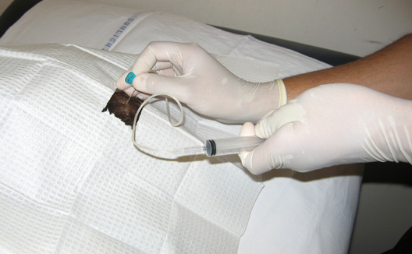
Current treatment
Disadvantage of Current treatment
  Invasive procedures
  High risk of infection in the brain
  Potential damage to brain tissue
  Mechanical failure
    Dislocate shunt valve
    Shunt blockage
    Fracture of shunt
  No feedback sensing fluid accumulation
Krishna, V. (2012, Feb 17). Ventriculoperitoneal shunt tap. Retrieved from a Aschoff, P. Kremer, B. Hashemi, and S. Kunze, “The scientific history of hydrocephalus and its treatment.,” Neurosurgical review, vol. 22, no. 2-3, pp. 67-93; discussion 94-5, Oct. 1999.

