Slide 1
Highlight of Various Diseases
Zach Dean and Ginger Ververelli

Slide 2
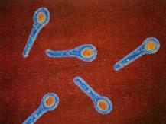
How are pathogens spread?
Air
Water
Food
Blood/Body Secretions
STDs
Direct skin contact
Adapted from the Wikimedia Commons file " Clostridium_tetani2.JPG “http://upload.wikimedia.org/wikipedia/commons/5/59/Clostridium_tetani2.JPG

Slide 3
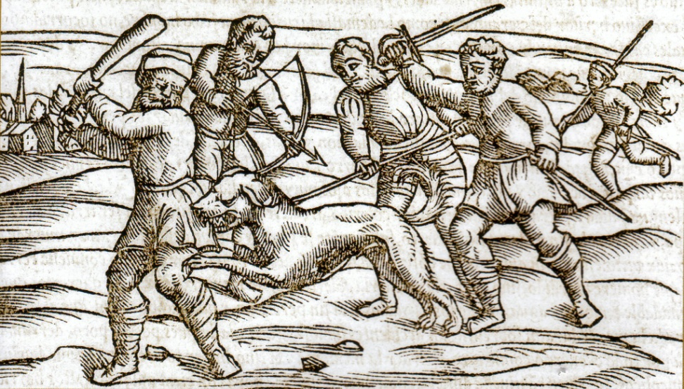
Rabies
Untreated, it will kill you; only one untreated patient has ever survived.
Transmissible through bites/saliva.
For treatment, you must kill the animal; it is very expensive
Rabies virtually shuts off the brain.
Will it produce the same graph as the in-class experiment?
Adapted from the Wikimedia Commons file " Middle_Ages_rabid_dog.jp “http://upload.wikimedia.org/wikipedia/commons/9/9f/Middle_Ages_rabid_dog.jpg

Slide 4
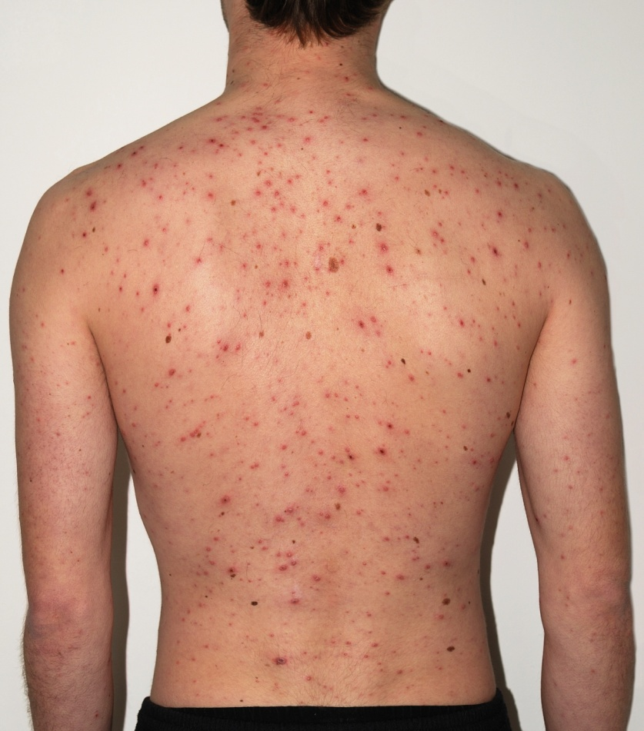
Chickenpox
Transmitted via skin contact and throat/nose mucus
Patient is contagious 1-2 days prior to symptoms
Highly contagious
Very treatable/patients only usually acquire the disease once.
Adapted from the Wikimedia Commons file " Checkenpox_Adult_back.jpg “http://upload.wikimedia.org/wikipedia/commons/e/e7/Checkenpox_Adult_back.jpg

Slide 5
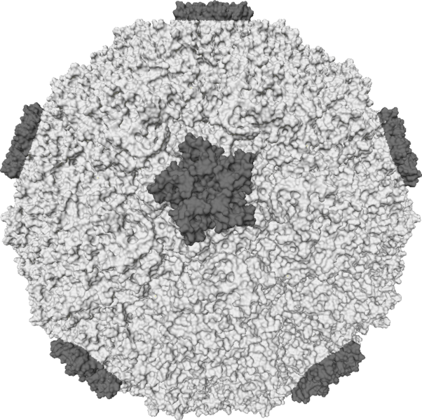
Common Cold
Spread by direct contact and transmission of bodily fluids.
Symptoms appear on day 1 and exist for about 5 days
There is no specific treatment available
Adapted from the Wikimedia Commons file " Rhinovirus.PNG “http://en.wikipedia.org/wiki/File:Rhinovirus.PNG

