Slide 1


Fluorescent Probes for Cancer Detection
Zach Dean

Slide 2
Introduction
Background
  Why did I choose a math-based field?
    Liked math classes/building/designing things (engineering)
  Career Goals:
    Professor
    Or Industry with a Large Company
  2nd Year Biomedical Engineering Ph.D. Student
    Studying: Wound Healing/Cancer Prevention
      Use in tissue growth (growing organs, and so on) and immunology

Slide 3
My Research

Slide 4
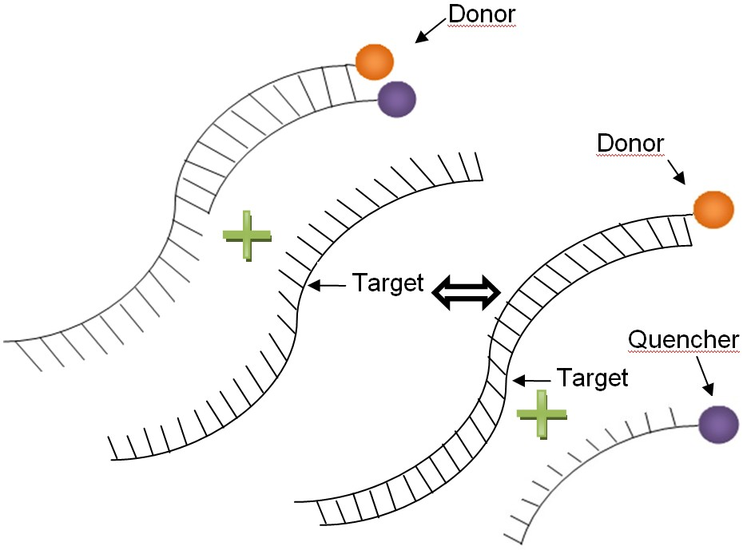
Creating Light Through Probes
DNA
DNA
“Donor” and “quencher” are synthetic; made to attach to the DNA/RNA that I am looking for. When quencher is close to the donor, the quencher can “soak up” the light from the donor; however, once the quencher detaches, light it emitted.
Notes:
So, how do we detect the microRNAs?
The probes that I work with are basically made of DNA. Since DNA and microRNAs have 2 strands that you can pull apart, it means that my probe can attach to microRNAs inside the cell.
Outside the cell, the probe has a donor molecule and a quencher molecule. The donor and quencher in a space together don’t emit light; the quencher virtually soaks up the light from the donor. However, when my probe finds a microRNA molecule, the quencher falls off and the donor pairs with the microRNA; then, the donor is free to emit light, and you can detect the light. The more microRNAs present, the more light available.

Slide 5
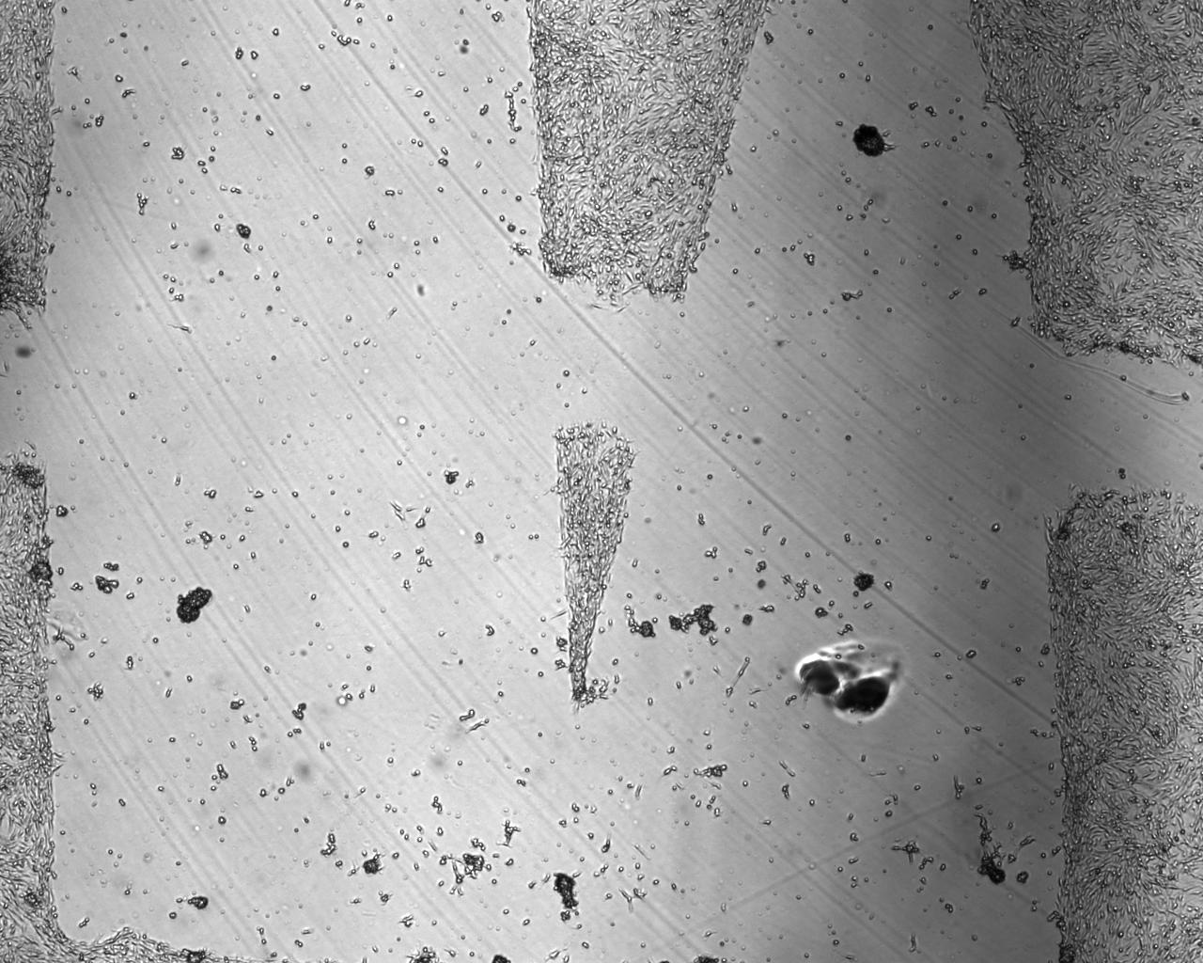
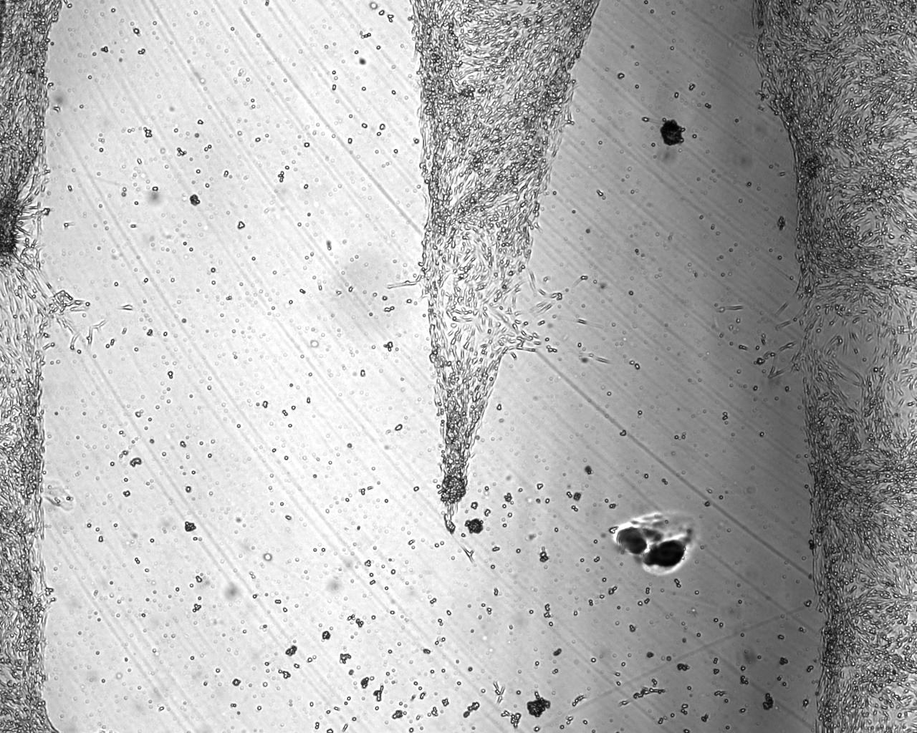
Wound Healing Assay: Triangle Pattern
Time: 0 Hours
Time: 24 Hours
The cells are from a cow’s aorta, the largest artery in the body.

Slide 6
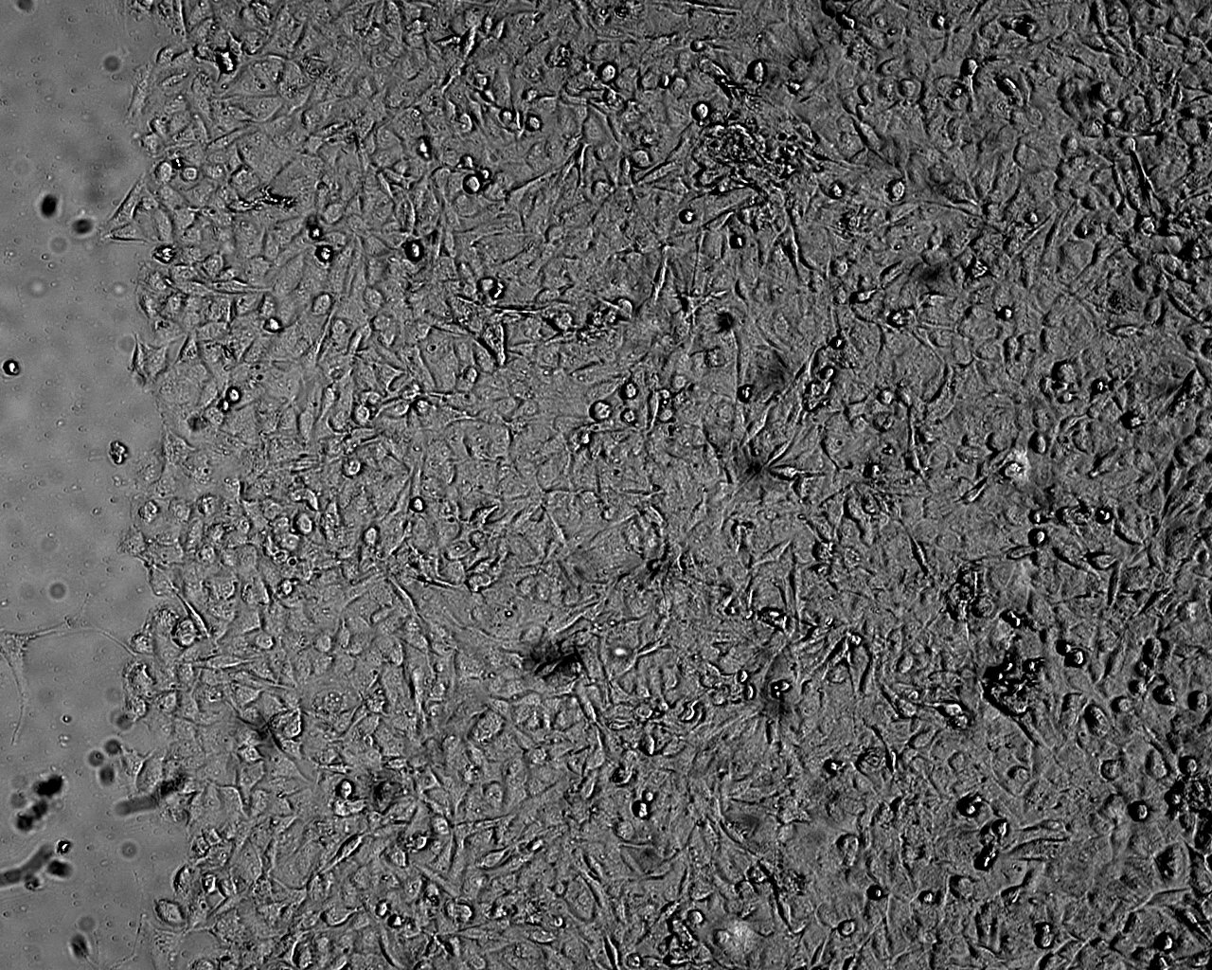
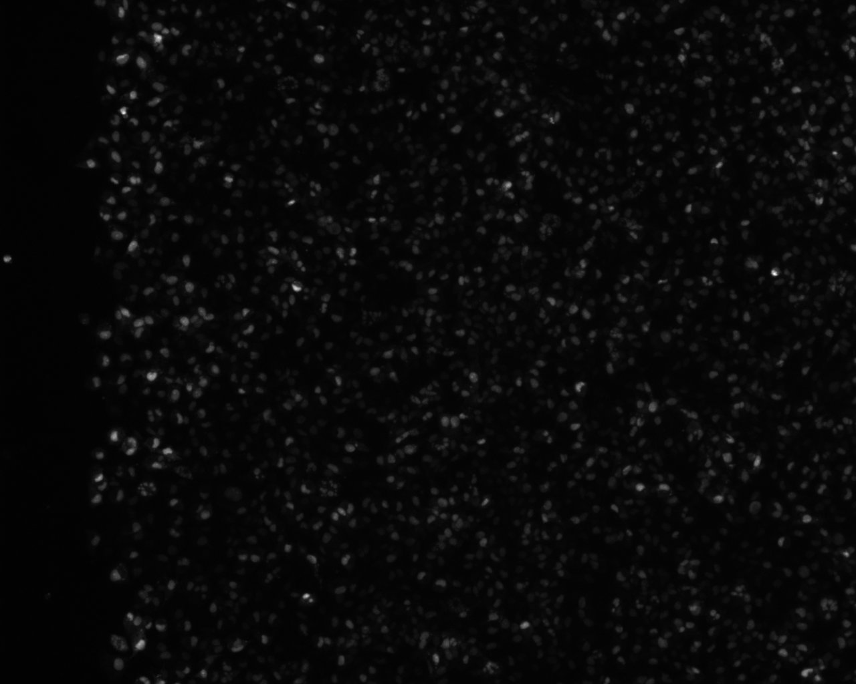
Protein upregulation is visible due to the probe
Brightfield Image of Wound
Beta Actin Fluorescence Intensity at Wound
Beta Actin is a filament that makes up part of the cell’s structure. In muscle cells, it is involved in muscle contraction.

Slide 7
Future Work
Cancer Diagnosis, Therapy
Detecting other molecules (proteins, etc.)
Speed up/Slow Down Cell Growth in the Lab

Slide 8
Interesting Advancements in Cancer Research
Sometimes it may be good to get a short break from math, so I’ll bring in some new advancements in science.

Slide 9
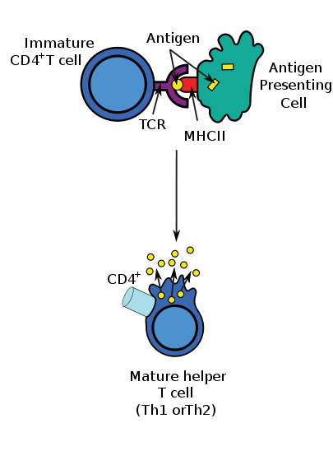
CTL (“Cytotoxic killer T-cell”)
These cells know what your cells look like.
  They brush against the cells
    If they see that the bacteria cells’ outside “skin” isn’t the same as your cell’s “skin”
      They either eat the cell!
      Or they tell the cell to die
Adapted from the Wikimedia Commons file " Antigen_presentation.svg “http://en.wikipedia.org/wiki/File:Antigen_presentation.svg

Slide 10
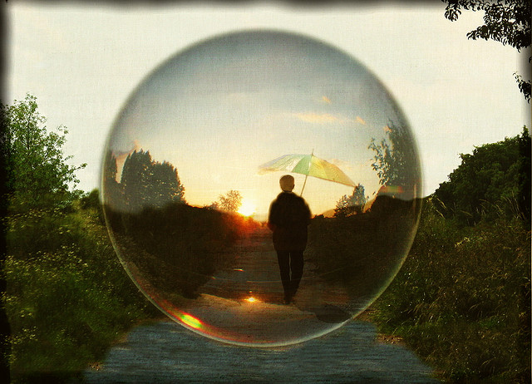
Finally: Bubble Boy
Was real
  Suffered from SCID
    AKA “Severe Combined Immune Deficiency Syndrome”
  Due to having no immune system, lived his life in a plastic bubble.
  Lived to be 12.
Today, SCID cured via bone marrow transplant
Math:
  5.0-10.0 *10^3 WBC/uL blood
h.koppdelaney.“Big Bubble." 5 June, 2008. Online image. 13 May 2013.<http://www.flickr.com/photos/h-k-d/2595755975/>

Slide 11

Stock Market Project

