Slide 1
Forces

Slide 2
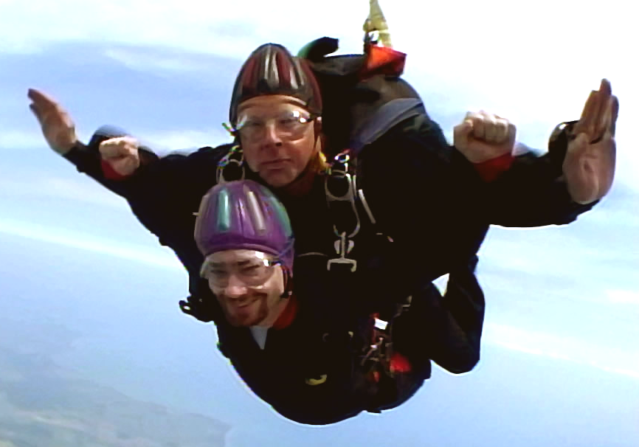
2 Important Points
What is mass?
  The AMOUNT of matter making up things
  Certain things weigh more than others although they take up the same space
What is force?
  Force is the strength of the object to move in a certain direction
  It is basically an object (with mass) with acceleration
    Example: Skydiving
      You speed up. Air underneath you can’t push back enough to keep you in the air.
      Gravity wins.
Adapted from the Wikimedia Commons file “Tandemskydive.png“http://upload.wikimedia.org/wikipedia/commons/2/2c/Tandemskydive.png

Slide 3
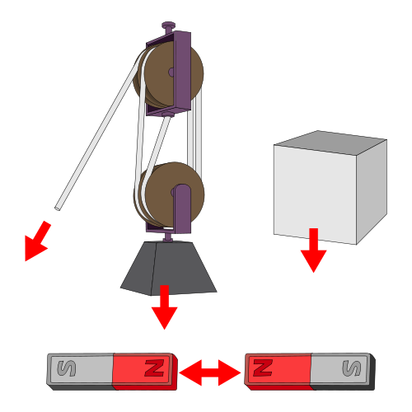
Another Example
Lifting up on something heavy
  Like a table
    The table wins.
    Force of the table’s weight pushes down and you can’t lift up with enough force to get it off the ground.
Adapted from the Wikimedia Commons file “Force_examples.svg“http://en.wikipedia.org/wiki/File:Force_examples.svg

Slide 4
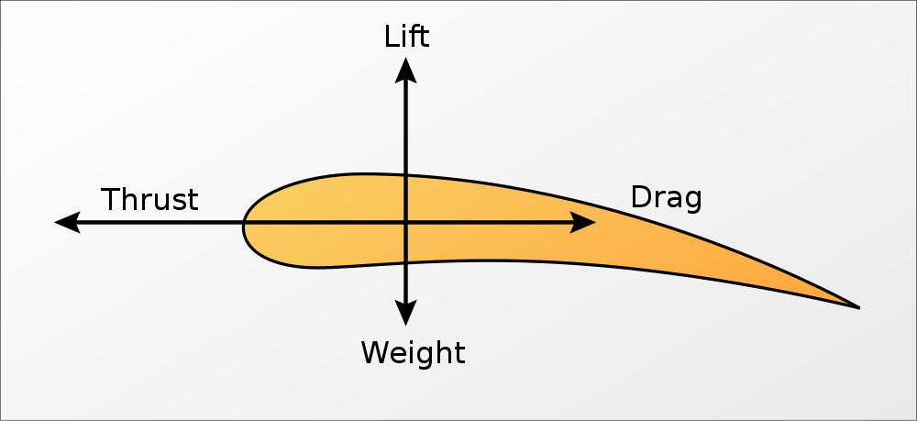
How Does this Apply to Math?
Lift
  Has an equation
Weight
  Also has an equation
    (Force=mass * gravity)
Drag
  Has an Equation
Thrust
  Has an Equation
THEY ARE SYSTEMS
  Opposing equations are set equal to each other to solve for (as an example):
    The LIFT needed to overcome the WEIGHT of the plane!
Adapted from the Wikimedia Commons file “Aeroforces.svg“http://en.wikipedia.org/wiki/File:Aeroforces.svg

Slide 5
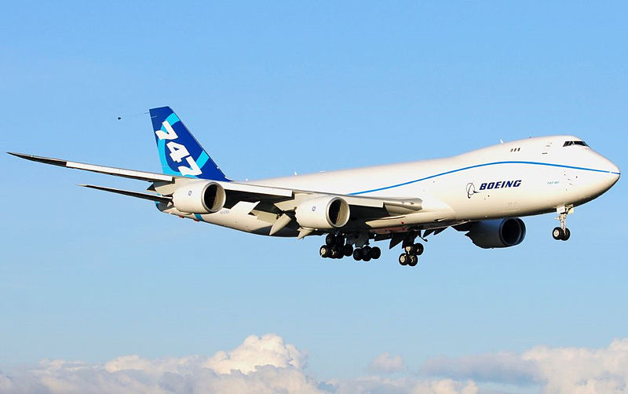
How Does this Apply to Math?
Lift
  Has an equation
Weight
  Also has an equation
    (Force=mass * gravity)
Drag
  Has an Equation
Thrust
  Has an Equation
THEY ARE SYSTEMS
  Opposing equations are set equal to each other to solve for (as an example):
    The LIFT needed to overcome the WEIGHT of the plane!
    During this process, you solve for variables!
FORCE OF LIFT
Adapted from the Wikimedia Commons file “Boeing_747-8_N747EX_First_Flight.jpg“http://en.wikipedia.org/wiki/File:Boeing_747-8_N747EX_First_Flight.jpg
WEIGHT

