Slide 1
Who am I?
Biomedical Engineering Ph.D. Student
  Means:
    I’ve been in school a LONG time.
      Guess?
    I like school/learning!
      More fun than work.
        (One reason to stay in school!)
  What is a Ph.D.?
    You learn about doing research/finding new things
    Put “Dr.” before your name

Slide 2
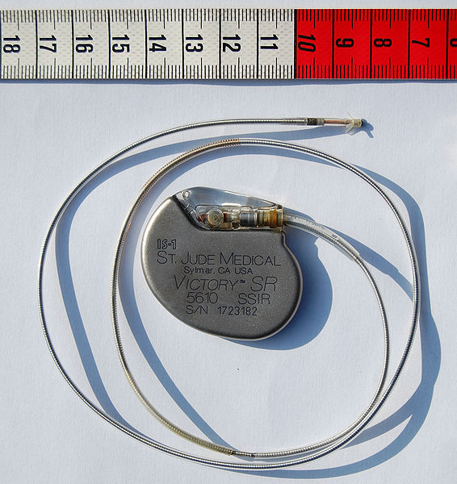
What is Biomedical Engineering?
Any guesses?
  Can you guess what I research?
Do any of you have interests in engineering?
  Science?
  Arts?
  Help with showing college requirements for each
Cardiac pacemaker. Can you guess what it does? (I’ll explain more on the next slide).
Adapted from the Wikimedia Commons file " St_Jude_Medical_pacemaker_with_ruler.jpg “http://en.wikipedia.org/wiki/File:St_Jude_Medical_pacemaker_with_ruler.jpg

Slide 3
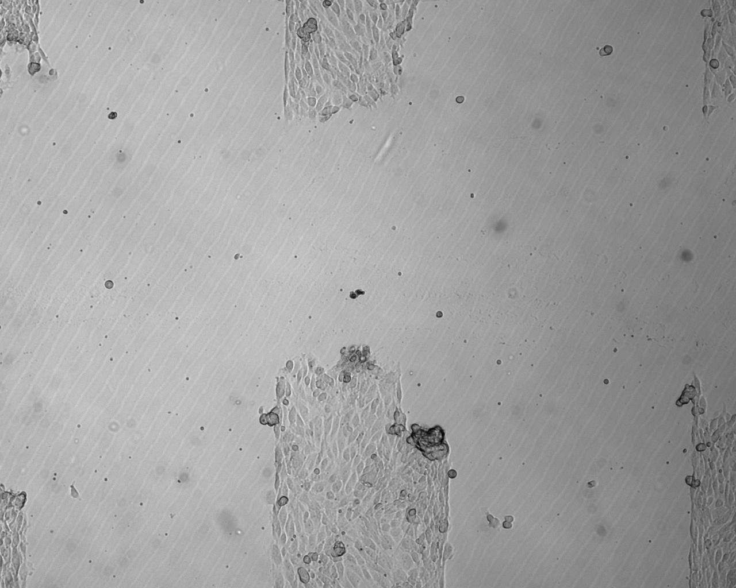
My research
Investigating cell growth
  Trying to grow organs
    I like Heart/Muscle
  Also use nanotechnology
    Do any of you know of any nano-devices?
    Devices that use nanotechnology?
      Some of you use at least one everyday…
What can we do if we grow organs?
  Who can we help?
Cells! Can you guess what kind of cells?

Slide 4
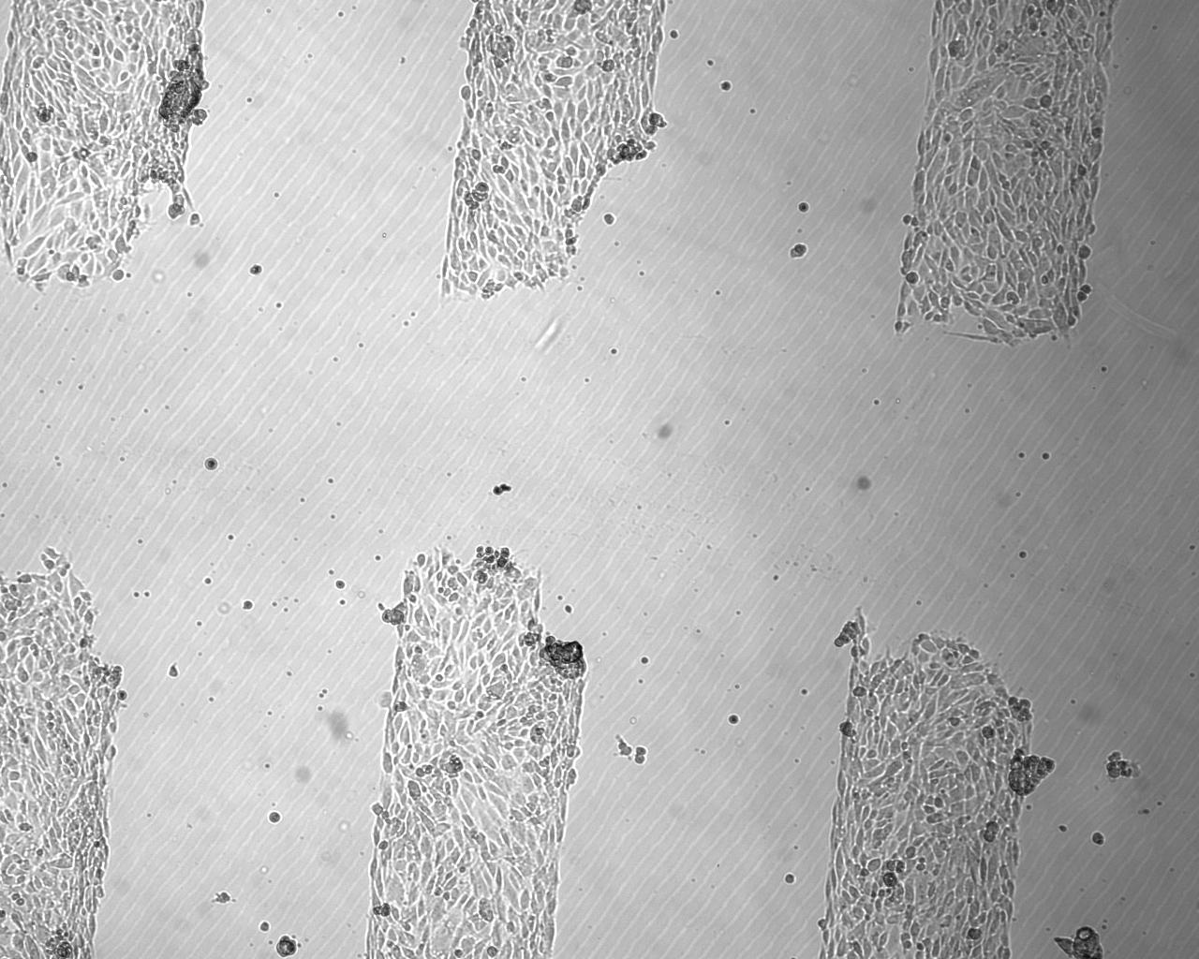
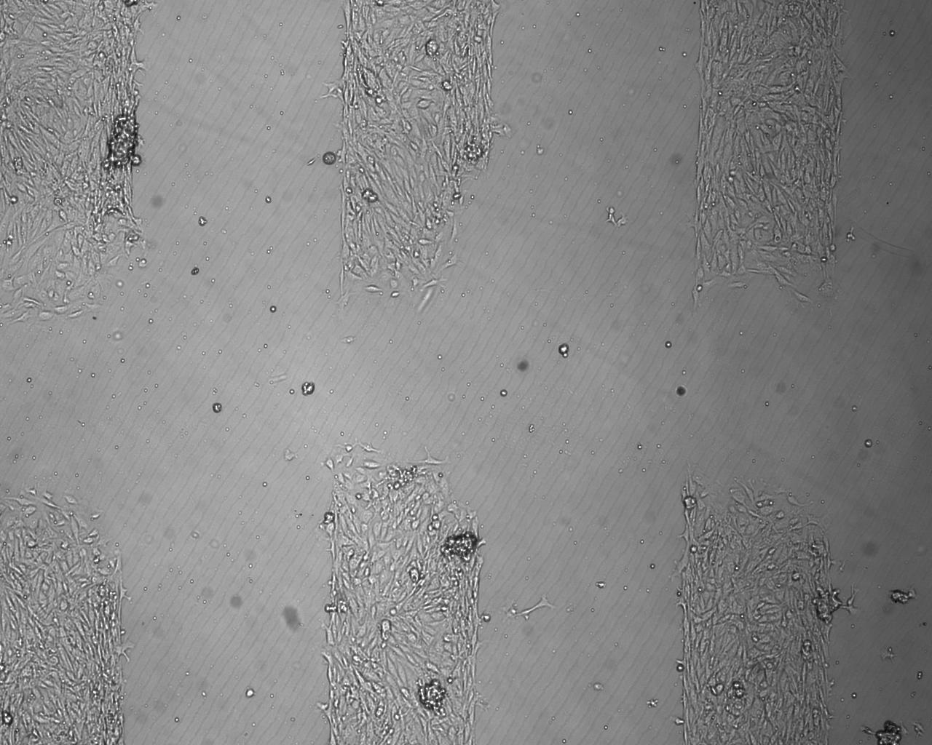
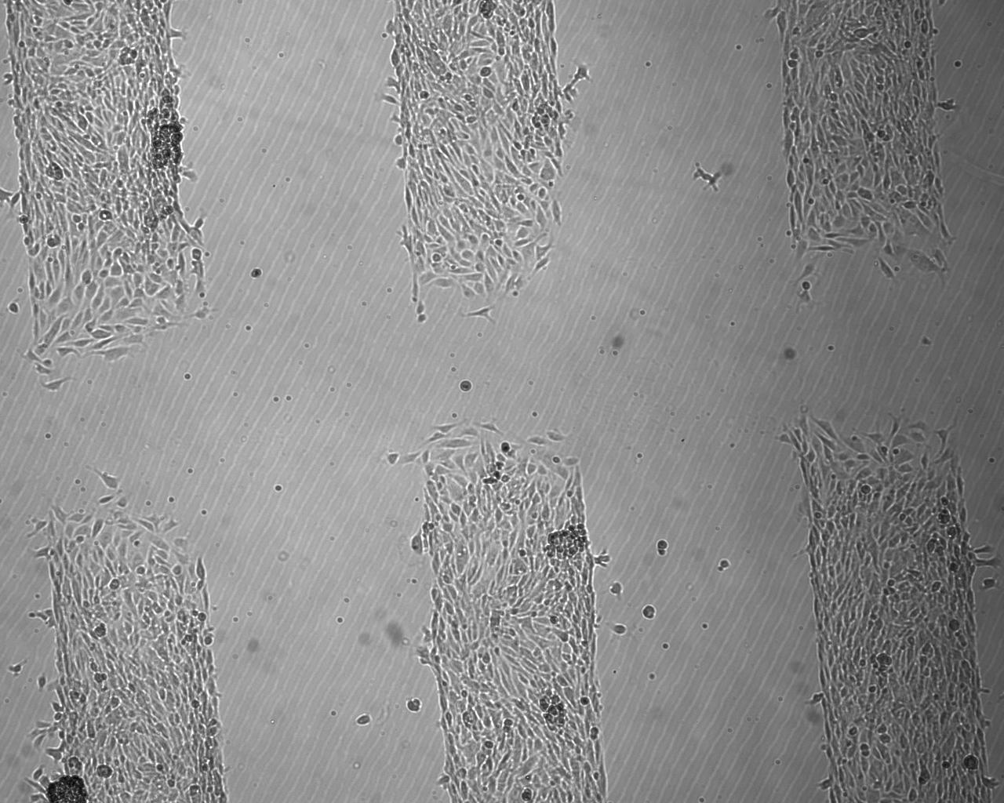
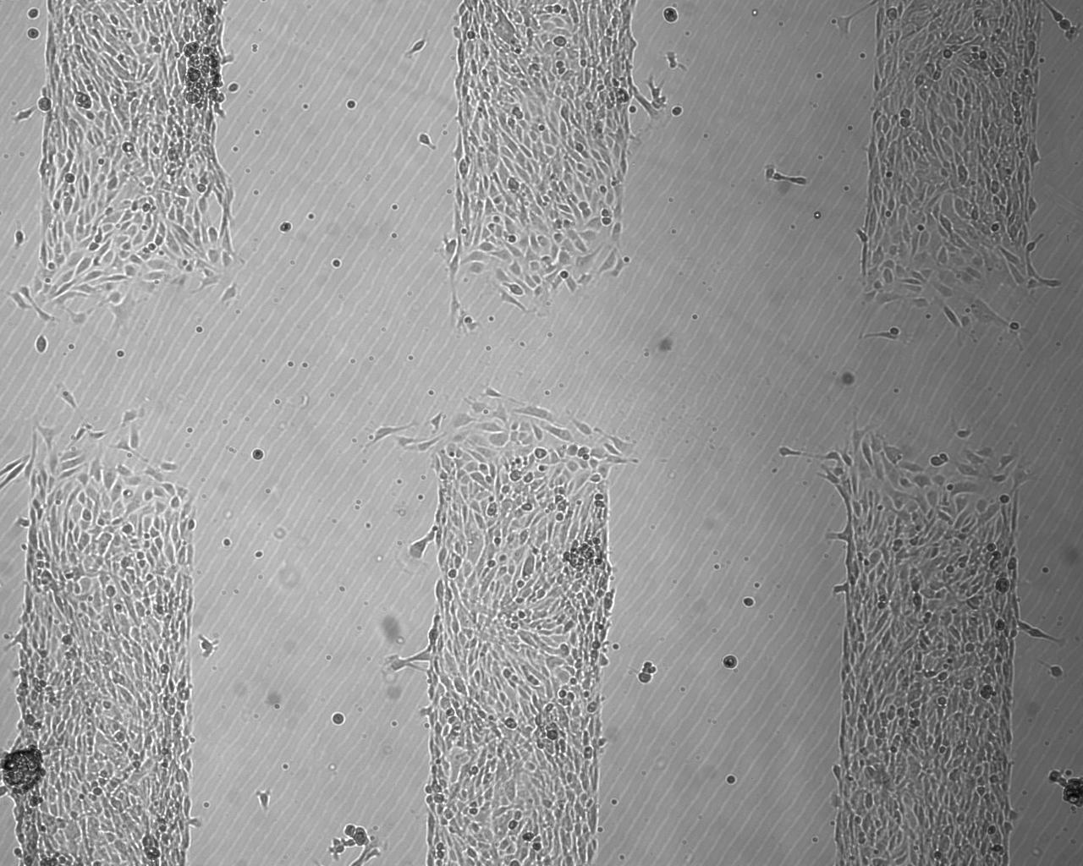
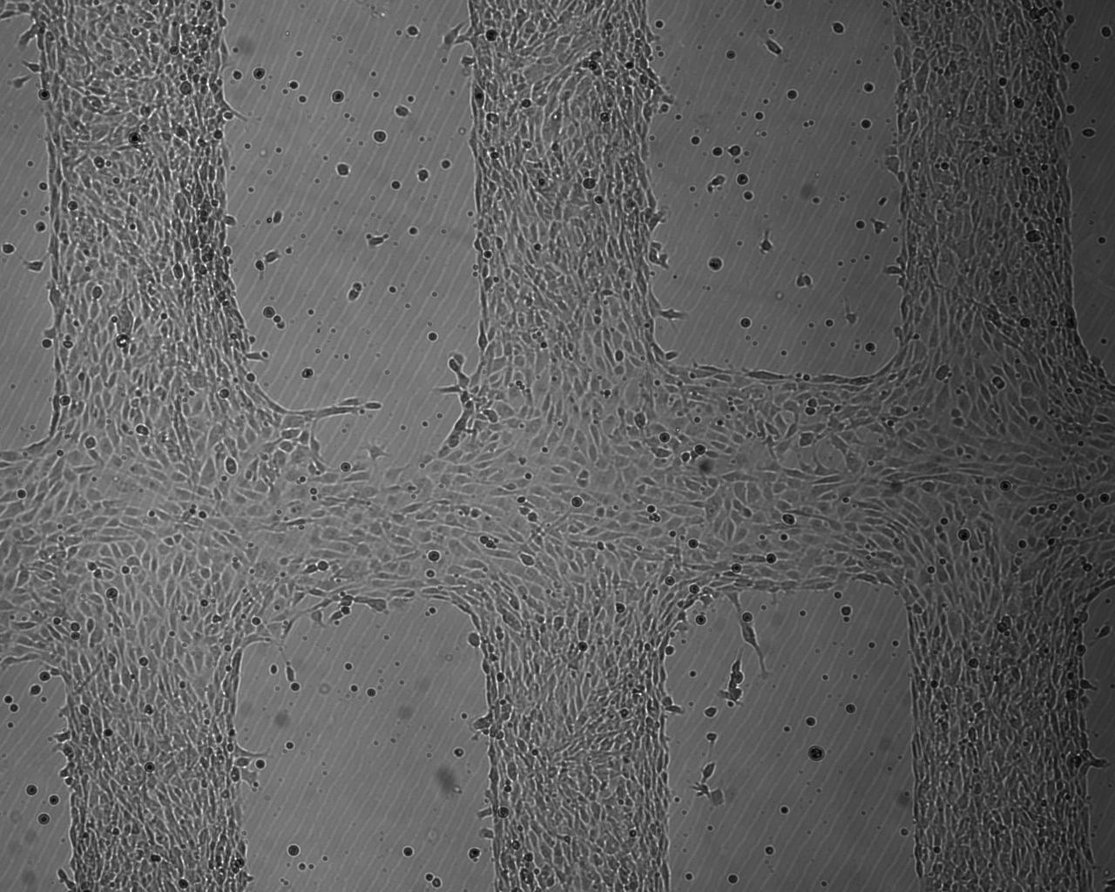
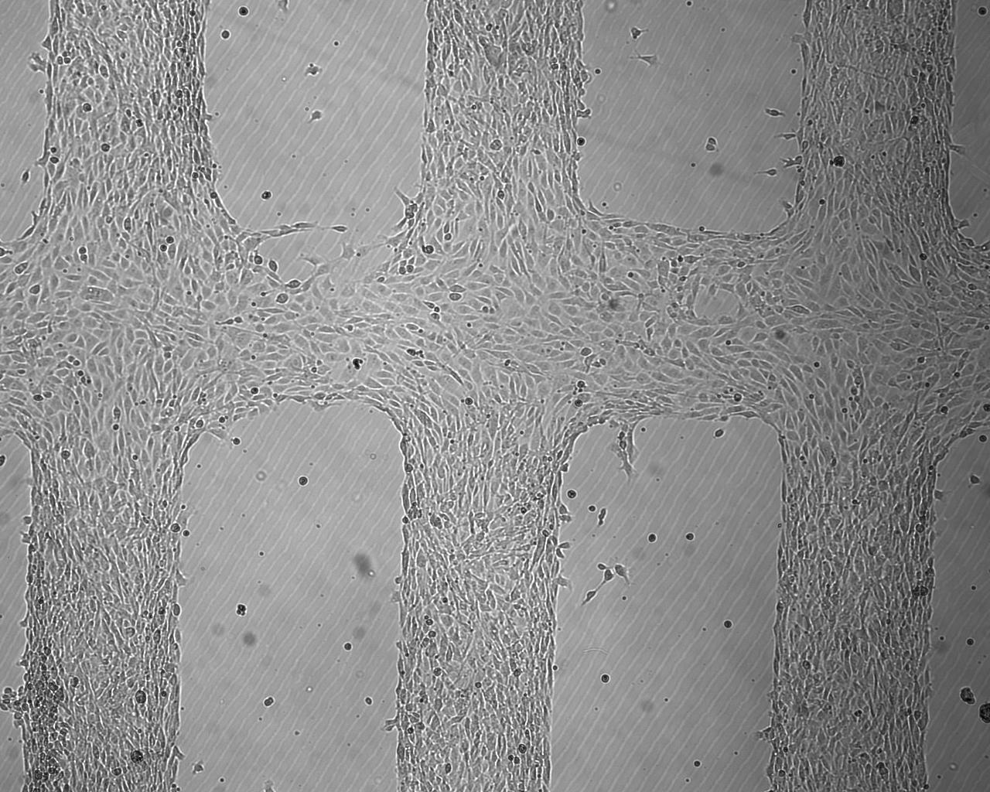
My research: cells grown at 325μm channel spacing, 4x magnification, 59.4μm/hr growth rate
0 Hours
2 Hours
4 Hours
6 Hours
23 Hours
25 Hours

Slide 5
So what did all of those numbers mean?
325µm channels
325µm channel size?
  Width of cells!
  0.032µm technology used to make computer chips!
59.4µm/hour growth rate
  Relative to:
    Your hair grows about 417µm per day!
    Scientific notation?
4x magnification
  Confusing math equation
  Basically…4x of your normal eyesight
    250mm from your eye = focus distance
Cells! Can you guess what kind of cells?

Slide 6
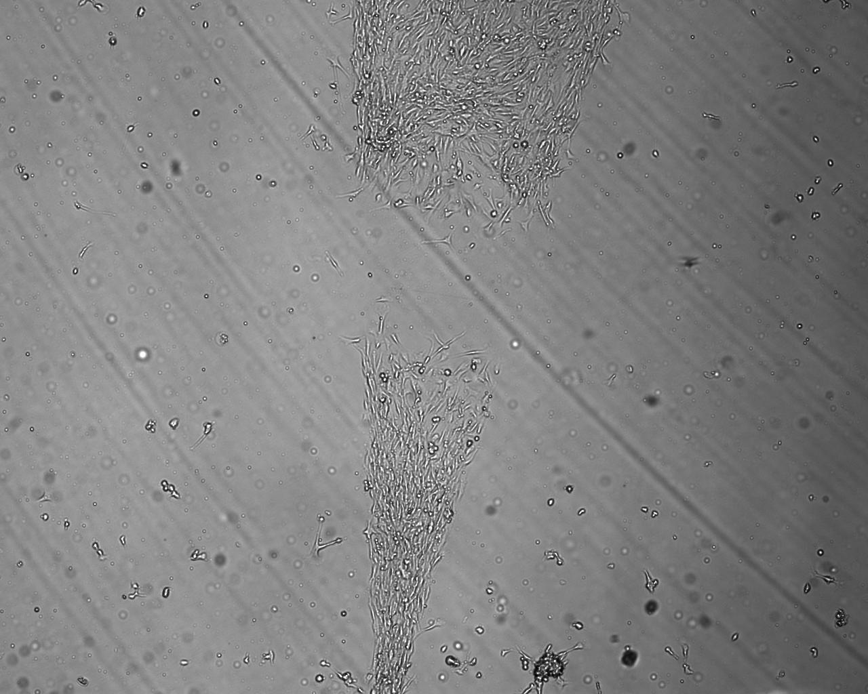
Growing Different Shapes (Triangle)

Slide 7
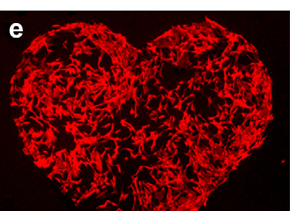
Cells from my lab grown to form a heart shape

Slide 8
Fun facts!
Everyday I come in, I’ll try to have some interesting news in science/engineering.
  Maybe I’ll discover something in my research to bring in!
You can also ask me science questions and I’ll try to find them out!
  For example: Have we cured cancer?
    Answer: No, but we’re getting close! Did you know that our immune system (the same cells in our bodies that fight colds and the flu) fights cancer? Scientists recently found this out…

Slide 9
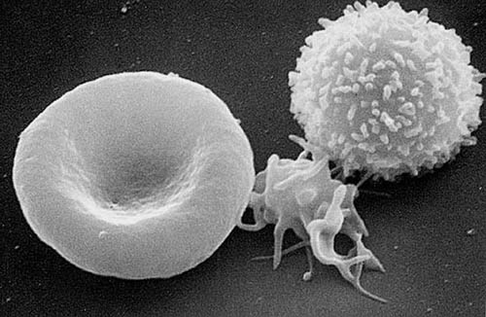
CTL (“Cytotoxic killer T-cell”)
These cells know what your cells look like.
  They brush against the cells
    If they see that the cell’s outside “skin” isn’t the same as your cell’s “skin
      They either eat the cell!
      Or they tell the cell to die
    Some cancer cells look like foreign cells (bacteria, etc.)…even though they are our own cells!
Adapted from the Wikimedia Commons file " Red_White_Blood_cells.jpg “http://en.wikipedia.org/wiki/File:Red_White_Blood_cells.jpg

Slide 10
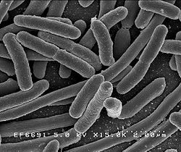
More current events/scientific findings
E.Coli
  What is E.Coli?
  Remember the recent E.Coli outbreak in Europe?
  Scientists have recently found 2 things:
    1) Reusable grocery bags can be good and bad.
    2) Sometimes washing the outside of a fruit/vegetable isn’t good enough (E.Coli were found to also live inside!)
E. Coli research in BME that we work on…
E.Coli
Adapted from the Wikimedia Commons file " EscherichiaColi_NIAID.jpg “http://en.wikipedia.org/wiki/File:EscherichiaColi_NIAID.jpg

Slide 11
Some last important things…
1) Seriously, ask questions/get my help if you need it/you don’t completely understand
2) I’ll go over topics like my research in more detail as the year goes along.
3) I’m really looking forward to having fun this year!

