Slide 1
Universal Properties of Shapes

Slide 2
Bell ringer
Write down as many 3-dimensional shapes as you can in 60 seconds.
What did you get?

Slide 3

Shapes in biology
What shape is a human?

Slide 4
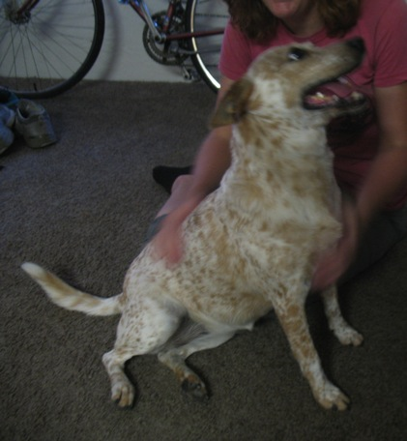
Shapes in biology
What shape is a dog?

Slide 5
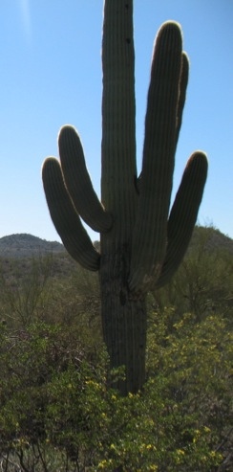
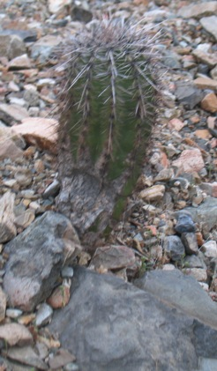
Shapes in biology
What shape is a cactus?

Slide 6
Do these shapes have any common properties?
What would happen if we assumed that every animal was a perfect cube?
Schreiber (2013) “Motivating Calculus with Biology”

Slide 7
“On being the right size”
Gravity- To the mouse and any smaller animal it presents practically no dangers. You can drop a mouse down a thousand-yard mine shaft; and, on arriving at the bottom, it gets a slight shock and walks away, provided that the ground is fairly soft. A rat is killed, a man is broken, a horse splashes. An insect is not afraid of gravity; it can fall without danger, and can cling to the ceiling with remarkably little trouble. It can go in for elegant and fantastic forms of support like that of the daddy-longlegs.
But there is a force which is as formidable to an insect as gravity to a mammal. This is surface tension. A man coming out of a bath carries with him a film of water of about one-fiftieth of an inch in thickness. This weighs roughly a pound. A wet mouse has to carry about its own weight of water. A wet fly has to lift many times its own weight and, as everyone knows, a wet fly is in very serious danger. An insect going for a drink is in as great a danger as a man leaning out over a cliff in search of food. If it once falls into the grip of the surface tension of the water, that is to say, gets wet it is likely to remain so until it drowns.
Modified from Haldane (1926), “On being the right size”

Slide 8
Properties of Volume
Do part 1 of your activity packet (calculating the volume of each shape).

Slide 9
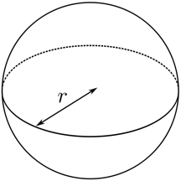
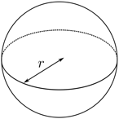

Hypothesis
For each shape, there is a dilation of 2 and a dilation of 3.
Make a hypothesis: How will the volume change when there is a dilation of 2 or 3?
Image by Dirk Hünniger

Slide 10
Properties of Volume
When a sphere had a dilation of 2, how much did its volume increase?
What about a dilation of 3?
When a cone had a dilation of 2, how much did its volume increase?
What about a dilation of 3?
When a cylinder had a dilation of 2, how much did its volume increase?
What about a dilation of 3?

Slide 11
Properties of Volume
What are the common properties of increasing volume?

Slide 12
Why does this work?

Slide 13
What does this mean for biology?
Taller animals weigh MUCH more.

Slide 14
Properties of Surface Area
Do part 2 of your activity packet (calculating the surface area of each shape).

Slide 15
Hypothesis
For each shape, there is a dilation of 2 and a dilation of 3.
Make a hypothesis: How will the surface area change when there is a dilation of 2 or 3?
Image by Dirk Hünniger

Slide 16
Properties of Surface Area
When a sphere had a dilation of 2, how much did its surface area increase?
What about a dilation of 3?
When a cone had a dilation of 2, how much did its surface area increase?
What about a dilation of 3?
When a cylinder had a dilation of 2, how much did its surface area increase?
What about a dilation of 3?

Slide 17
Properties of Surface Area
What are the common properties of increasing surface area?

Slide 18
Why does this work?

Slide 19
Properties of Surface Area and Volume
Do part 3 of your activity packet (calculating the surface area:volume ratio of each shape).

Slide 20
Hypothesis
For each shape, there is a dilation of 2 and a dilation of 3.
Make a hypothesis: How will the surface area:volume ratio change when there is a dilation of 2 or 3?
Image by Dirk Hünniger

Slide 21
Properties of Surface Area and Volume
When a sphere had a dilation of 2, how much did its surface area:volume ratio increase?
What about a dilation of 3?
When a cone had a dilation of 2, how much did its surface area:volume ratio increase?
What about a dilation of 3?
When a cylinder had a dilation of 2, how much did its surface area:volume ratio increase?
What about a dilation of 3?

Slide 22
Properties of Surface Area and Volume
What are the common properties of changing surface area:volume ratio?

Slide 23
Why does this work?

Slide 24
What does this mean for biology?
Bacteria size
Tumor size
Mammal size
Surface tension for mammals and insects

Slide 25
Do these shapes have any common properties?
What would happen if we assumed that every animal was a perfect cube?
You can do this for some things and still learn a lot about biology.

