Slide 1
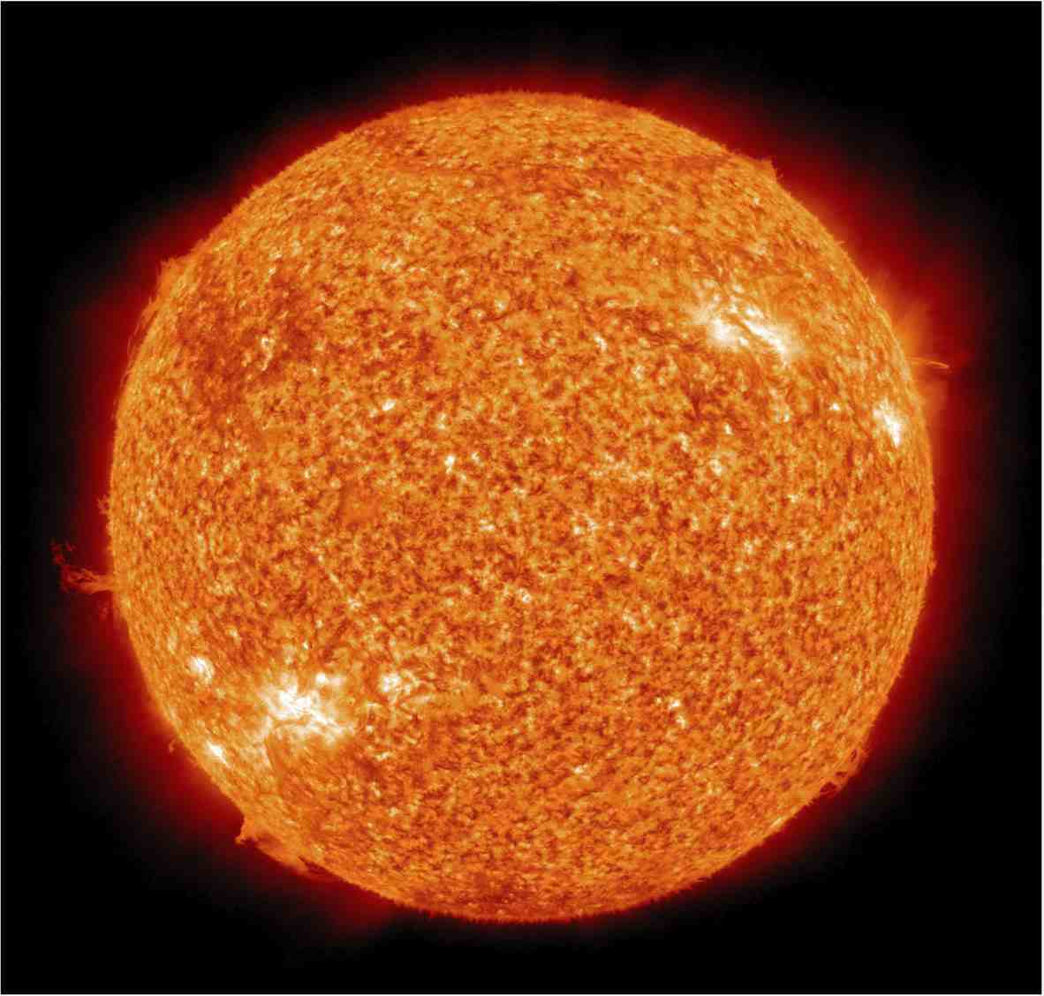
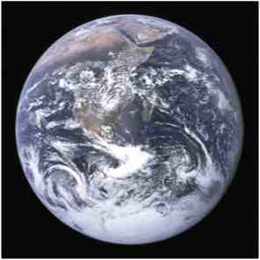
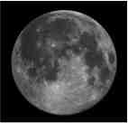
The Solar System
How do they move?
The Earth
Why doesn’t the Earth fly away?
The Moon
The Sun
Photos by NASA

Slide 2
The Solar System
Which is stronger:
-the force of gravity between the Earth and the sun?
or
-the force of gravity between the Earth and the moon?
The Earth
The Moon
The Sun

Slide 3
Equation of Gravity
F = force of gravity
G = gravitational constant = 6.674x10⁻¹¹ Nm²/kg²
m₁ = mass of the first thing (in kg)
m₁ = mass of the second thing (in kg)
r = distance between the two things (in m)

Slide 4
The Solar System
The Earth
What is the force of gravity between the sun and the Earth?
The Moon
The Sun

Slide 5
Equation of Gravity
F = force of gravity
G = gravitational constant = 6.674x10⁻¹¹ Nm²/kg²
m₁ = mass of the first thing (in kg)
m₁ = mass of the second thing (in kg)
r = distance between the two things (in m)
Remember: There are 1000 m (or 10³ m) in 1 km

