Slide 1
Scatterplots and
Scientific Hypotheses

Slide 2
Bellringer question
What is a hypothesis?

Slide 3
Bellringer question
If you roll a dice two times, and get a high number, what does that mean about your next roll?
  Hypothesis 1: It should be a high number.
  Hypothesis 2: It should be a low number.
  Hypothesis 3: It doesn’t matter.
Let’s test it!

Slide 4
The experiment
I will need 10 volunteers.
Roll 2 dice, and add up the score.
  Write down that sum.
Roll 2 dice again, and add up their score.
  Write down that sum.
If you got a high score on the roll, are you more or less likely to get a high score again?

Slide 5
Scatter Plots
A scatter plot is a graph of (x,y) points, but without a line connecting all of them.

Slide 6
Ways to describe a scatter-plot
Positive association- When one thing happens, another thing will probably happen too.
Negative association- When one thing happens, another thing probably will not happen.

Slide 7
Ways to describe a scatter-plot
No association- When one thing happens, it has no effect on the other thing.
So, which one are our dice rolls?

Slide 8
Bellringer question
If you roll a dice two times, and get a high number, what does that mean about your next roll?
  Hypothesis 1: It should be a high number.
  Hypothesis 2: It should be a low number.
  Hypothesis 3: It doesn’t matter.
Let’s test it!

Slide 9
More ways to describe a scatter-plot
Linear- The points fit in a straight line (or close to it).
Non-linear- The points do not fit in a straight line.

Slide 10
More ways to describe a scatter-plot
Linear- The points fit in a straight line (or close to it).
Non-linear- The points do not fit in a straight line.

Slide 11
More ways to describe a scatter-plot
Cluster- Lots of points that are close together.
Outlier- A point that is really far from the others.

Slide 12
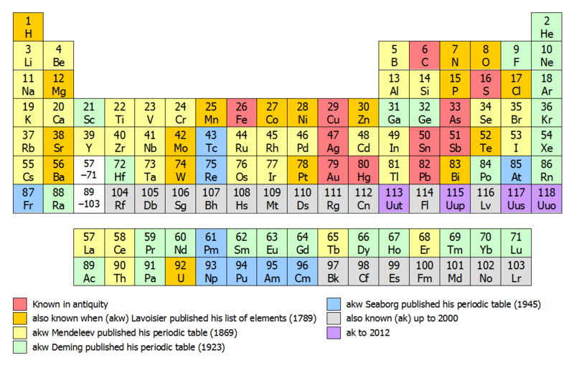
Picture from Wikipedia, Author Sandbh

Slide 13
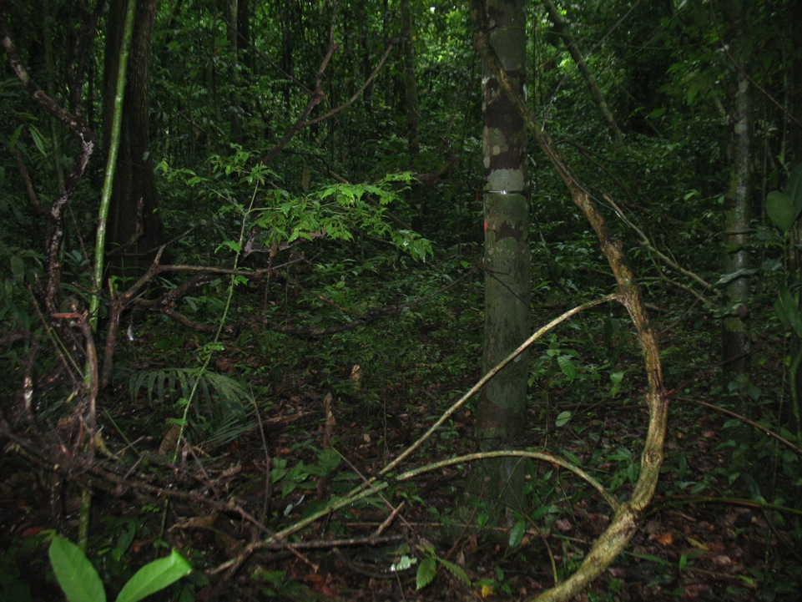
Experiments in Panama
We know that tree seeds are sometimes killed by fungus.
How do seeds defend themselves?
Are there ways to classify how different fungi act?
Photo by Simon Stump

Slide 14
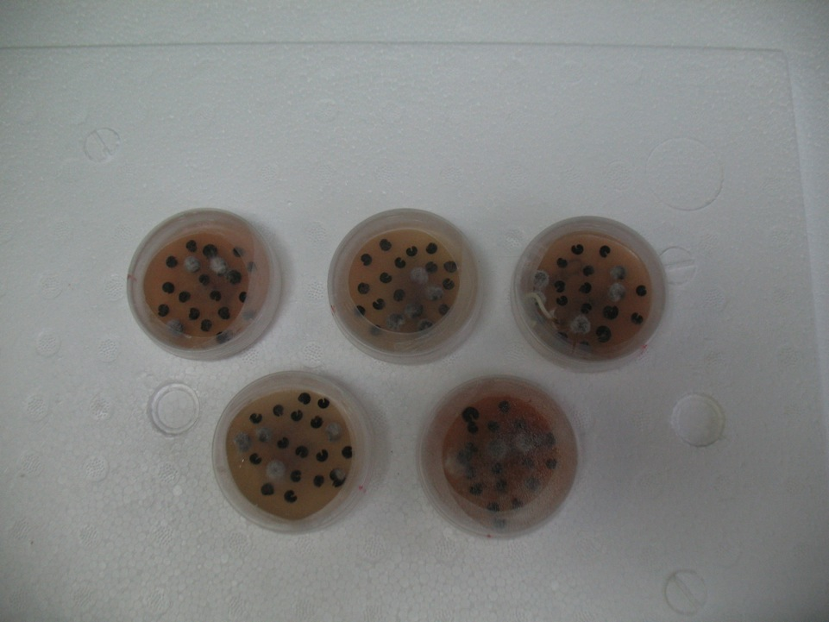
The Experiment
Took clean seeds, and exposed them to different kinds of fungus.
Measured if the fungus attacked the seeds.
Photo by Simon Stump

Slide 15
Hypothesis 1
Specialist fungi will have higher infection rates.
Data from Stump and Arnold, Unpublished

Slide 16
Hypothesis 2
If a fungus has a really high infection rate, then related fungi should also have a high infection rate.
Data from Stump and Arnold, Unpublished

Slide 17
Hypothesis 2
If a fungus has a really high infection rate, then related fungi should also have a high infection rate.
Data from Stump and Arnold, Unpublished

