Slide 1
Proportional Relationships in Biology

Slide 2
Bell Ringer…
Are 2/3 and 6/12 proportional?
  No; 6/12 = 1/2 ≠ 2/3
Are 2/3 and 10/15 proportional?
  Yes; 2/3 = (2*5)/(3*5) = 10/15
Are 2/3 and 4/9 proportional?
  No; both are simplified

Slide 3



Proportional Shapes
What does it mean for two shapes to be similar or proportional?
Same shape, different size.
Photo by Simon Stump

Slide 4
Proportional Shapes
Height=4
Width = 4
Width=4
Width = 10
Height
= 10
Height=10

Slide 5
Proportional Relationships in Biology
In biology, some relationships are proportional, and some are not.
This will sometimes tell us something about the organism.

Slide 6
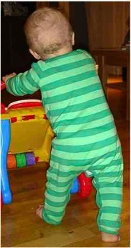

Proportional Relationships in Biology
Does body shape change with age?
Is a human baby proportional to a human adult?
Smaller Heads
Image by Shaun Mitchem and Steve Herbert
www.wikipedia.org

Slide 7
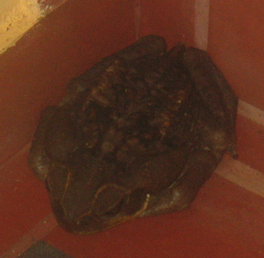
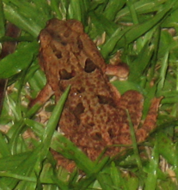
Proportional Relationships in Biology
In frogs, a small frog and a big frog do look the same…
Photo credit: Simon Stump

Slide 8
Proportional Relationships in Biology
Which has proportionately bigger legs: an ant, or an elephant?
An elephant is 3.3 m tall, and has a foot 0.5 m wide.
An ant is 4 mm tall, and has a foot 0.06 mm wide.

Slide 9
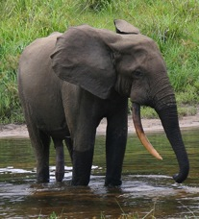
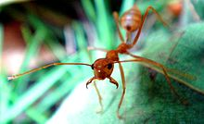
Photos by PHGCOM and Peter H. Wrege, retrieved from Wikipedia

Slide 10

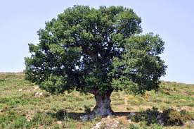
Proportions in plants
Are large and small plants proportional?
Pictures by Mark Hofstetter and Amada44, downloaded from Wikipedia

