Slide 1
Prime Numbers
A Brief Introduction to
Number Theory,
or Why I Love Mathematics

Slide 2




MR. Coatney (Coat –Knee)

Slide 3


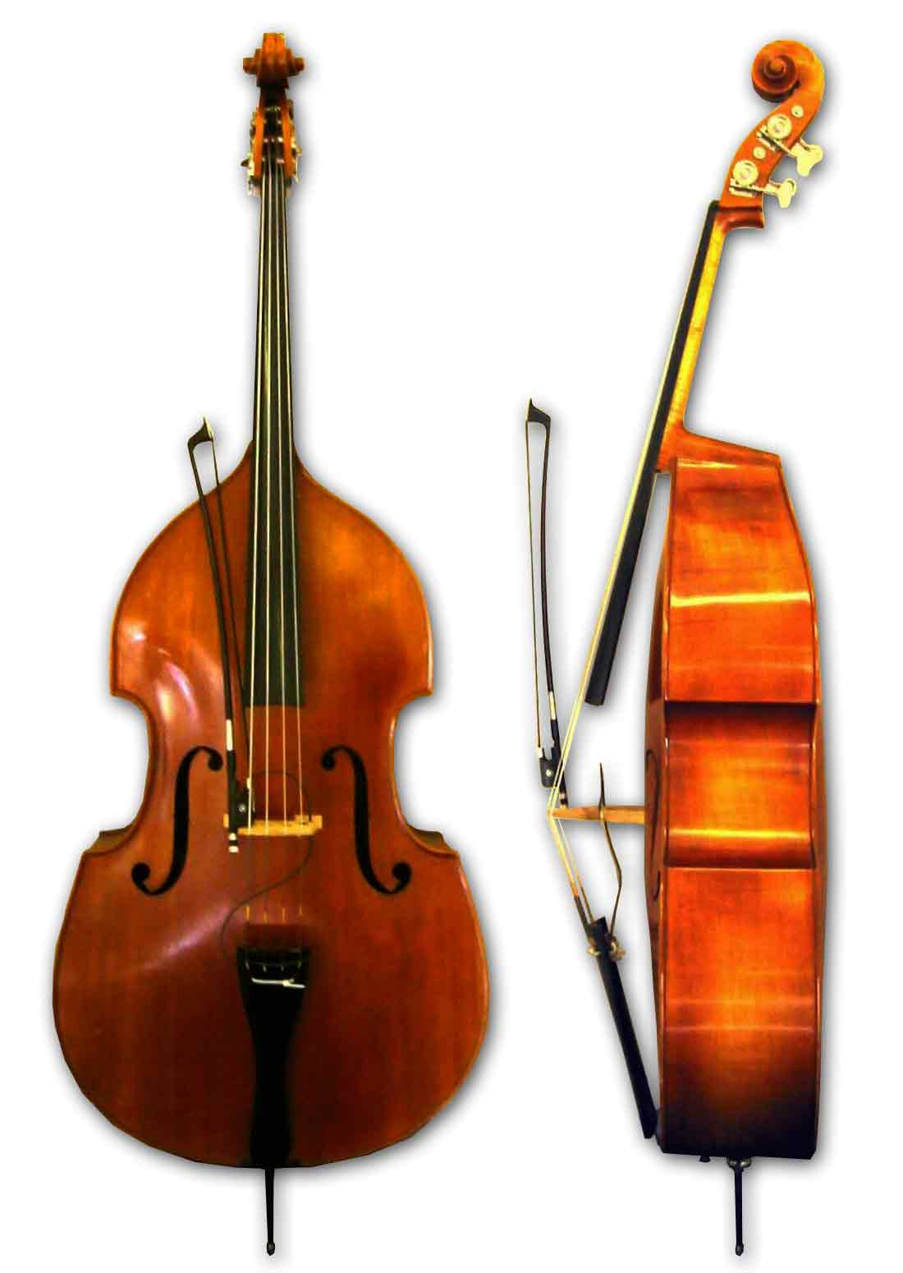






Things I like to do:

Slide 4
What are Prime Numbers?
Numbers that are divisible only by 1 and themselves.
Examples: 2, 3, 5, 7, 11, 67, 127, 257, …
They are the “building blocks” of whole numbers
4=2x2; 10=5x2; 105=3x5x7; 675=3x3x3x5x5
There is not a biggest prime. (not as simple as it might seem!)
The biggest prime we have sound so far is 2⁵⁷⁸⁸⁵¹⁶¹ - 1. This number has about 17.5 million digits.

Slide 5
What are Prime Numbers?
581,887,266,232,246,442,175,100,212,113,232,368,636,370,852,325,421,589,325,781,704,480,584, 492,761,707,442,316,428,281,349,423,376,942,979,071,335,489,886,655,517,752,224,731,316,967, 316,601,101,080,371,457,923,021,838,436,917,492,197,333,394,648,729,851,218,665,756,323,673, 512,565,202,964,097,437,803,696,250,542,088,744,968,273,344,617,858,384,022,131,920,787,583, 935,917,496,283,612,402,707,082,209,797,985,800,006,635,414,921,583,881,775,901,175,855,244, 421,937,156,984,065,294,070,824,916,668,433,336,287,290,654,803,493,450,648,643,707,818,608, 236,480,157,480,359,745,219,707,507,173,734,977,384,814,523,731,184,368,200,564,270,648,717, 597,756,654,478,727,288,872,431,916,344,358,766,382,062,118,229,667,496,087,869,810,535,788, 260, 544,601,094,919,298,182,471,920,835,982,201,714,594,815,305,146,917,008,039,554,371,406, 033,688,111,728,698,594,673,434,146,841,287,309,501,252,881,443,609,648,619,246,434,446,853, 335,817,940,499,494,202,254,526,499,749,808,188,056,692,363,870,593,931,331,056,739,450,745, 849,450,277,316,474,966,160,322,027,442,349,131,540,208,118,957,135,902,079,744,021,522,752, 754,410,608,517, 535,971,119,064,781,752,630,429,345,628,744,193,783,801,749,630,971,264,807, 914,259,080,410,922,868,814,577,971,460,035,564,308,409,253,605,033,745,118,455,302,325,995, 061,101,029,556,088,468,152,923,453,944,567,513,115,971,101,951,928,937,637,144,779,012,290, 161,103,331,391,922,577,580,675,238,958,268,548,708,573,587,817,743,205,427,542,507,472,121, 692,438,861,800,948,887,268,291,056,360,482,092,590,642,566,707,632,963,665,110,010,434,750, 569,940,797,382,431,639,453,690,186,507,352,301,072,743,156,788,765,570,872,474,010,539,739, 405,980,072,272,054,605,833,870,468,457,713,721,741,015,675,265,776,235,000,340,602,155,527, 718,732,812,862,860,944,521,088,174,890,705,446,428,307,971,755,518,113,633,494,603,601,856, 894,876,928,835,347,281,639,178,984,919,110,780,726,014,790,277,439,607,381,805,241,647,432, 368,802,300,562,435,076, …
This is just the first 1500 digits of this number!
Written into a book it would be almost twice as long as the entire Harry Potter series!

Slide 6
What Makes Prime numbers Special?
They make it so you can send messages in secret.
The government uses them, but so do banks, amazon.com, twitter, netflix, and most anything on the internet!
They also help you make sure your message got there in one piece.
Computers use the prime 2 so much, they have a special name for it, “binary arithmetic”.

Slide 7

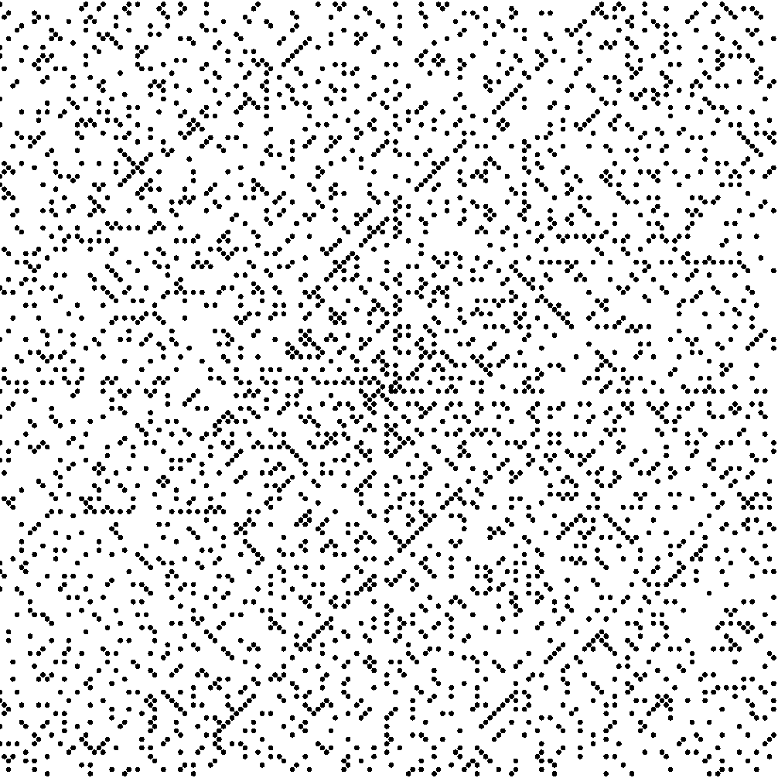
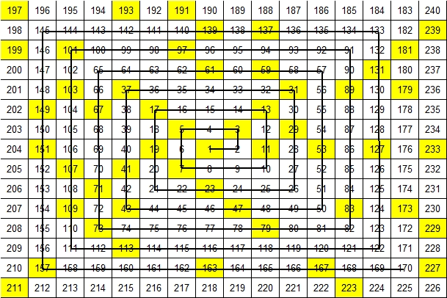
How do we learn about Primes?
We explore!
Ulam Spiral

