Slide 1
MATHLETES
10-24-12

Slide 2
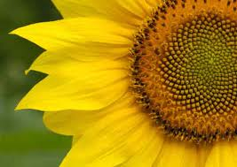
Fibonacci Numbers and
“The Golden Ratio”

Slide 3
Sequences
A sequence of numbers can be any list of numbers
  1, 2, 3, 4, 5, 6, 7, 8, 9, 10...
  2, 3, 5, 7, 11, 13, 17, 19...
  1, 4, 9, 16, 25, 36, 49, 64...
  Often, we are interested in sequences with some kind of pattern or rule

Slide 4
Examples of sequences
What rules or patterns do you see from the following sequences?
  3, 9, 15, 21, 27, 33...
  1, 3, 9, 27, 81, 243, 729...

Slide 5
Examples of sequences
3, 9, 15, 21, 27, 33...
  Add 6 to the previous number
  S_{n} = S_{n-1} + 6

Slide 6
Examples of sequences
1, 3, 9, 27, 81, 243...
  Multiply the previous number by 3
  S_{n} = 3*S_{n-1}

Slide 7
The Fibonacci Sequence
Start with the numbers 1 and 1, and apply the following rule:
S_{n} = S_{n-1} + S_{n-2}
In other words, the next term is found from adding up the previous 2 numbers

Slide 8
The First Few Fibonacci Numbers
1, 1, 2, 3, 5, 8, 13, 21, 34, 55, 89...
It goes on forever!
A few things to note:
  Has both even and odd numbers
  Has both prime and composite numbers
What other properties might this sequence have?

Slide 9
Can you start with different numbers?
Of course!
  4, -3, 1, -2, -1, -3, -4, -7, -11...
  1, 6, 7, 13, 20, 33, 53, 86...
  0, 0, 0, 0, 0...
It turns out they all have similar properties (except the silly 0,0,0... case)

Slide 10
The Constant Quotient
1, 1, 2, 3, 5, 8, 13, 21, 34, 55, 89...
Observe the following:
  5/3 = 1.6666...
  8/5 = 1.6
  13/8 = 1.625
  21/13 ≈ 1.6154
  34/21 ≈ 1.6190
  55/34 ≈ 1.6176
As we take quotients of consecutive terms, they get closer and closer to some particular number.

Slide 11
The Constant Quotient
It also satisfies the following equations:

Slide 12
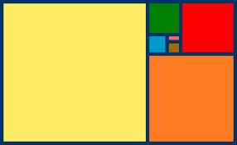
φ ≈ 1.618034
The most “aesthetically pleasing” rectangle has a length to width ratio of φ:1

Slide 13
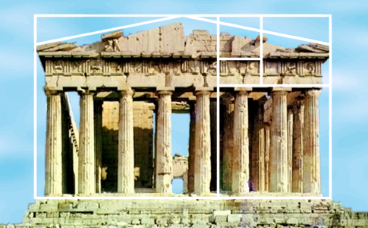
Fibonacci Numbers and the Golden Ratio in art and nature
The Parthenon in Greece

Slide 14
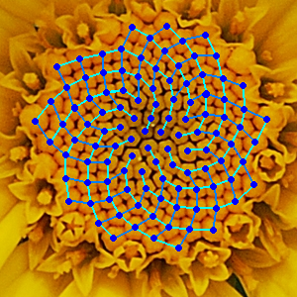
Fibonacci Numbers and the Golden Ratio in art and nature
Count the number of spirals in the sunflower

Slide 15
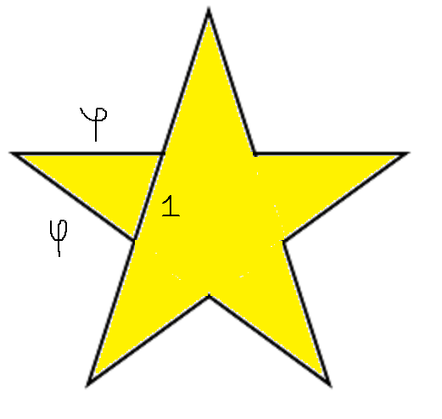
Stars! (At least their drawings)

Slide 16
A Formula connecting the Golden Ratio to the Fibonacci Sequence
S₁ = 1, S₂ = 1, S₃ = 2, S₄ = 3...

