Slide 1
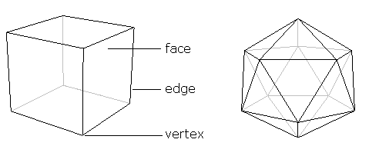
Exploring 3-D shapes!
Glasses not required!

Slide 2
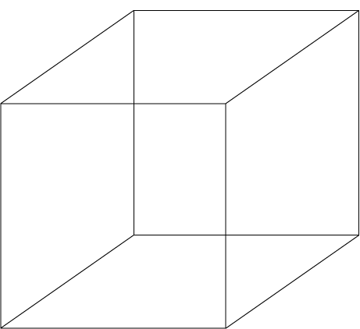
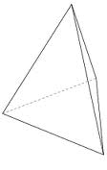
Polyhedra!
A polyhedron is a 3-dimensional, closed object whose surface is made up of polygons.
Common examples: cubes and pyramids

Slide 3
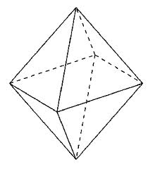
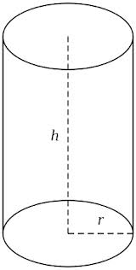
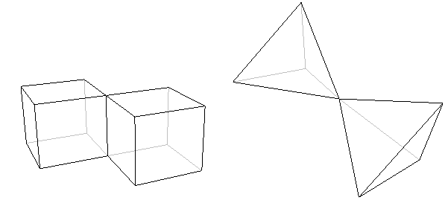
Are these polyhedra?

Slide 4
Things We Can Count
Faces – the polygons on the outside of the polyhedron.
Edges – the lines that touch polygons to each other.
Vertices – the “corners” that connect edges to other edges

Slide 5

Most Fun Example – Soccer Ball
32 faces (20 hexagons, 12 pentagons)
60 vertices (each connected to 2 hexagons and one pentagon)
90 edges

Slide 6
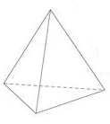

Our goal:
Count the number of faces, edges, and vertices on each of the following polyhedra:
Cube
Triangular pyramid
Square pyramid

Slide 7
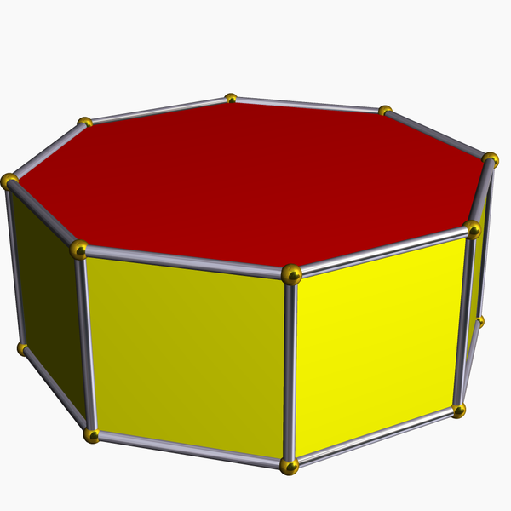
And These Things:

Slide 8
What These All Share:
Try and come up with a formula that relates the numbers of edges, faces, and vertices of a certain polyhedron, and see if it works for EVERY polyhedron.
Something maybe like: E + F = ????

Slide 9
Euler’s Polyhedron Formula:

