Slide 1
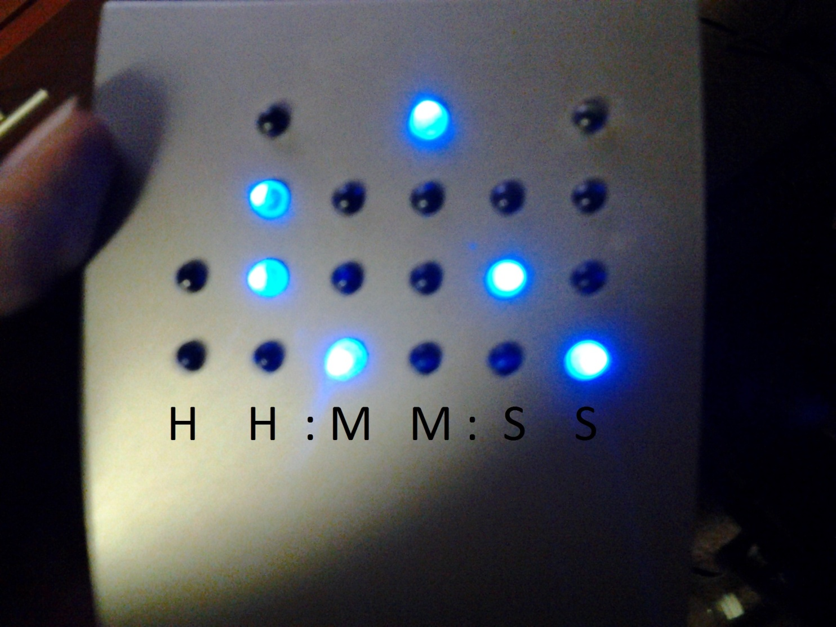
What Time Is It?

Slide 2
Today’s Topic
The factorial function (n!)
Permutations
Combinations

Slide 3
Sample Question:
The Mathletes club has 8 members. We need to send 2 students to the front office. How many different combinations of 2 students can we send?

Slide 4
Students A, B, C, D, E, F, G, H
AB
AC
AD
AE
AF
AG
AH
BC
BD
BE
BF
BG
BH
CD
CE
CF
CG
CH
DE
DF
DG
DH
EF
EG
EH
FG
FH
GH
28 possible
ways!

Slide 5
Does Order Matter?
For the classroom example, no.
Where might it matter?
  Running a race – who gets First Place? Second? Third?
  Lottery drawing – who gets the Grand Prize? The runner-up?

Slide 6
The Factorial (!) Function
For a positive integer, n, we define n! as follows…
Example:

Slide 7
Example
Compute 7!

Slide 8
How to compute 7!

Slide 9
One Thing to Note
0! = 1

Slide 10
Permutations (Order Matters)
How many ways can you choose r people from a group of size n if the order matters?

Slide 11
Permutations Example
7 people are running a race. In how many different ways can first, second, and third place awards get handed out?
n = 7, r = 3

Slide 12
Permutations Example

Slide 13
Combinations (Order Doesn’t Matter)
How many ways can you choose r people from a group of size n if the order DOESN’T matter?

Slide 14
Combinations Example
The Mathletes club has 8 members. We need to send 2 students to the front office. How many different combinations of 2 students can we send?
n=8, r = 2

Slide 15
Combinations Example
Same answer as before:

Slide 16
Different Notations
Permutations
  nPr
  P(n,r)
Combinations
  nCr, C(n,r)
  “n choose r”

Slide 17
Closure
Evaluate each of the following:
What patterns show up?

Slide 18
Challenge!
Show that
for any r and n.

Slide 19
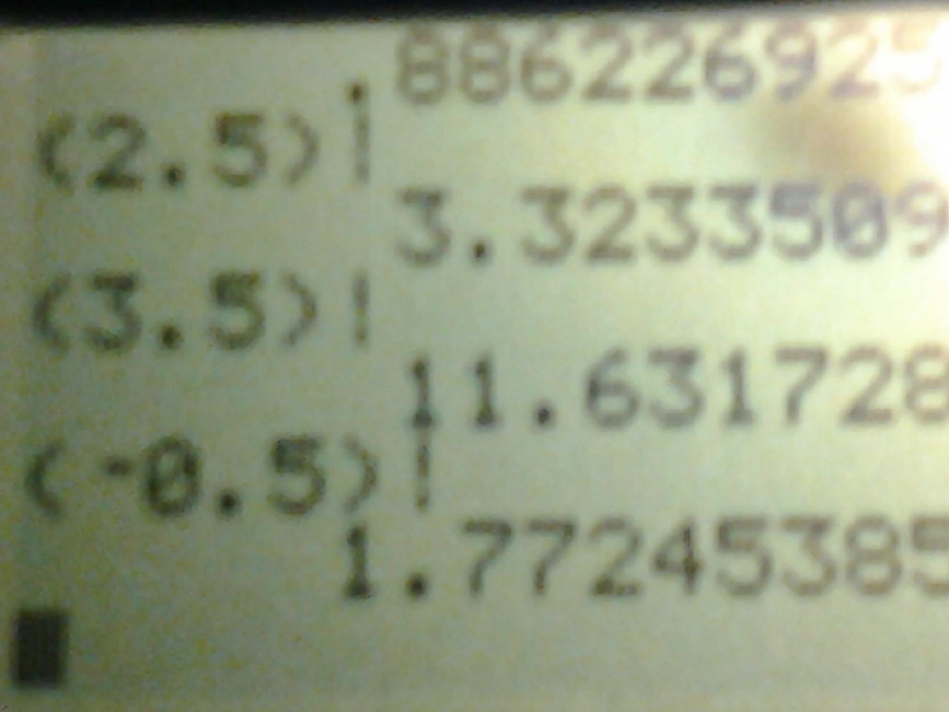
Freak Out Your Friends!

