Slide 1
Graphing Linear Equations in Two Variables
Mr. Wilson
Honors Algebra 1-2, FWJH
September 28, 2012

Slide 2
What is a Graph?
A graph is a list of ordered pairs following the coordinates on the axes.
  We usually call the horizontal axis the x-axis
  The vertical axis is usually called the y-axis
  We write these ordered pairs as (x,y)
  We start where the axes intersect: the origin
A graph can have a finite or an infinite number of ordered pairs.

Slide 3
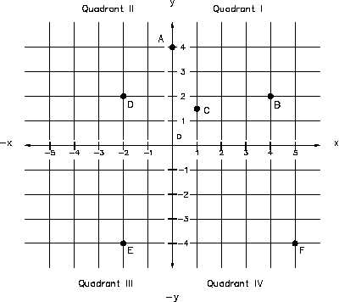
A Graph with Finite Points
We can individually list all the points

Slide 4
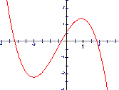
A Graph with Infinite Points
We can draw lines or curves without lifting our pencils

Slide 5
Graphing Equations
The points we draw are solutions to a specific equation or meet certain requirements
  Linear Equations (what we’ll be doing today!!)
  Quadratic Equations (Later this year)
  Learn more kinds of equations in Algebra 3-4, trig, and different classes.

Slide 6
Example of Graphing Equations
Find all points (x, y) that satisfy

Slide 7
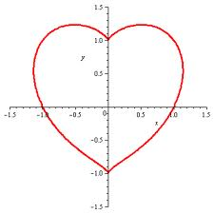

Slide 8
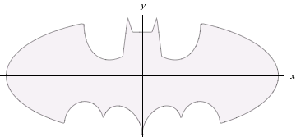
What Equations Can Describe This?
I
Image courtesy of wolframalpha.com

Slide 9
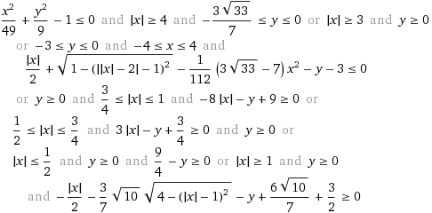
The Batman Curve

Slide 10
What Does a Linear Graph Look Like?
Things to pay attention to:
The shapes of the graphs
The looks of the equations

Slide 11
Crickets: Nature’s Weatherman
Counting the number of times a cricket chirps in 7 seconds can tell you the temperature!

Slide 12
Skiing Down a Mountain
A Skier’s elevation (E) as she skis down a mountainside over time (t) is

Slide 13
How Many Mullahys?
The number of Ms Mullahys is

Slide 14
Taxi Fares
What will the taxi fare (F) be for a trip covering a distance of M miles?

Slide 15
What Are Some Things We Noticed?
1) Graph is a straight line.
2) Have an infinite # of ordered pair solutions.
3) Variables do not have exponents.
no x² or y³ business
4) Can have either one or two variables.
From now on, we’ll just use x and y as our variables.

Slide 16
Are These Linear Equations?
1) y = 2x - 4
2) 3x + 6y = 9
3) x² + y² = 15
4) x = -3
5) 2y/3 – x = 12

Slide 17
Question
Determine whether (x,y) = (3, 4) a solution of
y = 2x – 2
Is (3,4) on the graph of
y = 2x – 2

Slide 18
Determine whether (5, -1) is on the graph of
y = 2x + 7

Slide 19
How To Graph a Linear Equation
Step 1: Solve for y by itself.
Step 2: Make a two-column t-chart. We’ll put x on the left and y on the right.
Step 3: Pick a few different values of x (your choice, but pick ones that will be easy to work with.)
Step 4: For each x you picked, determine what value y has to be.
Step 5: Plot your ordered pairs

Slide 20
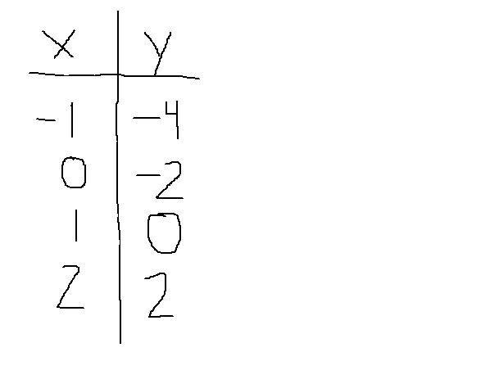
How to Graph a Linear Equation
Step 6: Draw a straight line through your points. Make the line go on forever. (Note: the graph MUST go through ALL your points)
Example: y = 2x - 2

Slide 21
SLATES TIME
Graph the equation y = 3x -4
Graph the equation 3y – 3x = 6

