Slide 1

More On Vectors
By Mr. Wilson
September 21, 2012
Honors Geometry, FWJH

Slide 2
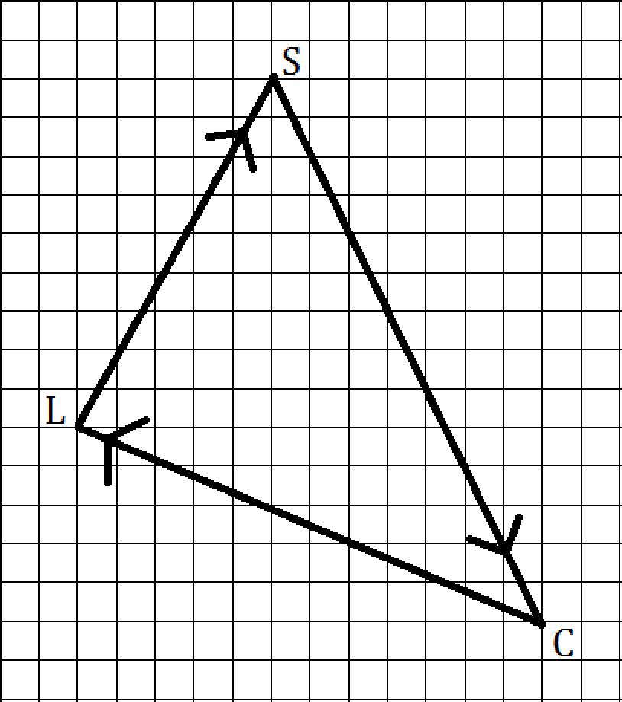
What vector describes me walking from my Car (C) to Lunch (L) ?
From Lunch (L) to my School class (S)?
From School (S) back to my car (C)?

Slide 3
So I walked along all these vectors and yet I wound up right where I started?
What if I walked these same vectors in a different order? Will I still get back to my car?

Slide 4
Adding Vectors
In general, when adding vectors <a₁, b₁> and <a₂, b₂>, they result in the new vector
<a₁ + a₂, b₁ + b₂>
It doesn’t matter what order you add the vectors. You end up at the same spot.

Slide 5
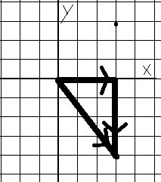
We’ve Been Doing This Already!
What do we mean by < 3 , -4 >?
  Go right 3 in the x-direction
  Go down 4 in the y-direction
< 3 , -4 > = < 3 , 0 > + < 0 , -4 >

Slide 6
SLATES TIME!
Add the following vectors:
< 12, -3 > + < 2, 0 > = ?
< -5, 2 > + < -4, -3 > = ?
<10,0> + <0,-10> + <-10,0> + <0,10> = ?

Slide 7
Multiplying a Vector by a Number
We can stretch, squish, or flip a vector around by multiplying it by a scalar (factor)
Example:
3< -2 , 4 > = < 3(-2) , 3(4) > = < -6 , 12 >

Slide 8
Notes on Scalar Multiplying
If |N| > 1, then the vector is getting stretched out. Its length is increasing.
If |N| < 1, then the vector is getting squished in. Its length is decreasing.
If N < 0, then the vector is now going in the opposite direction

Slide 9
Multiply a Vector by… Another Vector?
The Dot Product of two vectors
and is given by
Note that the dot product of two vectors is a SCALAR (NUMBER), NOT A VECTOR

Slide 10
Notes on Dot Product
If the two vectors are parallel, we have
If the two vectors are perpendicular,
This comes up in Trigonometry, Physics, Multi-Dimensional Calculus

Slide 11
SLATES AGAIN!
Are these vectors parallel, perpendicular, or neither?
< 6 , -8 > and < -3, 4 > ?
< 2, -5 > and < 5, -2 >?
< 0 , 3 > and < -9 , 0 > ?
Find a vector perpendicular to <9,7>.

