Slide 1
The Nature of
Infinity

Slide 2


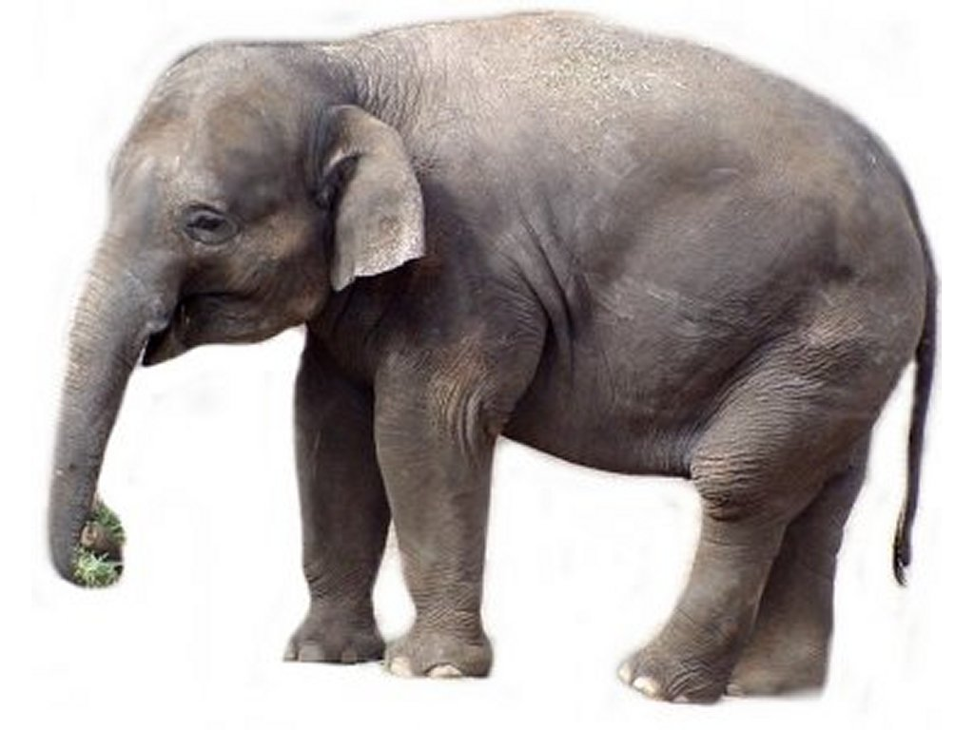

What is a set?
A set as any collection of well-defined objects, which we usually denote with { } .
2
π
1
,
,
,
-12.652
3
…, -2, -1, 0, 1, 2, …

Slide 3

Finite sets
We say a set is finite if given enough time we could count the number of elements.
Grains of sand in the Sahara Desert

Slide 4
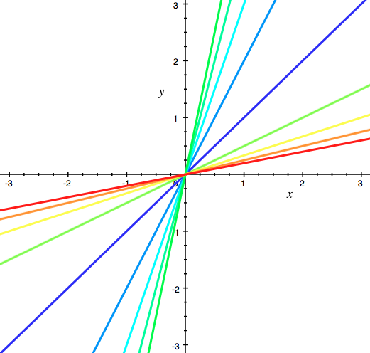
INFinite sets
We say a set is infinite if we cannot count the number of elements no matter how much time we have.
Lines passing through the point (0,0)

Slide 5

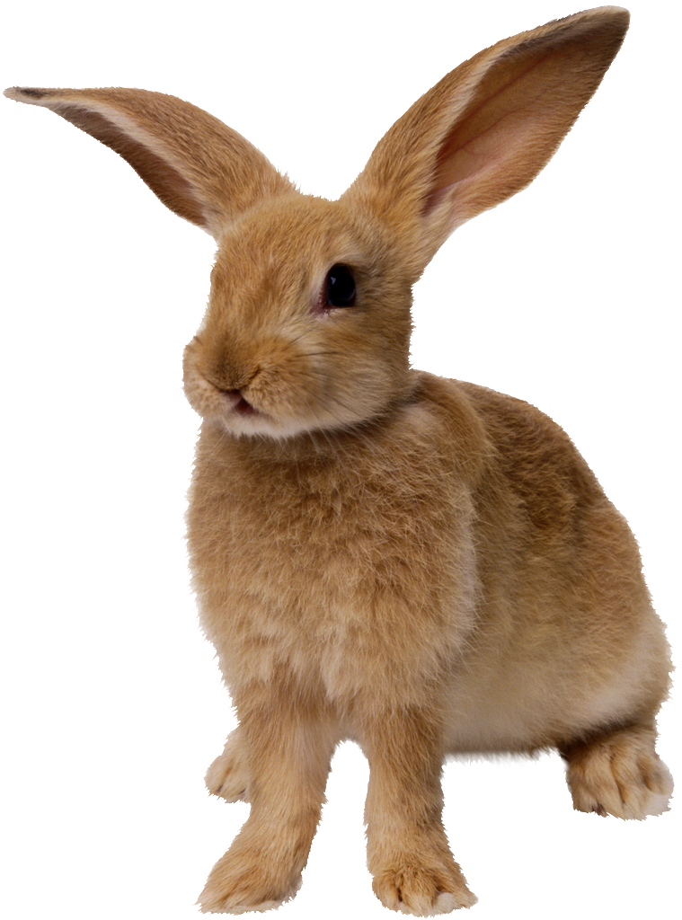


Farmer’s Paradox
How many of Al’s plants will be left?
How many of Bob’s plants will be left?
…
Al
1
2
3
4
5
6
7
…
…
Bob

Slide 6
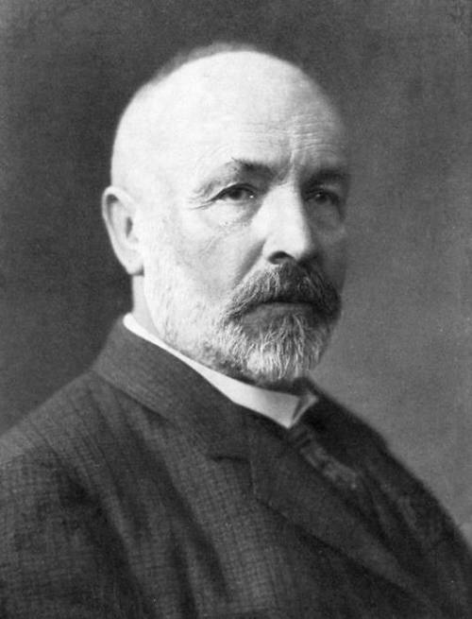
GEorg Cantor
Georg Cantor was an 18th century German Mathematician, and was the first to rigorously study infinite sets. He is considered the creator of an area of mathematics called Set Theory.
Cantor was a mathematical genius whose theory of infinite sets was groundbreaking and way ahead of its time.

Slide 7
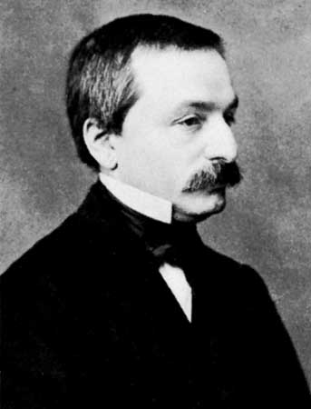
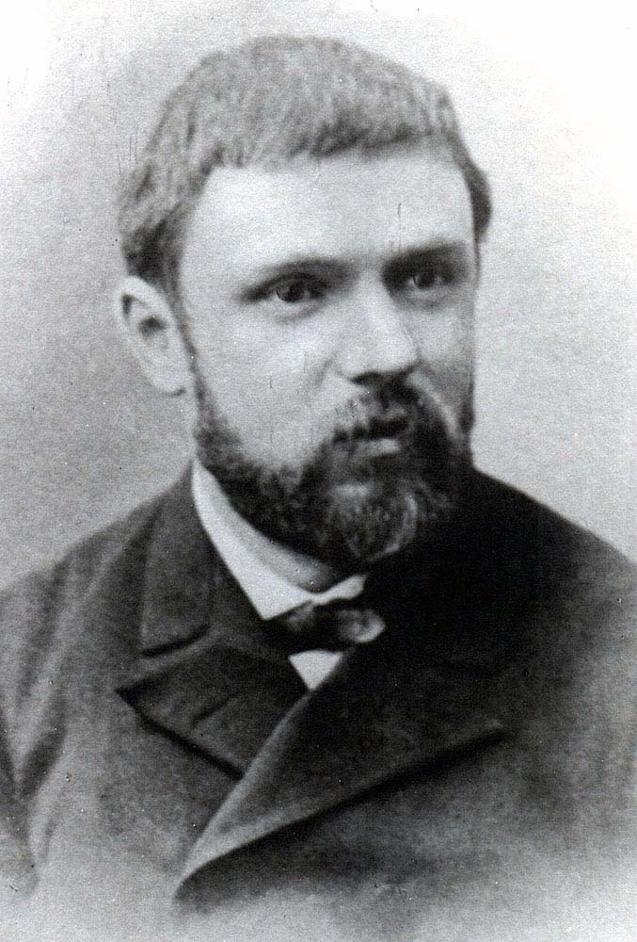
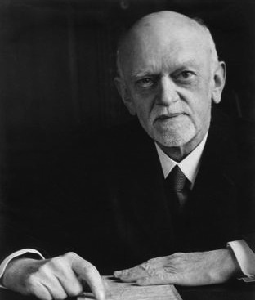
GEorg Cantor
In fact, his theory was so fantastic and counter-intuitive that many mathematicians refused to believe them and treated Cantor with a great deal of contempt.
However, many came to see the genius in Cantor’s ideas.
“I don’t know what predominates in Cantor's theory - philosophy or theology, but I am sure that there is no mathematics there.”
“The future will view Cantor’s theory of infinite sets as disease from which one has recovered”
“[Cantor’s work] is the finest product of mathematical genius and one of the supreme achievements of purely intellectual human activity”
Henri Poincare
Leopold Kronecker,
Cantor’s one-time advisor aand most ardent critic
David Hilbert

Slide 8
Cantor’s Dangerous Idea
Cantor wanted to measure the size of sets. With finite sets this is easy enough, you can simply count the number of elements of the set.
What if the set is infinite?
To answer this question, imagine you forgot how to count and consider the two sets below:
Clearly, these sets are the same size. Without counting can you come up with a way of showing they have the same number of elements?
We use the buddy system and pair elements from each set. If we have no elements left over, the sets are the same size! We call this pairing a one-to-one correspondence
2
8
5
71
11
,
,
,
,
1
,
4
,
9
,
16
,
25

Slide 9
Cantor’s Dangerous Idea
Suppose we remove two elements from the first set:
8
,
5
,
71
1
,
4
,
9
,
16
,
25
We can see that these two sets are no longer the same size by counting, and no matter how we try to pair elements up there will always be two left over.
This is obvious and pretty boring when we’re considering finite sets, but when we look at infinite sets we find some surprises…

Slide 10
Cantor’s Dangerous Idea
Consider the following two sets:
(0,1)
(1,1)
0
1
(0.719…, 0.548…)
7
1
8
0.
…
0.
9
…
4
0.719…
5
0.548…
(0,0)
(1,0)
Do these two sets have the same number of elements?
YES!

Slide 11
HOTEL INFINITY
Cantor wondered if every infinite set has the same number of elements?
To answer this, imagine you are the manager of a hotel with an infinite number of rooms numbered 1, 2, 3, …
Given an infinite set, can you check each element into its own room in your hotel?
1
2
3
4
5
6
7
8
9
10
11
12
13

Slide 12
HOTEL INFINITY
Can you find a way to check in the even counting numbers?
Can you find a way to check in the integers?
Can you find a way to check in the rational numbers?
1
2
3
4
5
6
7
8
9
10
11
12
13

Slide 13
HOTEL INFINITY
We can write the rational numbers out in a grid as follows:
1
Room 1:
Room 2:
Room 3:
Room 4:
Room 5:
Room 6:
Room 7:
1 | 1/2 | 1/3 | 1/4 | 1/5 | …
2 | 2/2 | 2/3 | 2/4 | 2/5 | …
3 | 3/2 | 3/3 | 3/4 | 3/5 | …
4 | 4/2 | 4/3 | 4/4 | 4/5 | …
… | … | … | … | …
1/2
2
3
1/3
1/4
2/3
…

Slide 14
HOTEL INFINITY
This means that the set of even counting numbers, counting numbers, integers, and rational numbers all have the SAME number of elements!
But we still haven’t answered our question of whether or not every infinite set has the same number of elements.
It turns out that this is not the case! The set of real numbers cannot be checked into our infinite hotel.

Slide 15
HOTEL INFINITY
We want to show that no matter how we check the real numbers in, there will be at least one real number left over.
8.01461…
Room 1:
Room 2:
Room 3:
Room 4:
Room 5:
Room 6:
9.3780129370109283…
6.1230801298301928…
3.1221231245690900…
19.1251212315673123…
23.3337333333333333…
4.2342052527888545…
…

Slide 16
What does this mean?
How many more irrational numbers are there than rationals?
If you were to randomly choose a real number the probability that it is rational is 0!
The probability that it is irrational is 1!

