Slide 1
Math is Everywhere
St. Michael’s Family Math Night
November 10, 2010

Slide 2
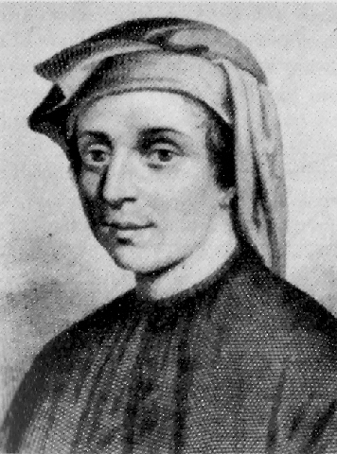
The Golden Ratio…
Fibonacci was 12th century Italian mathematician whose is famous for advocating the use of the digits 0-9 and place values rather than Roman numerals.
However, he is probably more well known for a sequence of whole numbers bearing his name, the Fibonacci sequence.
0
1
1
2
3
5
8
13
21
34
…

Slide 3

The Golden Ratio…
What’s so great about the Fibonacci sequence?
1
1
If we were to continue computing these ratios, we would see that they get closer and closer to the number
1
1
1
2
2
Consider the ratio of consecutive non-zero numbers in the Fibonacci sequence.
2
1
3
1.5
3
2
5
1.6667
=
1.6180339887498948482045868343656381…
5
3
8
1.6
8
5
13
1.625
13
8
This number is called the Golden Ratio. It is an irrational number so its decimal expansion goes on forever and never repeats. This number is so special that mathematicians just call it .
21
1.61538462
21
13
34
1.61904762
34
21
Φ
…

Slide 4
The Golden Ratio…
Φ
The ratio is a very mysterious number…
hypotenuse
=
Φ
base
hypotenuse
Such a triangle is called a Golden triangle…
This spiral can be found everywhere in nature…
base

Slide 5
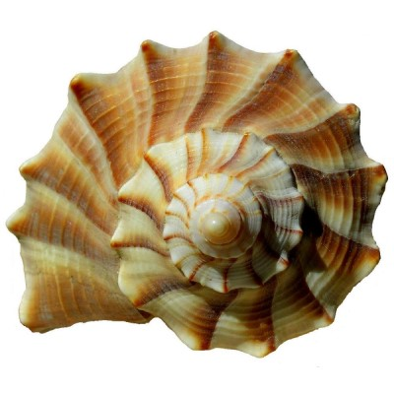
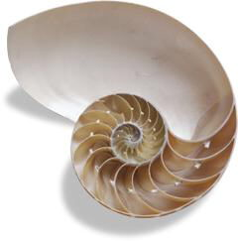
The Golden Ratio…
In shells…

Slide 6
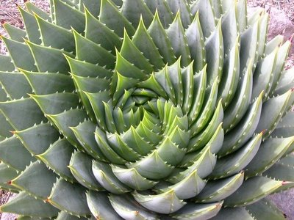
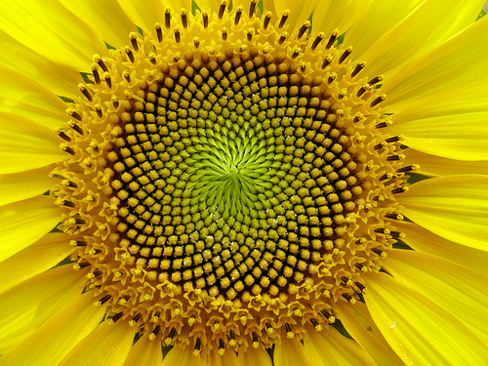
The Golden Ratio…
In plants…

Slide 7
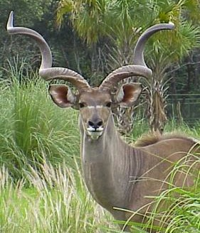
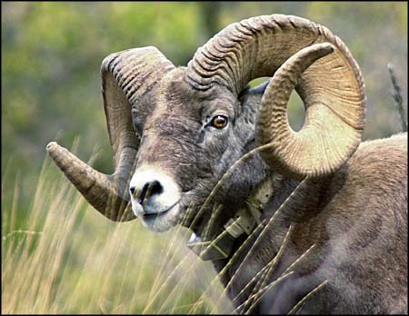
The Golden Ratio…
In animals…

Slide 8
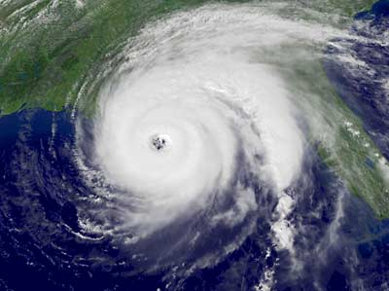
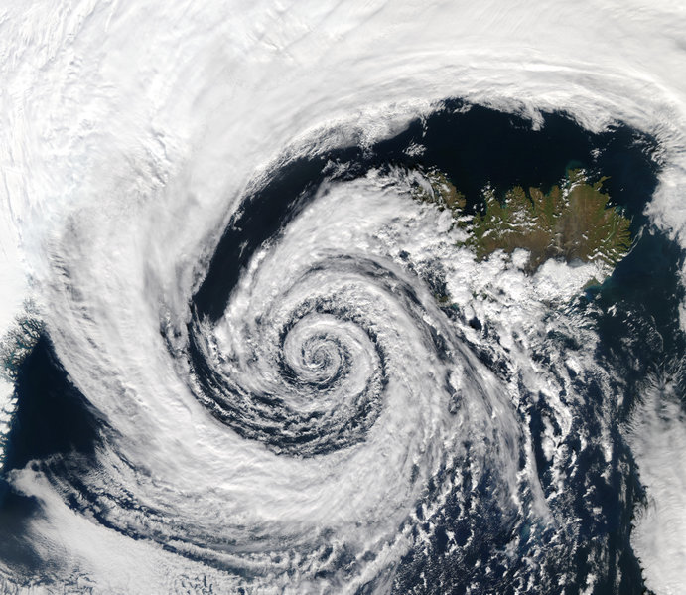
The Golden Ratio…
In storms…

Slide 9
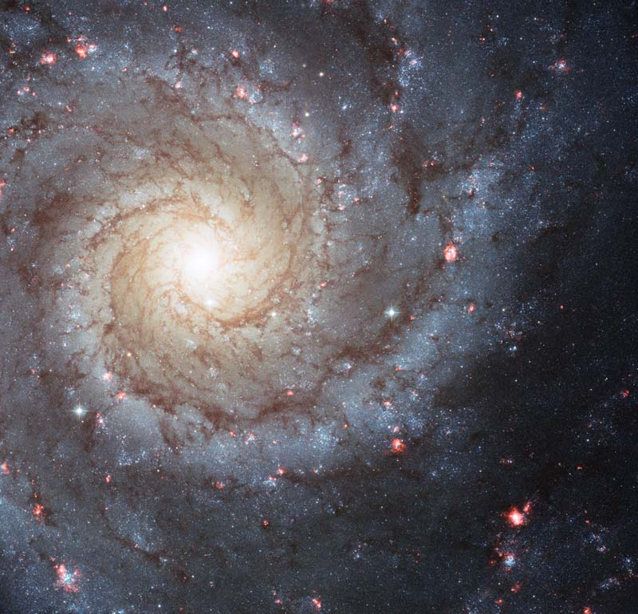
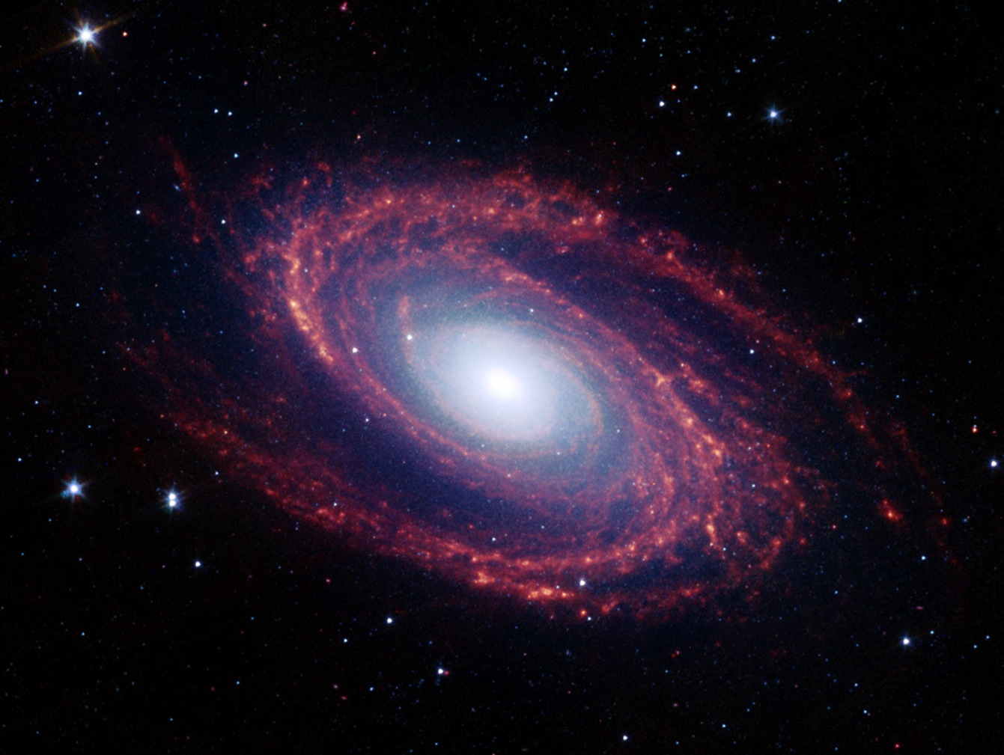
The Golden Ratio…
And even in space…

Slide 10
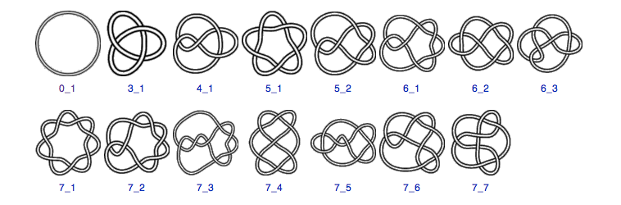
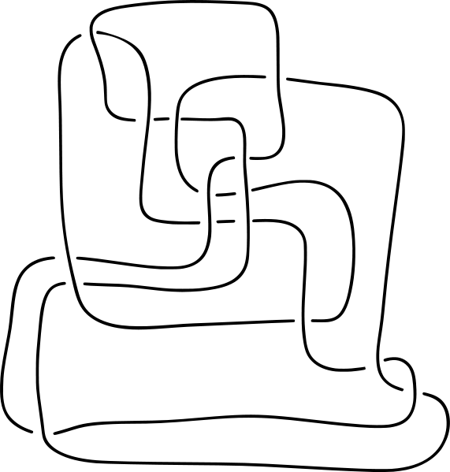
Math is in your genes …
One area of active mathematical research is called knot theory.
Knot theorists are mathematicians that try to determine if two knots are really same knot, just tangled differently. For example,
The above are all possible knots with 0, 3, 4, 5, 6, or 7 crossings.

Slide 11
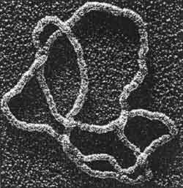
Math is in your genes …
In the 1980’s knot theorists made a very exciting discovery. They realized that the knots they’ve been studying for centuries show up in an unexpected place…
DNA is like the set of blueprints or the recipe used to build the different cells in the human body.
Techniques from knot theory have helped scientists understand how DNA molecules are “unpacked”, they have also help them understand and how DNA replication can be stopped.
Often these DNA molecules come in a tangled mess like the one to the right. In order for the DNA molecule to do its job, our bodies need a way of untangling the mess.

Slide 12
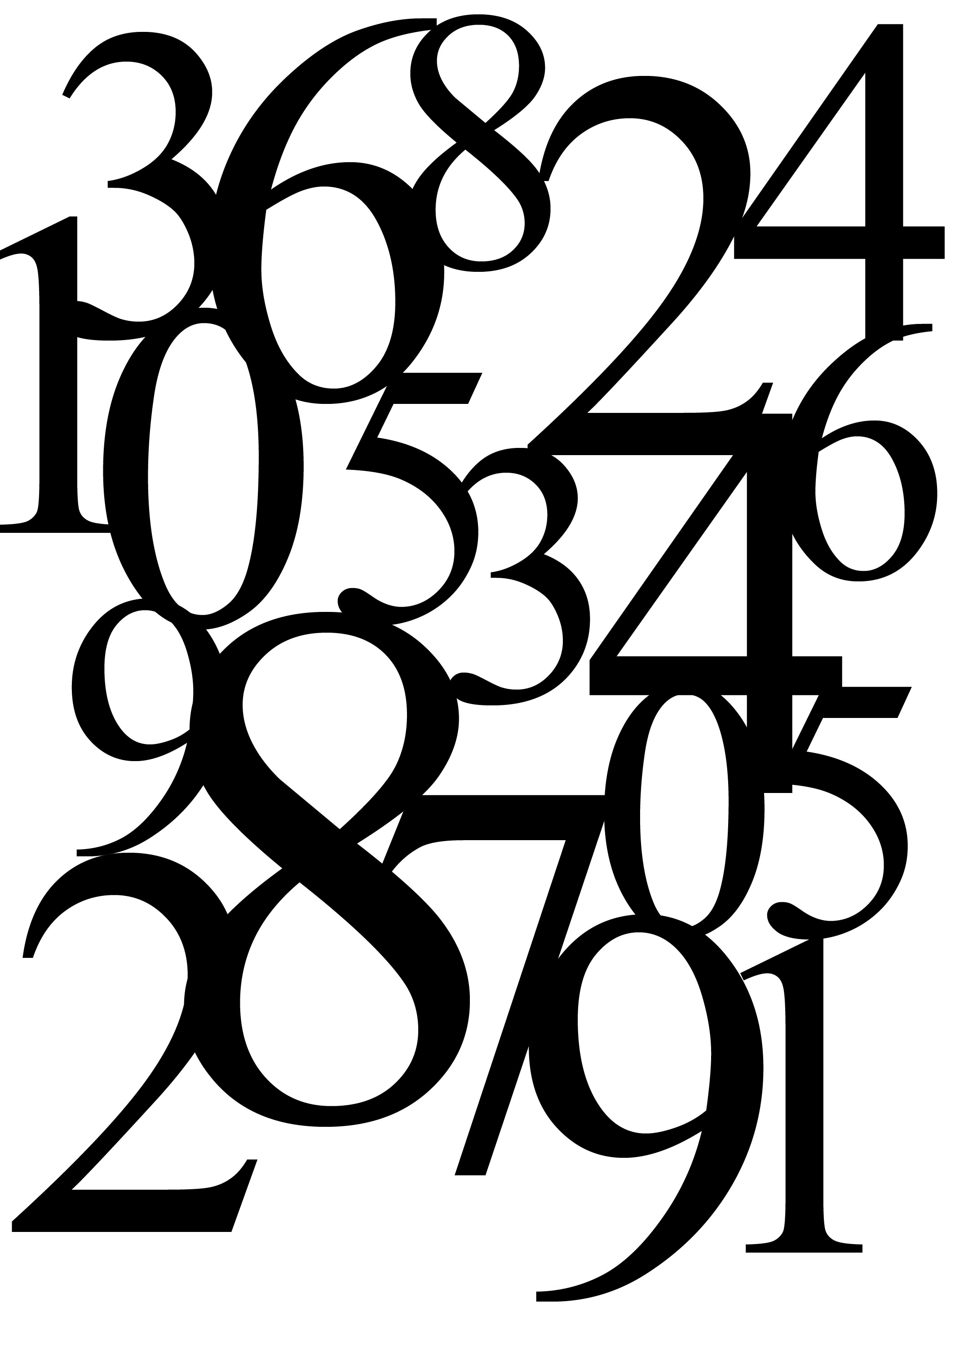
Cicadas and number theory…
Number Theory is one of the oldest areas of mathematics, and began as the study of the whole numbers.
Number theorists are particularly interested in prime numbers, which are whole numbers that are only evenly divisible by 1 and themselves.
7 is evenly divisible by 1 and 7
12 is evenly divisible by 1, 2, 3, 4, 6 and 12
So 7 is a prime number and 12 is a composite number.

Slide 13
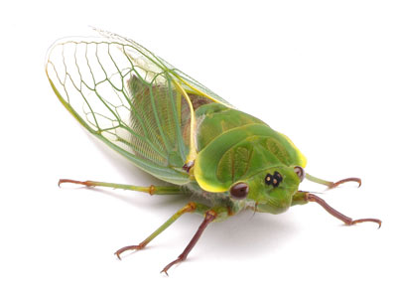
Cicadas and number theory…
Periodic cicadas are large insects known for the loud, shrill buzzing noise they produce to attract mates.
They lay their eggs in trees.
After the eggs hatch, the young cicadas make their way down the tree and burrow into the soil below
Once full-grown, the cicadas emerge from the soil shed their skin (molt) and lay their eggs.
The cicadas will spend several years underground
feeding on the root sap of various trees and shrubs.

Slide 14
Cicadas and number theory…
What’s interesting is the amount of time that these periodic cicadas wait before emerging from the soil.
13 years
17 years
Why are periodic cicadas waiting a prime number of years to emerge and lay their eggs?

Slide 15
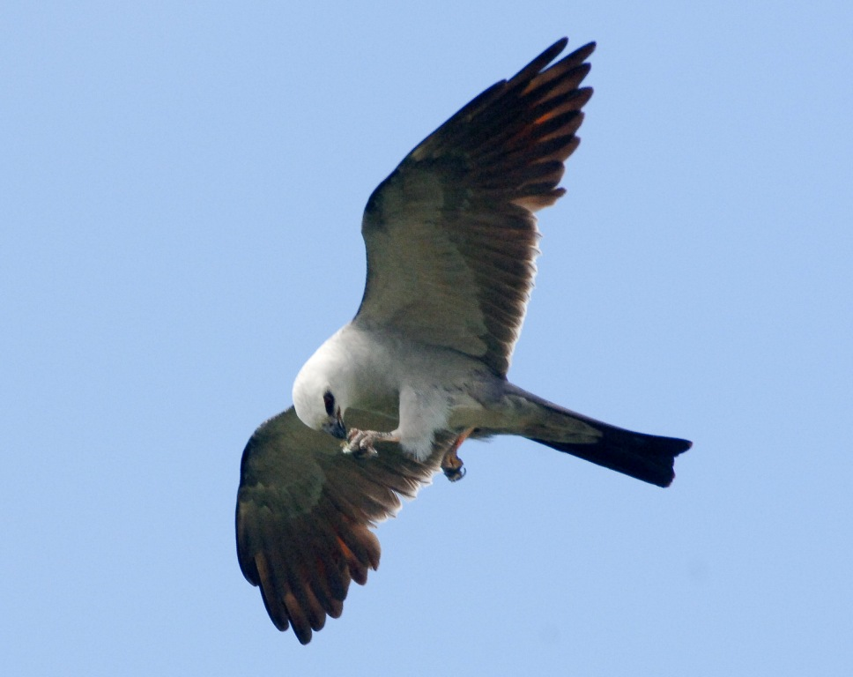
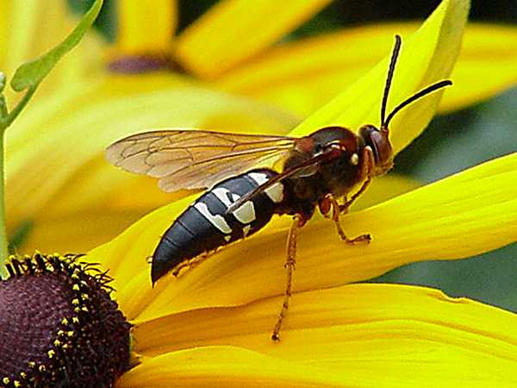
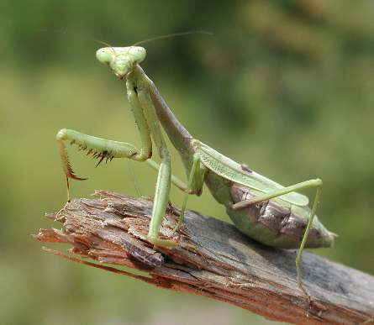
Cicadas and number theory…
In order to avoid being eaten by these guys…
By cycling at a large prime number, cicadas minimize the chance that some predator can make them a part of their regular diet. For example, the emergence of a 17-year cicada species would sync with a 5-year predator only every 85 years!

Slide 16
π is a magic number…
π
circumference
=
diameter
=
3.14159265358979323846264338327950288419716939937505820974944592307816406286208998628034825342…
diameter
circumference
π is an irrational number so its decimal expansion goes on forever and never repeats…

Slide 17
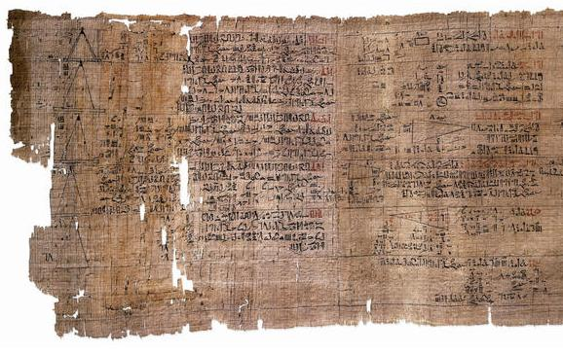
π is a magic number…
Mathematicians have been trying to calculate π to more and more decimal places for thousands of years.
Around 2000 BC the Babylonians had estimated to be 3.125. The ancient Egyptians had a better estimate of 3.141592.
π
In 2002, a Japanese scientist found 1.24 trillion digits of using a Hitachi supercomputer. It took the computer almost 18 days to perform the computation.
π
π
Using only the first 11 decimal places of we could compute the circumference of Earth with an error of less than 1 millimeter!
π
Using only the first 39 decimal places of we could compute the circumference of known universe with an error less than size of a hydrogen atom!

Slide 18
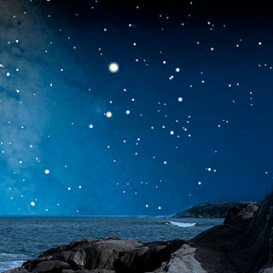
π is a magic number…
There is a very deep and mysterious connection between and “randomness’’. In fact, We can find encoded in the randomness of the stars…
π
π
Mathematician Robert Matthews, computed the angular distances between the 100 brightest stars in the night sky.
With these random numbers he computed the value of to be 3.12772!
π

Slide 19
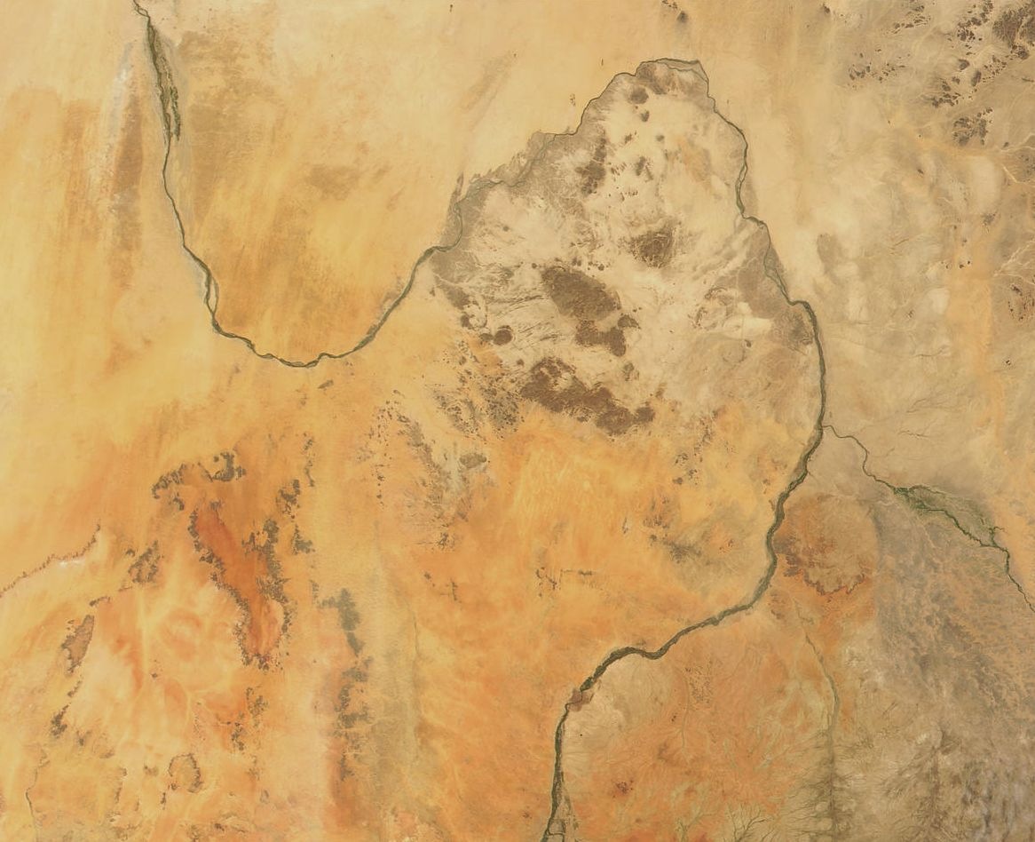
π is a magic number…
Professor Hans-Henrik Stolum, an earth scientist at Cambridge University, calculated the ratio between the actual length of rivers from source to mouth and their direct length “as the crow flies”.
He found ratio is approximately !
π
π
Why is the number showing up here?

