Slide 1
Combinations

Slide 2
Objectives:
I can predict and find the number of combinations that can be made from a given number of options
I can make a tree diagram to find all of the possible combinations

Slide 3
Vocabulary
Combination:
Selection of two or more things from a larger group
Tree Diagram:
A diagram that shows all possible outcomes
Outcome:
Result- the way something turns out at the end

Slide 4
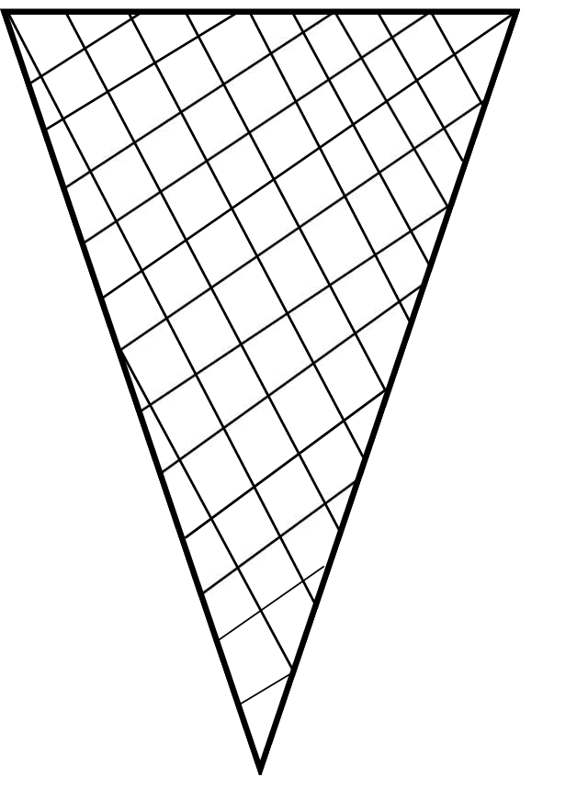
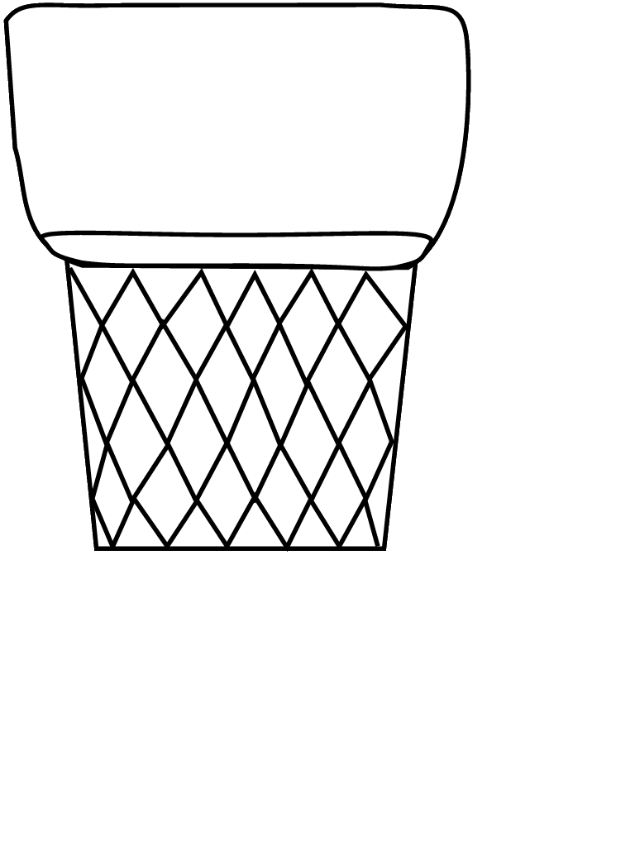



2 Containers: waffle cone or wafer cone
3 Flavors of Ice Cream: Chocolate, Vanilla, Strawberry

Slide 5
Predict how many unique combinations of ice cream cones you can make with one cone and two flavors of ice cream
Using paper ice cream and cones find all of the possible combinations and record them in the recording sheet

Slide 6
Remember : Use One Cone and Two flavors of Ice Cream for Each Combination
Example:
Record all of your combinations in the recording sheet (remember each combination can only be recorded once)
Ice Cream Flavor 1 (top) | Ice Cream Flavor 2 (bottom) | Container (cone type or bowl)
Chocolate | Vanilla | Waffle

Slide 7

3 Containers: waffle cone , wafer cone, bowl
3 Flavors of Ice Cream: Chocolate, Vanilla, Strawberry

Slide 8
Now predict how many unique combinations of ice cream cones you can make
Using paper ice cream and cones find all of the possible combinations and record them in the recording sheet

