Slide 1
METRIC MANIA !!!
VOLUME/CAPACITY

Slide 2
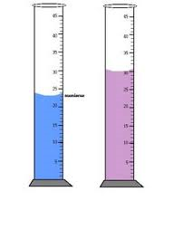
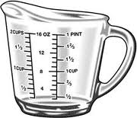
Capacity
Capacity refers to how much something can hold or how much space it takes up
We can measure the capacity of regular object using the formula length x width x height.
9 cm
_____ X _____ X _____ = _____
8 cm
10 cm
We can measure the capacity of a fluid using measuring cups or cylinders

Slide 3
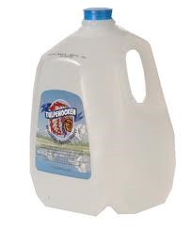
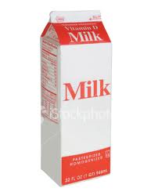
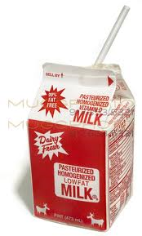
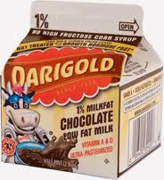
English Units vs. Metric Units
English Units – units used in the U.S.
1 Gallon = 4 Quarts
1 Quart = 2 pints
1Pint = 2 cups

Slide 4
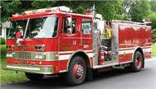
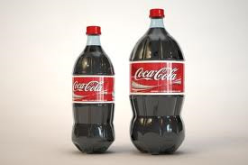
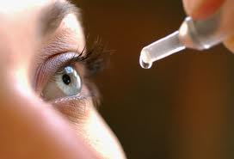
English Units vs. Metric Units
Metric Units – units used in most other countries and by scientists in U.S.
1 kiloliter = 1000 liters
1 liter = 1000 milliliters
1 Kiloliter – fire truck carries 2 kiloliters of water
1 Liter – bottle of soda
1 Milliliter is about 20 eyedrops

