Slide 1
METRIC MANIA !!!
MASS

Slide 2
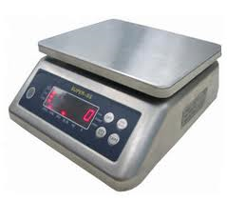
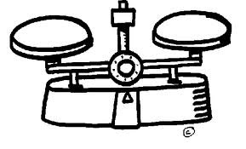
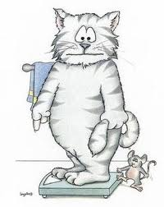
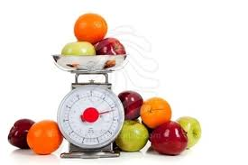
Mass
Mass refers to how heavy something is.
Mass is measured with a scale.

Slide 3
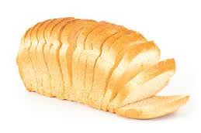
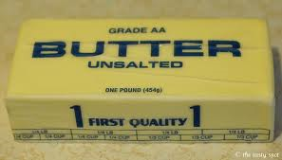
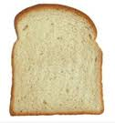
English Units vs. Metric Units
English Units – units used in the U.S.
1 Pound = 16 Ounces
One Loaf = 1 Pound
One slice = 1 Ounce

Slide 4
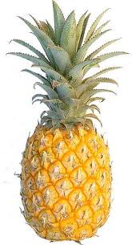
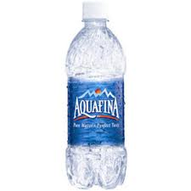

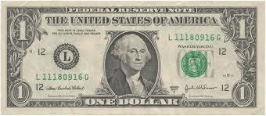
English Units vs. Metric Units
Metric Units – units used in most other countries and by scientists in U.S.
1 kilogram = 1000 grams
1 gram = 1000 milligrams
Mass equals one kilogram
Mass equals one gram

Slide 5
English Units vs. Metric Units
Can you think of something that has a mass of 1 milligram??
Remember: You need 1000 milligrams to equal just 1 gram

