Slide 1
AcaDec
Science w/ Ms. Hendryx
9/29/11

Slide 2
Review vector math:
=
+

Slide 3
Review vector math:
Pythagorean Theorem: a² + b² = c²
c
a
b

Slide 4
Review vector math:
Pythagorean Theorem: a² + b² = c²
c=?
6
8

Slide 5
Review vector math:
Combining concepts: vectors and Pythagorean Theorem
5
+
=
12
c=?
c=?
-2
+
=
2

Slide 6
Review vector math:
Now apply it to physics…
+
=
v_{x}=8
v=10
v_{y}=?
OR!
-
=
v_{x}=8
v=10
v_{y}=?

Slide 7
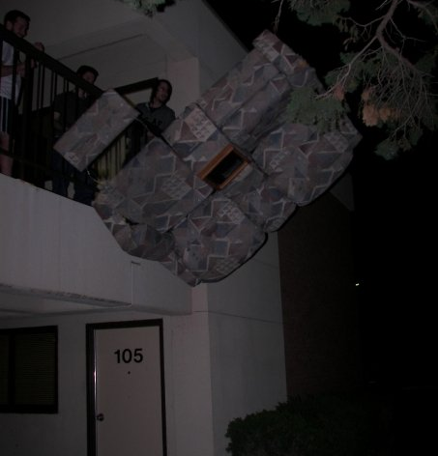
Group practice!
4 of my friends in college pushed a broken couch off of the 6-meter apartment balcony rail (being sure no one was below). They shoved it so that it had v_{x0} of 2 m/s coming off the balcony. What was the total velocity v of the couch as it hit the ground?
v_{x0} = 2m/s

Slide 8
Group Practice!
A block is being pulled along using a rope. Use the force diagram below. Find the total force acting on the block (F_{x}). Find the block’s acceleration.
Notes: there is no vertical motion, so F_{n}+F_{y} = F_{g}. Assume acceleration due to gravity is -10m/s² to find F_{g}.
F=75 N
F=75 N
F_{n} = 25 N
F_{y}
F_{x}
F_{f} = 2 N
m = 5 kg
Δx
F_{g}

