Slide 1
AcaDec
Science w/ Ms. Hendryx
4/2/12

Slide 2
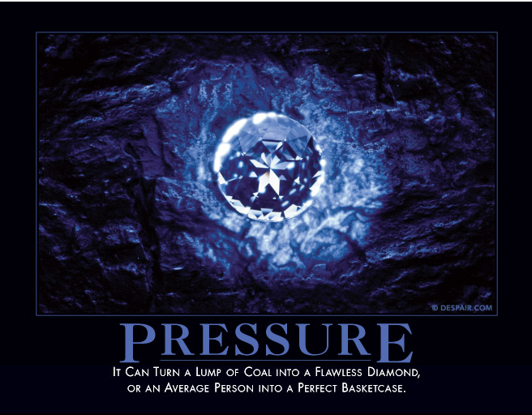
No pressure, no diamonds…

Slide 3
Pressure:
Force per unit Area
SI Units of Pressure: N/m², or a Pascal (Pa)

Slide 4
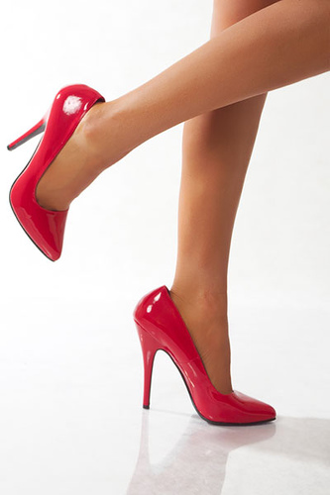
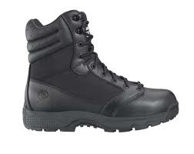
Whose heel would you rather have step on your foot?
50 kg (~100 lb) woman in 1 x 1 cm stilettos
200 kg (~400 lb) man in 8 x 8 cm boots
F =
A =
P =
Man has 4x more force.
Woman has 1/64th the area.
Woman has 16x more pressure.
Ouch.

Slide 5
Bernoulli's principle states that an increase in the speed of the fluid occurs simultaneously with a decrease in pressure

Slide 6
Bernoulli's principle states that an increase in the speed of the fluid occurs simultaneously with a decrease in pressure
Where is the air moving fastest?
Where is the pressure lowest?
Same amount of air moving, so it must be faster in the bottom of the cone.
So where is the pressure greatest?
Nature abhors a vacuum.

