Slide 1
AcaDec
Science w/ Ms. Hendryx
12/13/11

Slide 2
Quiz #6
Write Ohm’s Law.
Estimate to the nearest order (power of 10):
  The number of meters in 174 decimeters
  The number of liters in 36 centiliters
  The number of milligrams in a gram
What are the units of:
  Force?
  Current?

Slide 3
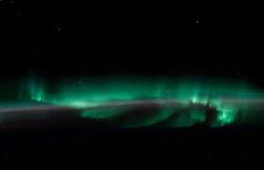
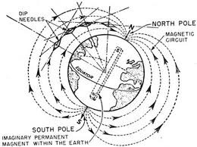
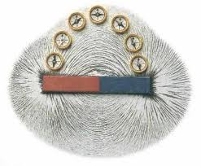
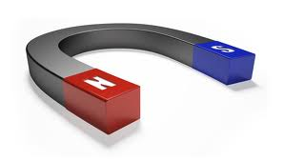
Magnetism
  What do we know about magnetism?
No Magnetic Monopoles!
Has fields like electicity

Slide 4
magnetism
  VOCABULARY:
  Magnetic Field, B
  Magnetic Flux, Φ_{B}
  Magnetic Force, F
  Electromotive Force, ε
    (Voltage Difference)
  Permeability of Free Space, μ₀
  Speed of Light, c
  Like the electric field, but between magnetic poles instead of charges [Tesla, T]
  The density of magnetic field lines through a given area [Tesla/m²]
  Force on a MOVING charge [Newtons]
  Rate of change of magnetic flux—not a real force!!! [Volts, V]
  CONSTANT! 1.26 x 10⁻⁶ [T*m/A]
  CONSTANT! 3 x 10⁸ m/s

Slide 5
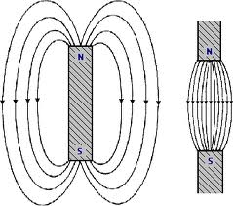
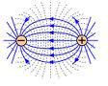
magnetism
Magnetic Field:
Electric Field:

Slide 6
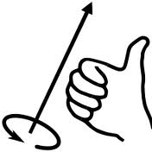
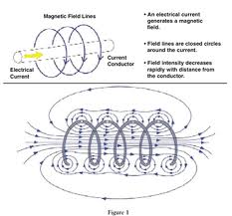
Right Hand rule #1
Current induces a magnetic field, and vice versa!
(Lenz’s Law: North is your thumb)

Slide 7
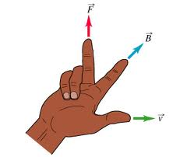
Right Hand rule #2
F = qvBsinθ
-
xxxxxxxxxxxxxxxxxxxxxxxxxxxxxxxxxxxxxxxxxxxxxxxx
………………………………………………………………
+
-
+
(“x” marks the spot into the page)
(you can only see the tip of the arrow coming at you out of the page)
A MOVING charge in a B-Field feels magnetic force.

Slide 8
Magnetization
  Atomic Dipoles:
  Each electrons spin around the atoms creating “current”, which induces magnetic fields, i.e. magnetism.

Slide 9
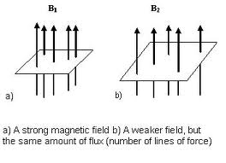
Magnetism
  Magnetic Flux:
A = Area
B = Magnetic Field (stronger means more lines closer together)
cosθ has to do with the angle of the field lines

Slide 10
Magnetism
  Faraday’s Law:
A change in magnetic flux (increasing/decreasing the field across a given area) results in a voltage bias, which results in a current.
Any part of changing the flux requires energy; the current doesn’t come from “nowhere”.

