Slide 1
AcaDec
Science w/ Ms. Hendryx
1/17/12

Slide 2
Quiz #7
Felectric=
PEelectric=
C =
Power Law: P =
Ohm’s Law: V =

Slide 3
Light
  VOCABULARY:
  Wavelength, λ
  Period, T
  Frequency, f
  Wave velocity, v
  Index of refraction, n
  Superposition
  Speed of Light, c
  Distance between similar points on a wave [m]
  The time it takes for a wave to travel a full wavelength (sec)
  How often a wave repeats [Hertz, Hz=1/s]
  Velocity of a point on a wave (m/s)
  How much slower light travels in a material than in vacuum
  Addition of wave amplitudes; results in INTERFERENCE
  CONSTANT! 3 x 10⁸ m/s

Slide 4
waves
Frequency: 1/T
(depends on wave source)

Slide 5

waves
  What do we know about waves?
Amplitude
Peak
Trough

Slide 6
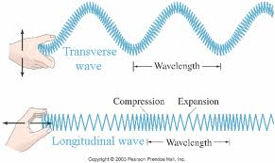
waves
  Water waves
  Sound waves
  Light waves

Slide 7
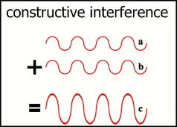
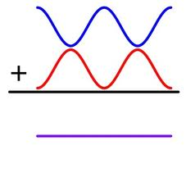
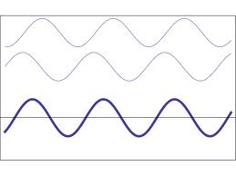
waves
Superposition: Waves add!
destructive interference
(shifted by ½)
What if the amplitudes aren’t the same?
What if the waves don’t match up perfectly?
Does the frequency change?

Slide 8

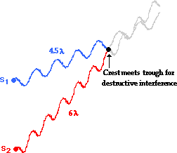
waves
Superposition: Waves add!

Slide 9
waves
Superposition: Waves add!
r_{A}
r_{B}

Slide 10
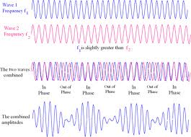
waves
Superposition: Waves add!
What if the waves don’t have the same frequency?

Slide 11
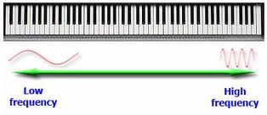
waves
Tuning:
If notes aren’t in tune, you hear interference as beats.
You want the beat frequency as low as possible.
http://serc.carleton.edu/NAGTWorkshops/deepearth/activities/40826.html

Slide 12
waves
Superposition: Waves add!
What if the waves don’t have the same frequency?
As it turns out, the frequency of the beats is the DIFFERENCE between the 2 wave frequencies!
The note A has a frequency of 440 Hz. What is the frequency of the A on my oboe if you can hear a 2 Hz beat?
sharp or flat…

Slide 13
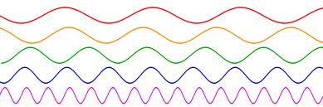
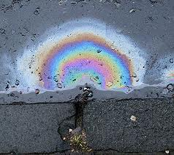
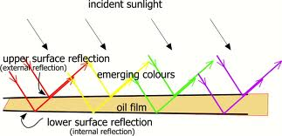
waves
700 nm
400 nm
The colors you see are constructively interfering.
Different thicknesses mean different wavelengths will constructively interfere.

