Slide 1
AcaDec
Science w/ Ms. Hendryx
3/27/12

Slide 2
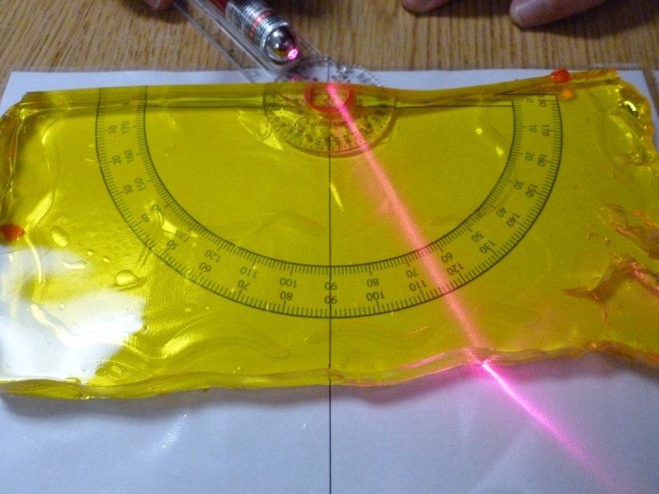
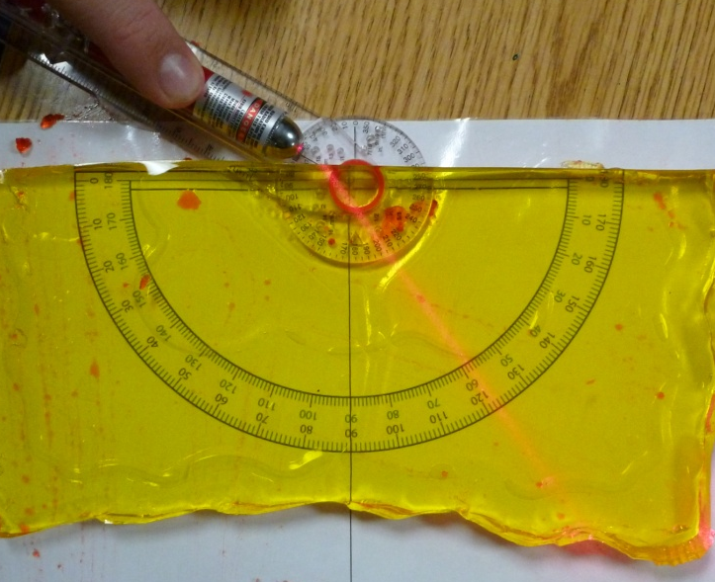
Calculating Jell-O’s Refractive Index
Snell’s Law:
Assume the index of air (n₁) is 1.
Using protractors and a laser pointer, students can calculate the index of refraction of Jell-O (n₂).

Slide 3
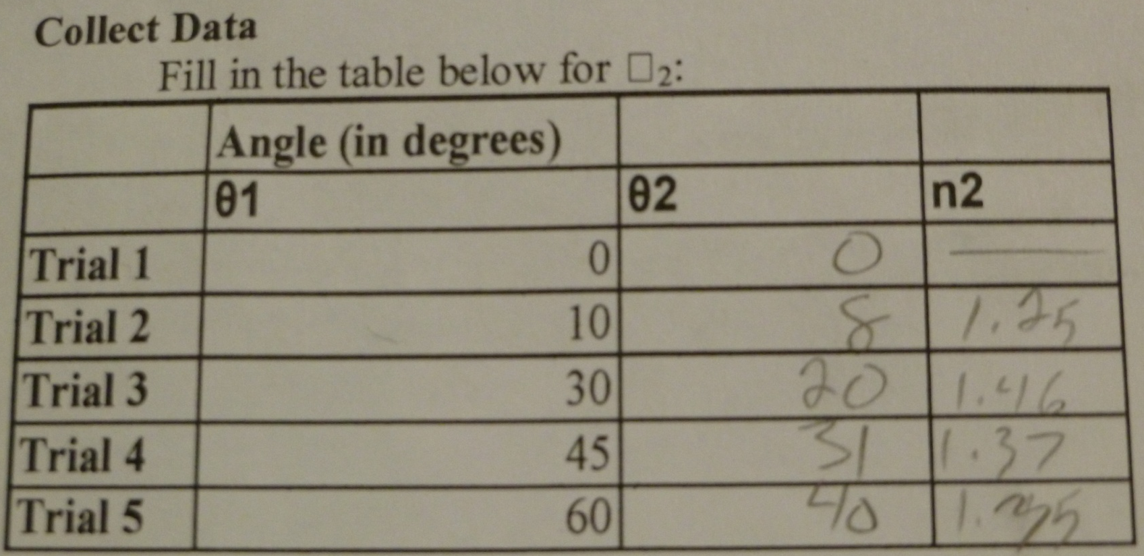
Calculating Jell-O’s Refractive Index: Student Work

Slide 4
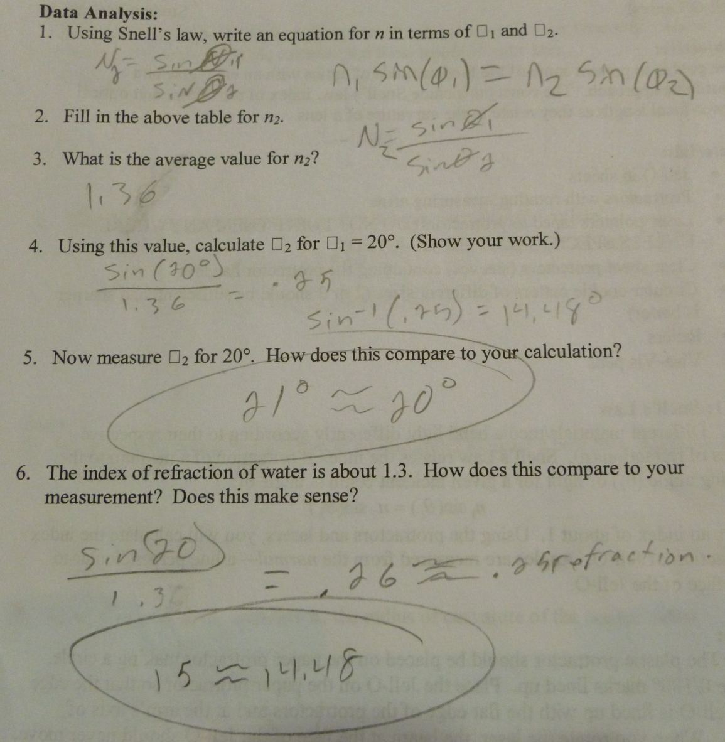
Calculating Jell-O’s Refractive Index: Student Work

Slide 5
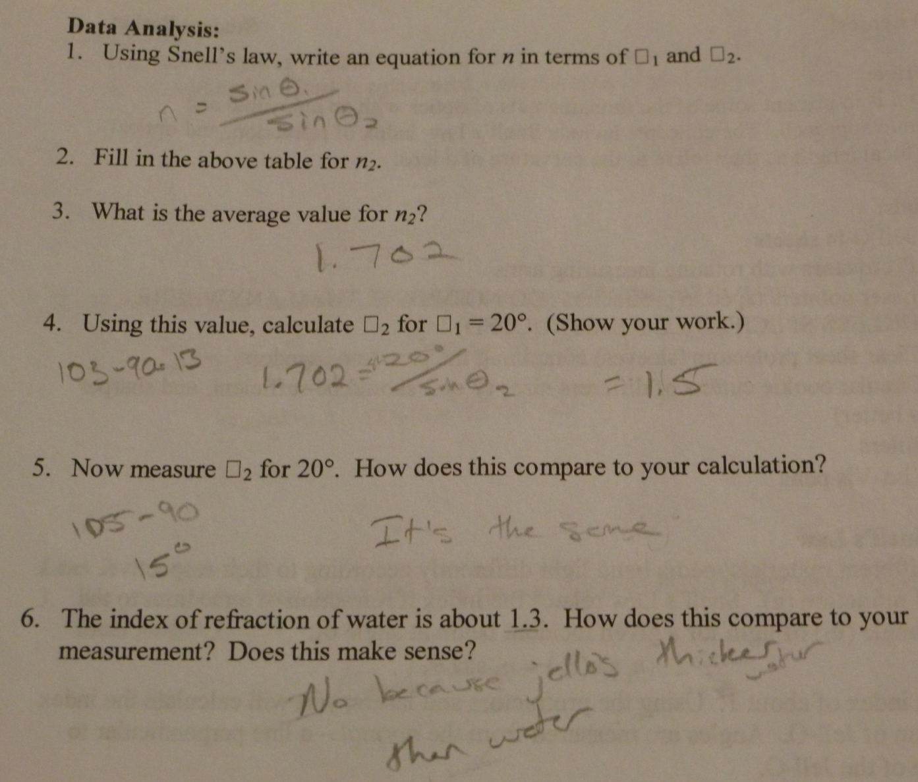
Calculating Jell-O’s Refractive Index: Student Work

Slide 6
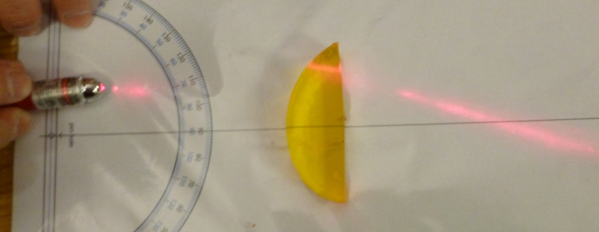
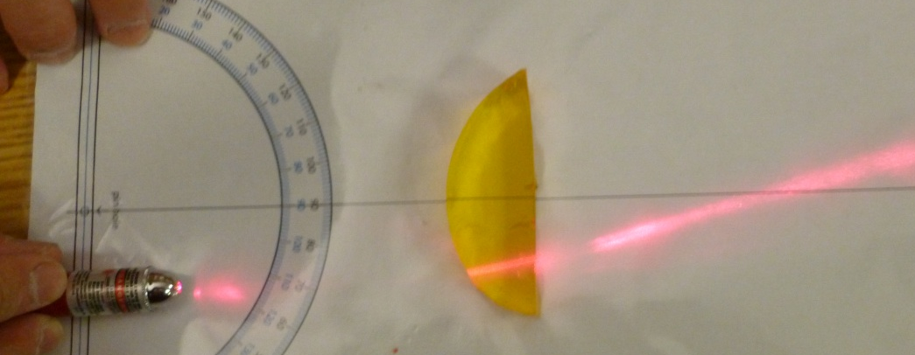
Calculating Focal Length using Radius of Curvature
Focal length, f is related to the radius of curvature, R, of a lens of index n via the following equation:
Students can measure f, and then verify their result using R and n_{Jell-O} that they have measured.
  This is easier than verifying R since there is more error in the focal length measurement.

Slide 7
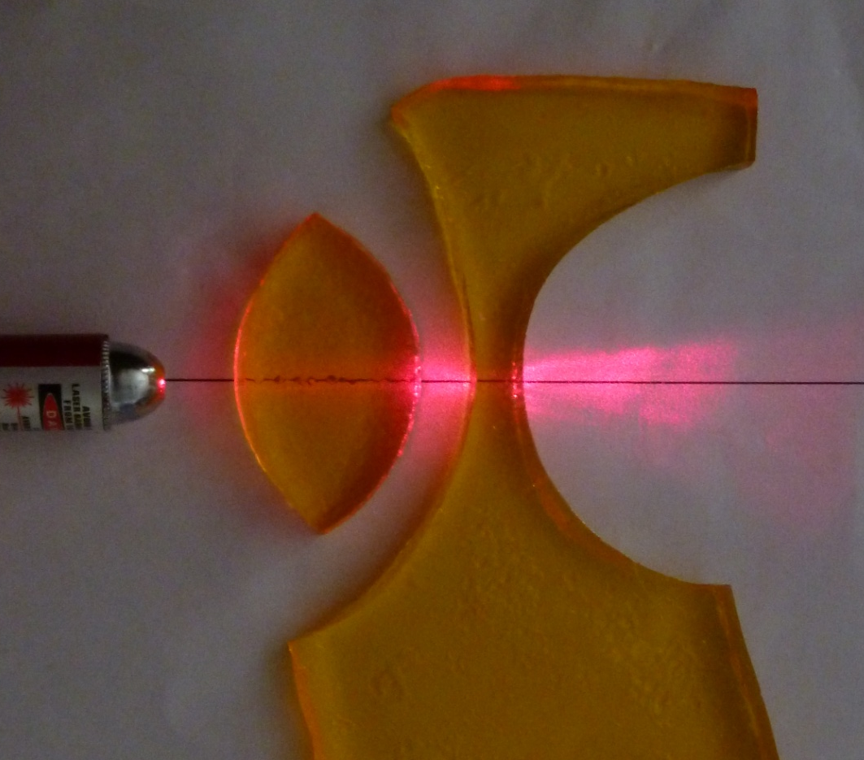
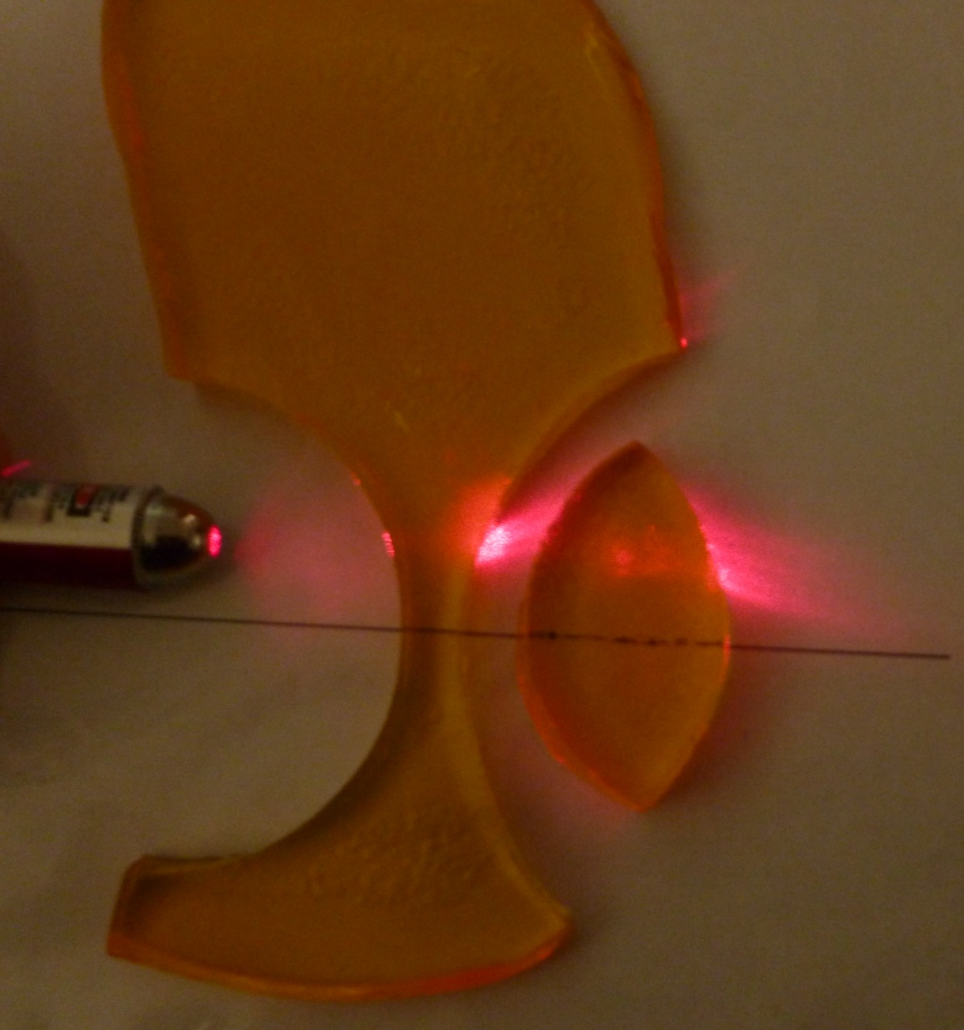
2-Lens System

Slide 8
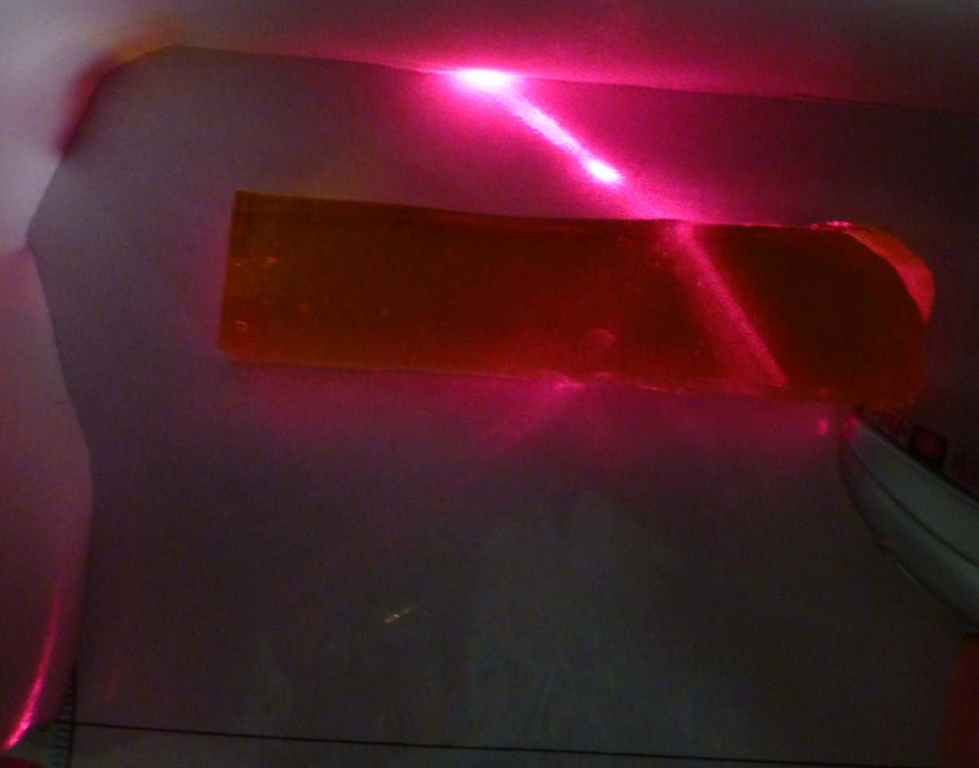
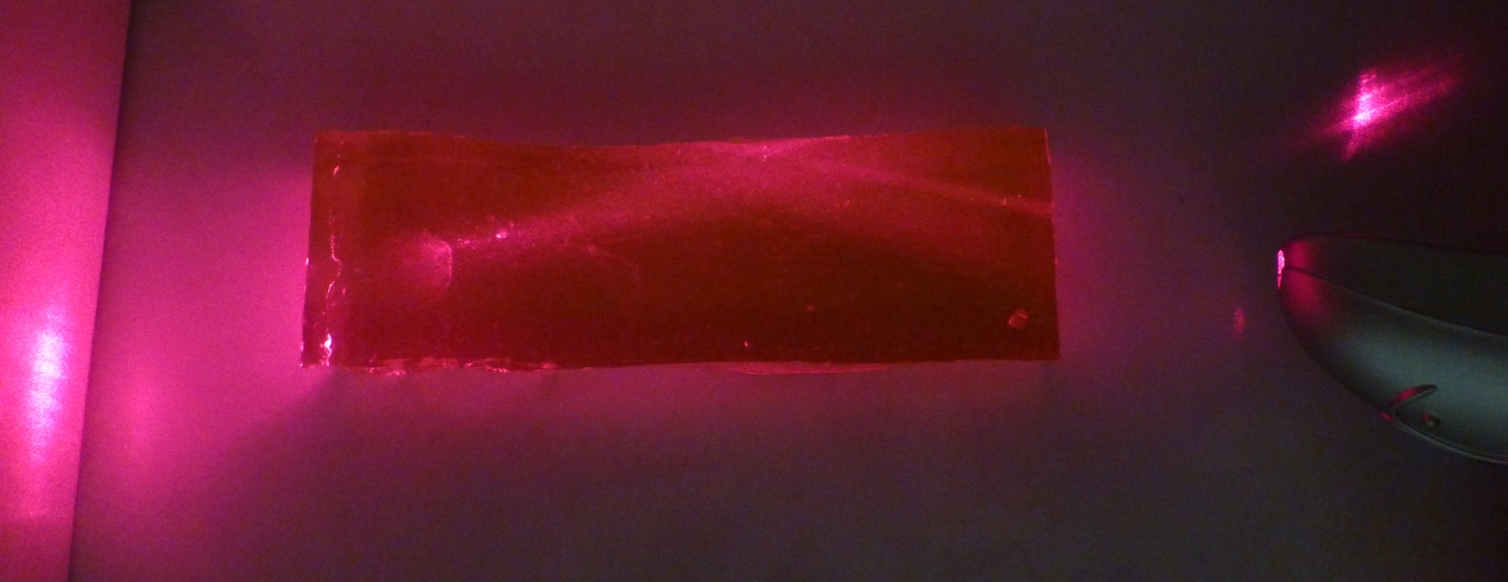
Internal reflection

