Slide 1
AcaDec
Science w/ Ms. Hendryx
9/22/11

Slide 2
Review units:
Velocity: m/s (distance over time)
Position: m (distance)
Acceleration: m/s² (distance over time squared)
Mass: kg
Force: N (mass x acceleration)
MEMORIZE!!!

Slide 3

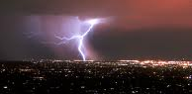
Energy:
Ability to DO something
Units: Joules
= N*m
= kg*m²/s²
Energy is a scalar quantity; it has no direction.
• Energy can be stored or used.
• Energy can be transferred (when it is used):
  Motion (WORK!)
  Light
  Sound
  Heat
  Electricity

Slide 4
Conservation of energy
Energy can’t be created or destroyed—it is conserved.
E_{f}=E_{i}
For now, we’re going to keep it simple: we’re only going to consider kinetic energy (KE) and potential energy (PE).
Sometimes we’ll only consider “systems”, or only part of the picture:
Your body
The universe

Slide 5
Kinetic energy:
Energy of Motion: KE = ½mv²
Example:
A car with a mass of 2,000 kg is traveling at 60 m/s: what is its energy?
Work = change in KE

Slide 6
Potential Energy:
Stored Energy: PE
Gravitational PE: PE = mgh
Example:
A ball with a mass of 2 kg is held 5 m above the ground: what is its energy?
If the ball is dropped, what is its speed when it hits the ground?

Slide 7
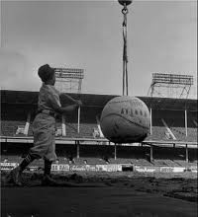
Momentum:
How hard it is to stop a moving mass
p = mv
(vector quantity—why?)
Units: kg*m/s—just like the equation!
What are we missing for this to look like units of Force?

Slide 8

Momentum:
Momentum is always conserved.
p_{f}=p_{i}
Momentum also adds.
Think of a pool table as your system. If you have 2 balls moving, the total momentum in the system is m₁v₁+m₂v₂. Consider the mass of each piece and how fast it is going.

Slide 9
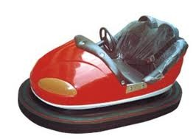
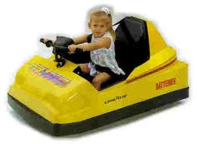
Momentum:
Let’s think bumper cars:
m = 500 kg
v = 0 m/s
m = 400 kg
v_{i} = 5 m/s
How fast is the red car going in the end?

Slide 10
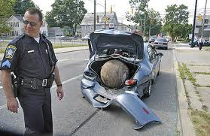
Inelastic collisions
Momentum is conserved, but KE and PE are not.

Slide 11
Momentum:
Let’s think bumper cars:
m = 500 kg
v = 0 m/s
m = 400 kg
v_{i} = 5 m/s
How fast are the cars going in the end?

Slide 12
Momentum:
Let’s think bumper cars:
m = 500 kg
v = 0 m/s
m = 400 kg
v_{i} = 5 m/s
How fast are the cars going in the end?

Slide 13
Combining Energy and momentum
They both have to be conserved!
They both deal with mass and velocity, which means one set of equations can be used to help solve the other.
Use them both!

