Slide 1
AcaDec
Science w/ Ms. Hendryx
12/6/11

Slide 2
Quiz #5
Write the 4 kinematic equations.
Estimate to the nearest order (power of 10):
  The number of meters in 1474 kilometers
  The number of meters in 36 millimeters
  The number of milligrams in a kilogram
What are the units of:
  Resistance?
  Current?

Slide 3
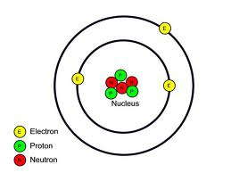
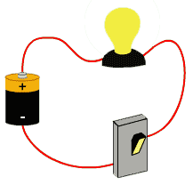
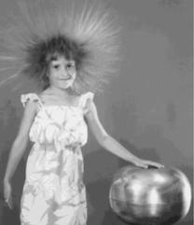
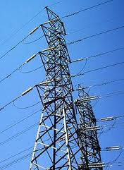
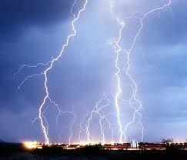
Electricity
  What do we know about electricity?

Slide 4
Electricity
  VOCABULARY:
  Charge, q
  Current, I
  Resistance, R
  Electric Potential (Voltage), V
  Capacitance, C
  An inherent measure of an object, + or - [Coulombs, C]
  The flow of charge [Amperes, Amps, A; A=C/s]
  Opposition to the flow of charge [Ohms, Ω]
  Electrical potential energy per charge [Volts, V]
  Ability of an object to hold stationary charge [Farads, F]

Slide 5
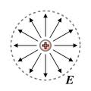
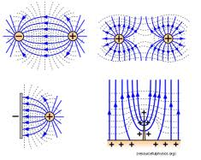
Electricity
+
(Acts on a charge to make it move)
Electrical Potential Energy
(How much the charge wants to move)

Slide 6
Electricity
Electric Potential
Voltage
(electrical energy per charge)
(Think of a mountain top—higher V is like a higher elevation)

Slide 7

Circuits:
  Symbols:
  Current
  Voltage bias (difference)
  Resistance
  Capacitance
I
+ -
ΔV
+ -
R
C

Slide 8
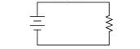
circuits
  Ohm’s Law:
ΔV = IR
ΔV=5 V
R = 100 Ω
I = ?
What direction does the current flow?

Slide 9
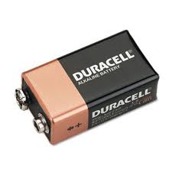
circuits
  Power Law:
  P = IΔV = I²R = ΔV²/R
  Units: Watts
A 9V battery in a circuit produces 45 mW of power.
What is the total current across the circuit?
What is the resistance in the circuit?

Slide 10
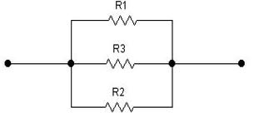
Kirchhoff’s Rules:
Rules we live by in Circuit Land:
The Junction Rule (Conservation of Charge):
When the circuit splits, so does the current.
I_{in} = I₁+I₂+…= I_{out}
It doesn’t have to split evenly!!!
I₁
I_{in}
I_{in}
I_{out}
=
I₂
I₃

Slide 11
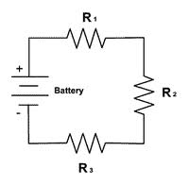
Kirchhoff’s Rules:
Rules we live by in Circuit Land:
2. The Loop Rule (Conservation of Energy):
The total voltage difference across a closed circuit (loop) is zero.
ΔV_{loop} = ΔV_{battery}+ΔV₁+ ΔV₂+…= 0
Treat every resistor as its own ΔV!!
ΔV₁
ΔV_{batt}
ΔV₂
=
+
+
ΔV₃

Slide 12
Circuits
ΔV = IR
R = ?
R = the “equivalent resistance”

Slide 13
circuits
ΔV = IR
R = ?
In series,
R = R₁ + R₂ + R₃ + …
I
V
In a closed loop, the voltages add, so
V = IR₁ + IR₂ + IR₃ +…

Slide 14
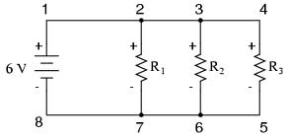
circuits
ΔV = IR
R = ?
In a closed loop, the voltages add to 0, so
ΔV = IR = I₁R₁ = I₂R₂ = I₃R₃
Currents add at junctions, so
I = I₁ + I₂
V/R = V/R₁ + V/R₂
In parallel,
(because the current is dividing)
I

Slide 15
circuits
C = Q/ΔV
C = Capacitance
Q = charge
ΔV = Voltage
ΔV
+ -
d
-
+
-
+
-
+
-
+
-
+
A

Slide 16
circuits
C = Q/ΔV
E = (1/2)C(ΔV)² = (1/2)QV
ΔV
+ -
Only charge from 1 plate
d
-
+
-
+
-
+
-
+
-
+
A

Slide 17
circuits
C = ε₀A/d
C = Capacitance
ε₀ = permittivity of free space
A = Area
d = Separation Distance
ΔV
+ -
d
-
+
-
+
-
+
-
+
-
+
A

Slide 18
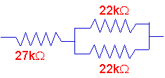
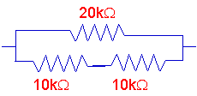
Practice:

