Slide 1
The Discriminant
Given a quadratic equation use the
discriminant to determine the nature
of the roots.

Slide 2
What is the discriminant?
The discriminant is the expression b² – 4ac.
The value of the discriminant can be used
to determine the number and type of roots
of a quadratic equation.

Slide 3
How have we previously used the discriminant?
We used the discriminant to determine
whether a quadratic polynomial could
be factored.
If the value of the discriminant for a
quadratic polynomial is a perfect square,
the polynomial can be factored.

Slide 4

Solve These…
Use the quadratic formula to solve each
of the following equations
x² – 5x – 14 = 0
2x² + x – 5 = 0
x² – 10x + 25 = 0
4x² – 9x + 7 = 0

Slide 5
Let’s evaluate the first equation.
x² – 5x – 14 = 0
What number is under the radical when
simplified?
81
What are the solutions of the equation?
–2 and 7

Slide 6
If the value of the discriminant is positive,
the equation will have 2 real roots.
If the value of the discriminant is a
perfect square, the roots will be rational.

Slide 7
Let’s look at the second equation.
2x² + x – 5 = 0
What number is under the radical when
simplified?
41
What are the solutions of the equation?

Slide 8
If the value of the discriminant is positive,
the equation will have 2 real roots.
If the value of the discriminant is a NOT
perfect square, the roots will be irrational.

Slide 9
Now for the third equation.
x² – 10x + 25 = 0
What number is under the radical when
simplified?
0
What are the solutions of the equation?
5 (double root)

Slide 10
If the value of the discriminant is zero,
the equation will have 1 real, root; it will
be a double root.
If the value of the discriminant is 0, the
roots will be rational.

Slide 11
Last but not least, the fourth equation.
4x² – 9x + 7 = 0
What number is under the radical when
simplified?
–31
What are the solutions of the equation?

Slide 12
If the value of the discriminant is negative,
the equation will have 2 complex roots;
they will be complex conjugates.

Slide 13
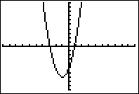
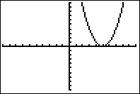
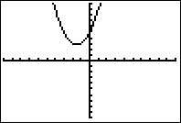
Let’s put all of that information in a chart.
Value of Discriminant | Type and Number of Roots | Sample Graph of Related Function
D > 0, D is a perfect square | 2 real, rational roots
D > 0, D NOT a perfect square | 2 real, Irrational roots
D = 0 | 1 real, rational root (double root)
D < 0 | 2 complex roots (complex conjugates)

Slide 14
Try These.
For each of the following quadratic equations,
Find the value of the discriminant, and
Describe the number and type of roots.
x² + 14x + 49 = 0 3. 3x² + 8x + 11 = 0
2. x² + 5x – 2 = 0 4. x² + 5x – 24 = 0

Slide 15
The Answers
x² + 14x + 49 = 0
D = 0
1 real, rational root
(double root)
2. x² + 5x – 2 = 0
D = 33
2 real, irrational roots
3. 3x² + 8x + 11 = 0
D = –68
2 complex roots
(complex conjugates)
4. x² + 5x – 24 = 0
D = 121
2 real, rational roots

Slide 16
Try These.
The equation 3x² + bx + 11=0 has one solution at x=1. What is the other solution?
Find the value of a such that the equation ax² + 12x + 11 = 0 has exactly one solution. What is that solution?
The equation x² + 243x – 7839 = 0 has two real solutions (why?). What is the sum of these two solutions? What is the product?

Slide 17

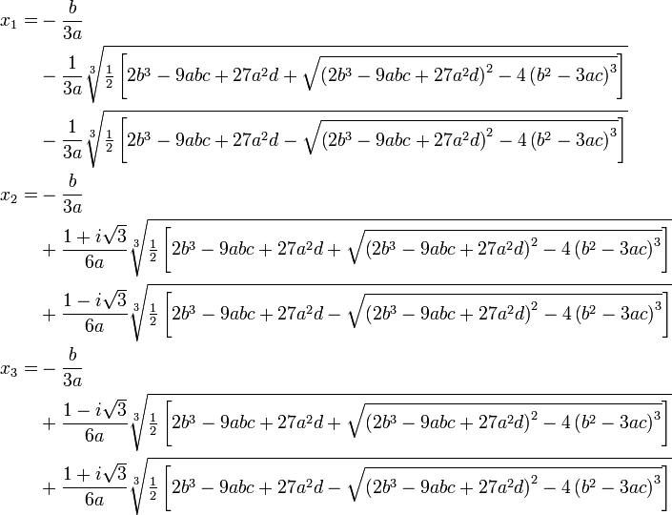
What about ax³+bx²+cx+d=0 ?

