Slide 1



Carolyn D. Reynolds
University of Arizona
College of Optical Sciences
Ph.D student
Hometown: Nathalie, VA
G-Teams Partner: Kelly Durfey
Mountain View High School

Slide 2
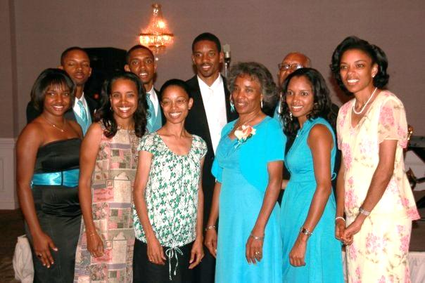
About Me
Youngest of 8 children
Father worked for the Dept. of Agriculture and mother was a mathematician
  all children pursued STEM degrees
B.S. in Optical Engineering and a minor in Mathematics
Long-term goals:
  Working in a research-driven company (recently interned at Brookhaven National Laboratory)
  Designing animated-educational videos similar to “School House Rock”
  Becoming the university president of my alma mater (Norfolk State University)
  Establishing a scholarship fund for minority students
  Opening an advanced tutoring center for students in grades K-6

Slide 3

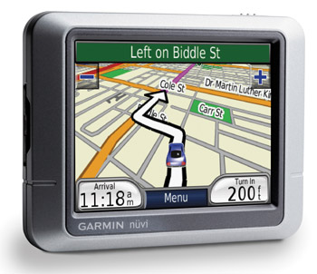






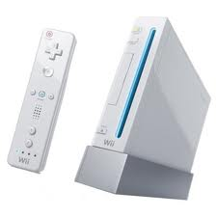


Research
Advisor: Dr. Robert Norwood
Goals:
    higher quality
    smaller
    cheaper
    energy efficient
Optical Communication

Slide 4
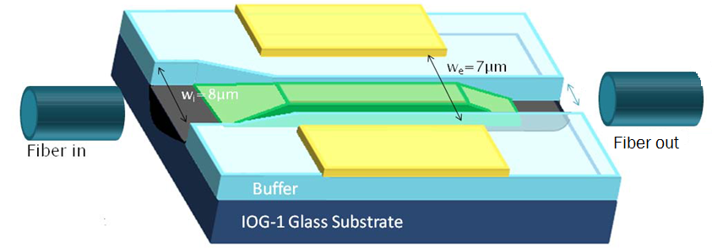
Communication Link
Modulator - device that prevents the signal from losing strength/information as it travels over an extended distance

Slide 5
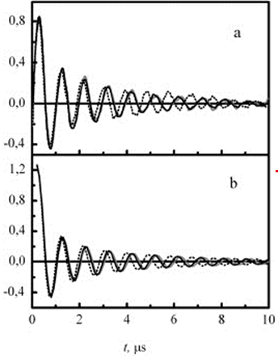

Disturbed water
Signal strength

Slide 6
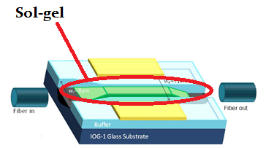
Methods
Phase I: Make modulator
Phase II: Test modulator for consistent results
Phase III: Test using various sol-gels

Slide 7
The World of
OPTICS

Slide 8

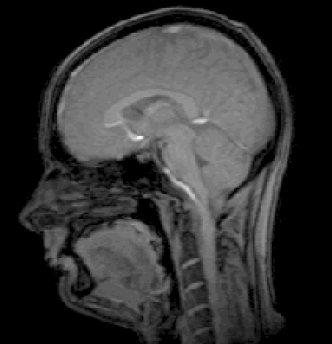
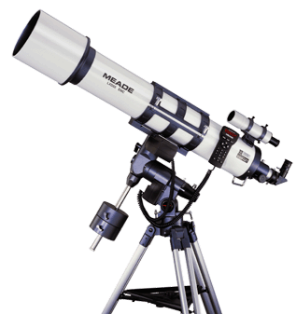

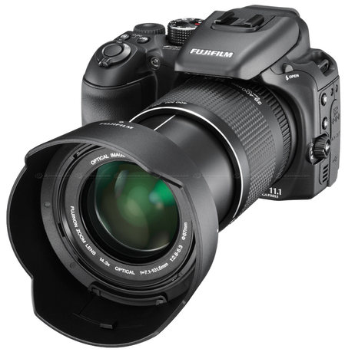

Optics
Solar Panels
Telescopes
Camera Systems
Medical Imaging
Lasers
Retina Displays

Slide 9


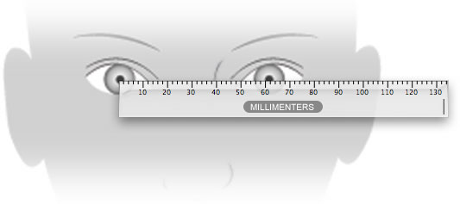
3D Images
Left
Right
Pupillary Distances
Adults: ~ 54-66 mm
Youth: ~ 41-55 mm

Slide 10
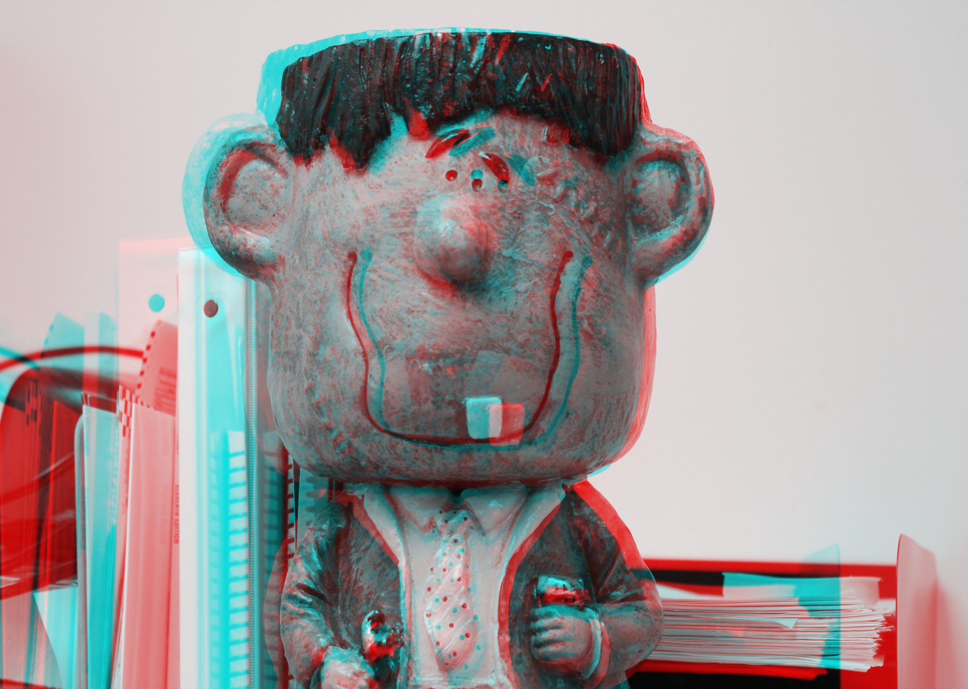

Slide 11
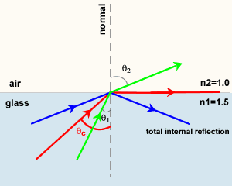
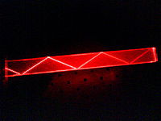
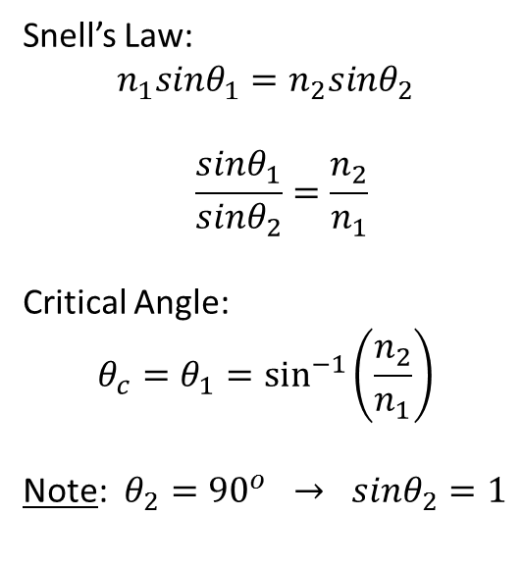
Total Internal Reflection (TIR)
Snell’s Law:
$$n_{1}sinθ_{1}=n_{2}sinθ_{2}$$
$$\frac{sinθ_{1}}{sinθ_{2}}=\frac{n_{2}}{n_{1}}$$
Critical Angle:
$$θ_{c}=θ_{1}=\sin^{−1}\left(\frac{n_{2}}{n_{1}}\right)$$
Note: $θ_{2}={90}^{o} → sinθ_{2}=1$

