Slide 1
Smarter Together! Rigorous Mathematics for All Students through Complex Instruction
Marcy Wood
Teaching, Learning, and Sociocultural Studies
mbwood@email.arizona.edu
G-TEAMS, December 2, 2013

Slide 2
Student Talk
Talk is essential to learning
Students learn best when they talk and work together
But student talk is frequently unproductive in part because some students talk too much and other students talk too little.

Slide 3
Reasons why students don’t talk
Language barrier
Lack of background knowledge
Personality

Slide 4
Reasons why students don’t talk
Language barrier
Lack of background knowledge
Personality
STATUS

Slide 5
Status
Notice the RANKING
Belief that some people are smarter and more worthy of being heard or directing activity than others. Thus those who seem smarter have more opportunities to get smarter and appear smarter!
Notice the OUTCOME
Notes:
When students are in groups, some people deserve, should talk more than others

Slide 6
Status
Belief that some people are smarter and more worthy of being heard or directing activity than others. Thus those who seem smarter have more opportunities to get smarter and appear smarter!
Unless you address the issue of who is seen as smart or good at math, you will always have students who don’t learn math.
Notes:
When students are in groups, some people deserve, should talk more than others

Slide 7
Being smart in math
What kinds of things do people who are smart in math do?

Slide 8
Being smart in math
What kinds of things do people who are smart in math do?
What kinds of things are valued in schools?

Slide 9
Being smart in math…
Is so much more than how we currently define it in school!

Slide 10
Being smart in math…
Is about DEVELOPING EXPERTISE
-- There is no math gene
-- 10,000 hours to expert

Slide 11
In order to help more students succeed at math
Need to change perceptions of smartness
  Broaden what it means to be smart in school
  Everyone is smart, has something to contribute, and has something to learn from others.

Slide 12
In order to help more students succeed at math
Need to change perceptions of smartness
  Broaden what it means to be smart in school
  Everyone is smart, has something to contribute, and has something to learn from others.

Slide 13
In order to help more students succeed at math
Need to change perceptions of smartness
  Broaden what it means to be smart in school
  Everyone is smart, has something to contribute, and has something to learn from others.
We often work on social responsibility for peers. We also need to work on intellectual responsibility for peers.

Slide 14
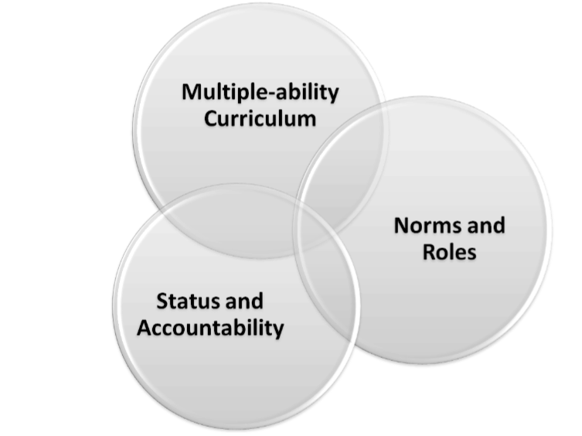
Complex Instruction (CI)
Cohen (1994)
Notes:
CI suggests that part of the problem to underperformance is underperformance – which arises from GROUP perceptions of individual’s competence. Addresses underperformance by starting with the premise that all students have mathematical strengths that can enrich the group and that we need to rethink what mathematics we value, how students (and teachers) interact, and how we draw out mathematical strengths.
Complex instruction (CI) is a combination of pedagogical strategies used to create a classroom “social system” that directly attends to problems of social inequality which undermine academic access and achievement if left unexamined. The complex instruction model aims to “disrupt typical hierarchies of who is ‘smart’ and who is not” (Sapon Shevin, 2004) and promotes equal-status interactions amongst students as they engage with tasks that have high cognitive demand within a cooperative learning environment. In particular, complex instruction addresses the central features of classrooms: curriculum, instruction, and classroom organization, which can construct failure for students or alternately change the situation so that more students are academically successful.

Slide 15
Complex Instruction (CI)
Participation objectives
Learning objectives
Cohen (1994)

Slide 16
Let’s Try a Task
Focus on aspects of the task that encourage everyone to participate in mathematics.
SPECIFICALLY consider how SMARTNESSES are emphasized.

Slide 17
Let’s Try a Task
6th grade task
Roles

Slide 18
This task requires
Logical reasoning
Visual reasoning
Making sense of pictures
Making sense of fractions, decimals, and percents
Thinking creatively
Ordering based on size
Finding connections
Communicating ideas
Relying on others
No one of us has all of these abilities yet. Each one of us has some of these abilities. Together your group has the abilities to solve this task.

Slide 19
Let’s Try a Task
Read task card
Materials on table

Slide 20
What about this activity supported all students in participating in rigorous content?

Slide 21
Conclusion
  Need to consider
    the ways in which labels of smart limit participation of students &
    how to help students see themselves and each other as smart
  No one is as smart as all of us together.

Slide 22
Conclusion
  2 books
  Cohen, E. (1994). Designing Groupwork, 2nd ed. New York: Teachers College Press
  Featherstone, H. F., Crespo, S., Jilk, L. M., Oslund, J., Parks, A., & Wood, M. B. (2011). Smarter Together! Collaboration and Equity in the Elementary Classroom, Reston, Va: NCTM.

