Slide 1

Learning about Learning. . . .
A Talk prepared for G-TEAMS and HEATWAVES
GK-12 Project Fellows
Debra Tomanek, Ph.D.
Associate Vice Provost, Instruction & Assessment
Professor, Molecular & Cellular Biology
Area of Scholarship: Science Education
11/18/2013

Slide 2
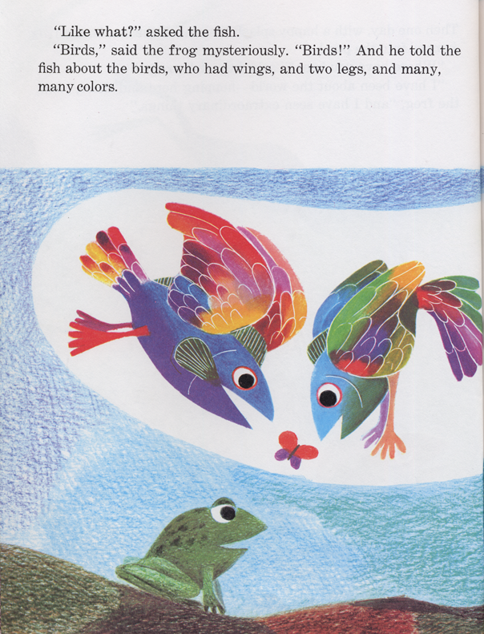

Slide 3
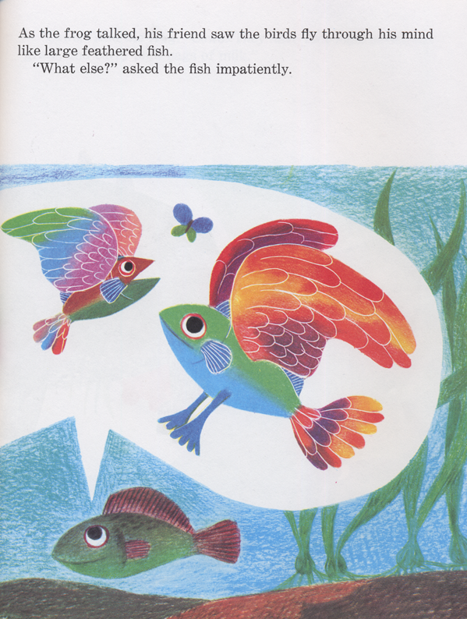

Slide 4
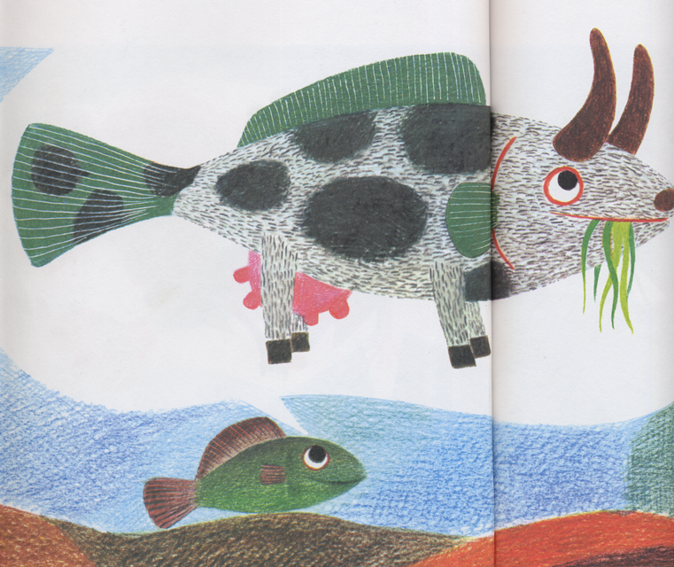

Slide 5
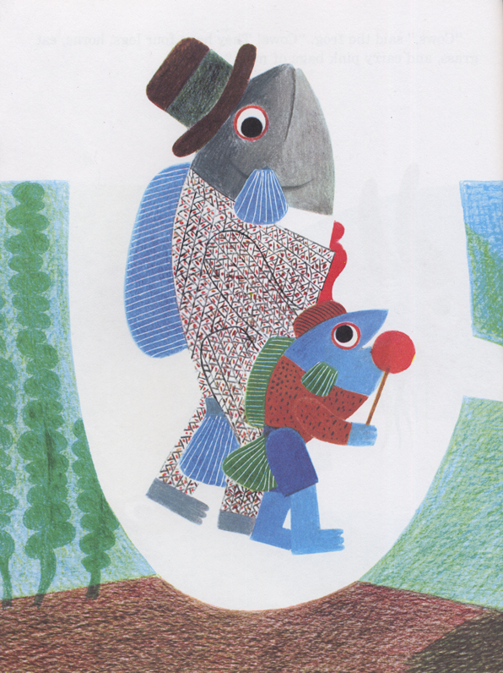

Slide 6
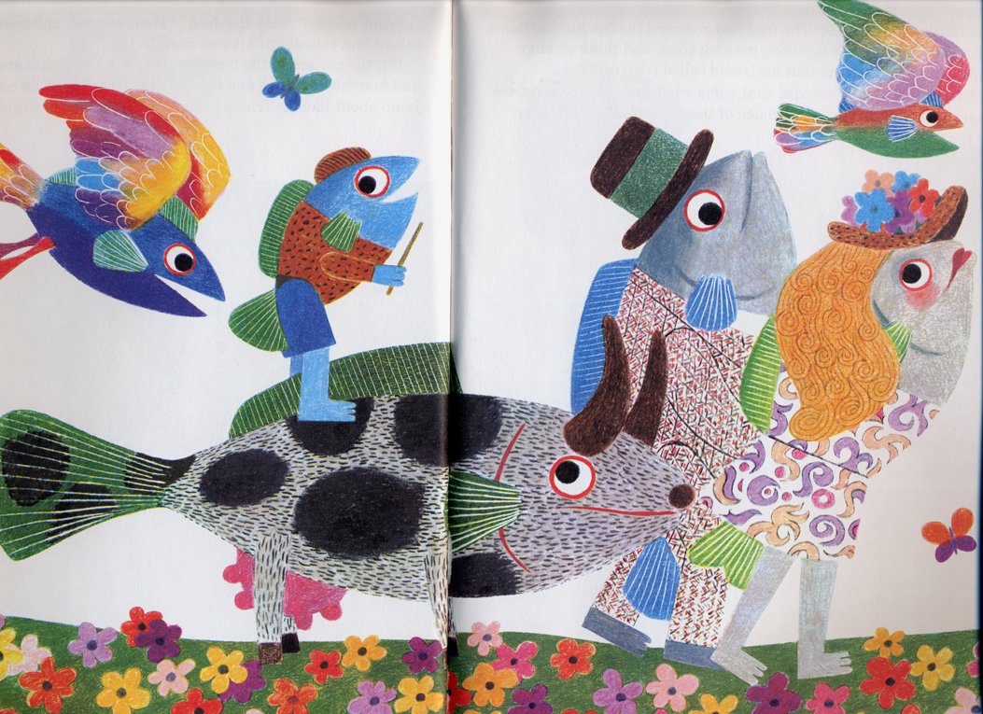

Slide 7
Quiz:
Was the frog a successful teacher?
Was the fish a successful learner?

Slide 8
Key findings from learning sciences research:
Finding #1: Initial learning must occur before successful TRANSFER of knowledge can occur.
Finding #2: TRANSFER does not always result in the “best” learning outcome (i.e., negative transfer).
Finding #3: Successful TRANSFER is influenced by the degree to which we learn with understanding rather than learn through memorization or following procedures.
Implication for us: Assessment of learning is a good thing.
Implication for us: It is difficult to correct wrong ideas without regularly checking for understanding.
Implication for us: Students need opportunities to practice using their learned ideas.

Slide 9
Memory Task
You will be shown some images on the next slide for a brief period of time. Have a pen and scratch paper handy, but no writing until I tell you to write. No cheating!

Slide 11
Make a list of all the images that you remember.

Slide 13
Memory
“Chunking” is a strategy used by even young children. If young children recognize the category, they can often recall as many items as adults (Linberg, 1980; Brown and Lawton, 1977). Knowledge, and not age, is the variable that affects successful chunking. Age becomes a factor only if the categories are not recognized by the person.
What other strategies are used by children (and adults)
to process information and to remember?
Rehearsal
Elaboration
Summarization

Slide 14
Key findings from learning sciences research: (cont.)
Finding #4: The success of time-on-task in promoting TRANSFER depends on how the time is used. Successful TRANSFER is promoted by tasks that provide opportunities for:
(1) pattern recognition,
(2) information processing, or
(3) creation of relevant connections.
Finding #5: Successful TRANSFER is also affected by the use of learning strategies compatible with the practice of metacognition. These strategies include:
deliberate practice
identification of the implications of learning
contrasting cases
  Examples:
  linear vs. nonlinear functions
  chemical vs. physical changes in matter
Can you think of some implications of findings #4 and #5 for your work with kids in schools?

Slide 15

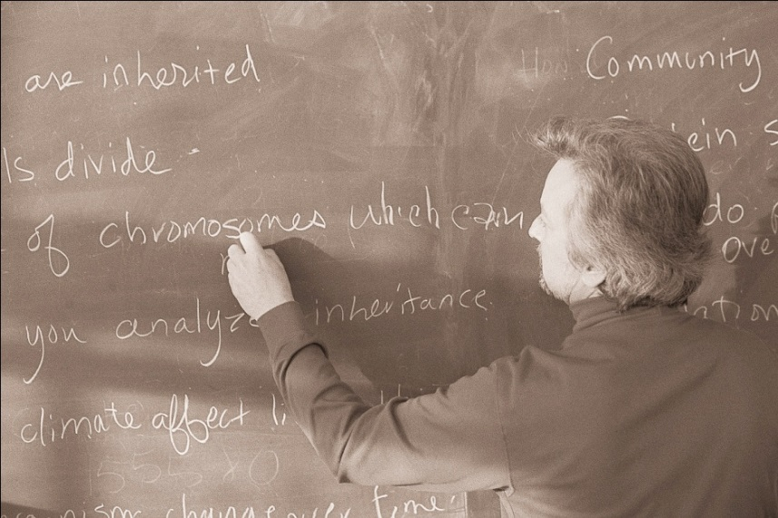
Why study expertise?
Studying examples of expertise
shows us what successful learning looks like.

Slide 16

Why study
expertise?
Studying how experts’ knowledge is organized informs our thinking about how to help our students gain more expert-like understandings of science and mathematical concepts.

Slide 17

Key findings from learning sciences research: expertise
On experts and problem-solving. . .
Question: Your bike breaks down on a recent ride. The gears seem to have stopped working. You decide to fix it yourself. What do you do first?

Slide 18

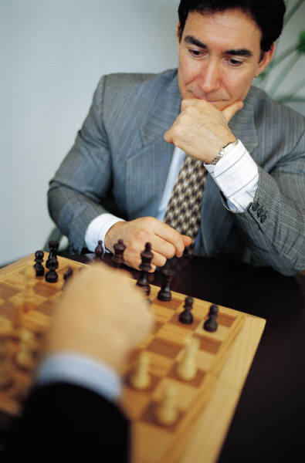

Finding #6: “Because of their ability to see patterns of meaningful information, experts begin problem solving at ‘a higher place’.” Experts’ recognition of patterns appears to trigger access to relevant knowledge.

Slide 19
Finding #7: Experts’ knowledge is organized into “big ideas” that allow experts to see and retrieve sets of appropriate information rather than isolated facts.
Examples from studies of learning?

Slide 20
Understanding and Problem Solving
In mathematics, experts are more likely than novices to first try to understand problems, rather than simply attempt to plug numbers into formulas. Experts and students in one study (Paige and Simon, 1966) were asked to solve algebra word problems, such as:
  A board was sawed into two pieces. One piece was two-thirds as long as the whole board and was exceeded in length by the second piece by four feet. How long was the board before it was cut?
The experts quickly realize that the problem as stated is logically impossible. Although some students also come to this realization, others simply apply equations, which results in the answer of a negative length.
A similar example comes from a study of adults and children (Reusser, 1993), who were asked:
There are 26 sheep and 10 goats on a ship. How old is the captain?
Most adults have enough expertise to realize that this problem is unsolvable, but many school children didn't realize this at all. More than three-quarters of the children in one study attempted to provide a numerical answer to the problems. They asked themselves whether to add, subtract, multiply, or divide, rather than whether the problem made sense. As one fifth-grade child explained, after giving the answer of 36: "Well, you need to add or subtract or multiply in problems like this, and this one seemed to work best if I add" (Bransford and Stein, 1993:196).

Slide 21
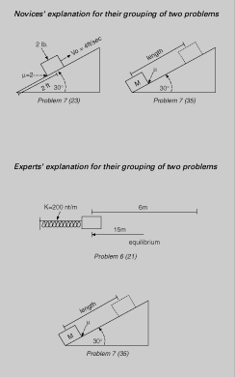
FIGURE 2.4
 |  | Explanations Novice 1: These deal with blocks on an incline plane. Novice 5: Incline plane problems, coefficient of friction. Novice 6: Blocks on inclined planes with angles.
 |  | Explanations Expert 2: Conservation of energy. Expert 3: Work-theory theorem. They are all straight-forward problems. Expert 4: These can be done from energy considerations. Either you should know the principle of conservation of energy, or work is lost somewhere. An example of sortings of physics problems made by novices and experts. Each picture above represents a diagram that can be drawn from the storyline of a physics problem taken from an introductory physics textbook. The novices and experts in this study were asked to categorize many such problems based on similarity of solution. The two pairs show a marked contrast in the experts' and novices' categorization schemes. Novices tend to categorize physics problems as being solved similarly if they "look the same" (that is, share the same surface features), whereas experts categorize according to the major principle that could be applied to solve the problems. SOURCE: Adapted from Chi et al.(1981).

Slide 22

Bottom line on experts, problem-solving, and meaningful patterns. . . . .
Research on expertise suggests the importance of providing students with learning opportunities that enhance their abilities to recognize meaningful patterns of information and to organize those patterns into sets of ideas. . . “big ideas.” (Simon, 1980; Bransford et al., 1989)
Talking Point: What might such “opportunities” look like in a math or science class?

