Slide 1

Depth of Knowledge & Common Core
Claudia Gaxiola
October 14, 2013

Slide 2
OUTCOMES
Significance of DOK / Bloom’s
Rigor and Common Core State Standards
  Implications for instruction

Slide 3

What is Rigor?
Do you have a solid definition?
Notes:
WG Discussion

Slide 4
…as defined by Mr. Webster
Harsh inflexibility in opinion, temper, or judgment: severity
The quality of being unyielding or inflexible: strictness
Severity of life: austerity: an act or instance of strictness, severity, or cruelty
A tremor caused by a chill
A condition that makes life difficult, challenging, or uncomfortable
Strict precision; exactness
Rigidity, stiffness; rigidness or torpor of organs or tissue that prevents response to stimuli
Notes:
Equate to a rigorous workout

Slide 5
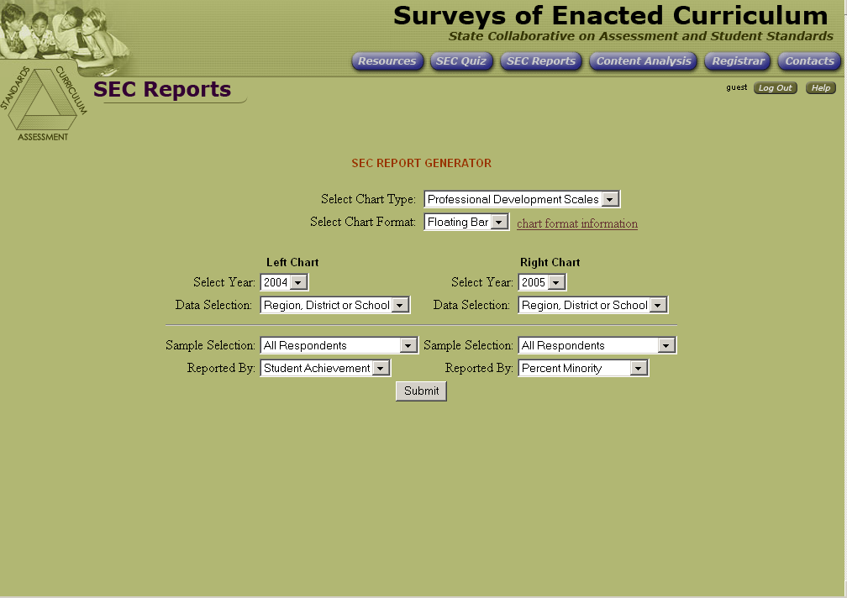
Expectations for Student Performance (Cognitive Demand)
Acquire
Use
Extend
Student Knowledge
Notes:
What is cognitive demand and Why is it important?
The CCSS brought with it increased rigor of both what students should know and be able to do.
Row 1 Students Acquire, Use and Extend their knowledge
For example, in this module we are showing how the first row may be defined or explained as:
Acquire: basic information about the Crosswalk document.
Use the information to determine the connections from old standards to new
Extend the new learning to other situations (training, etc.) and increase capacity and creativity.

Slide 6
Expectations for Student Performance (Cognitive Demand)
Acquire
Use
Extend
Recall
Skill/Concept
Strategic
Thinking
Extended
Thinking
Webb’s Depth of Knowledge
Notes:
Row 2 Performance and demonstration of knowledge and understanding
Depth of Knowledge
Recall
Skill/Concept
Strategic Thinking
Extended Thinking
This row often deals with assessment and performance tasks.
For example, in a few minutes we are going to play a game where you will be using and extending some the information acquired not just in this session, but also from years of experience too. As you progress in the game, consider how this row influences your performance.

Slide 7
Expectations for Student Performance (Cognitive Demand)
Acquire
Use
Extend
Recall
Skill/Concept
Strategic
Thinking
Extended
Thinking
Memorize/Recall
Perform
Procedures
Generate/
Demonstrate
Analyze/
Investigate
Evaluate
5 Categories of Cognitive Demand
Notes:
Row 3 Five categories. These are the Cognitive Demand Categories.
How can educators use Cognitive Demand?
Our understanding of cognitive demand helps teachers:
Better understand the intricacies of the standards.
Design lessons that are more rigorous.
LEA and site leadership can use cognitive demand to observe where teachers may be “stuck” or require additional professional development.

Slide 8
Expectations for Student Performance (Cognitive Demand)
Acquire
Use
Extend
Recall
Skill/Concept
Strategic
Thinking
Extended
Thinking
Memorize/Recall
Perform
Procedures
Generate/
Demonstrate
Analyze/
Investigate
Evaluate
Remember
Understand
Apply
Analyze
Evaluate
Create
Bloom’s Taxonomy
Notes:
For example, in this module we are showing how the first row may be defined or explained as:
Acquire: basic information about the Crosswalk document.
Use the information to determine the connections from old standards to new
Extend the new learning to other situations (training, etc.) and increase capacity and creativity.
Row 2 Performance and demonstration of knowledge and understanding Depth of Knowledge Chart is behind the ACTIVITIES and HANDOUTS TAB for Module 3
Recall
Skill/Concept
Strategic Thinking
Extended Thinking
This row often deals with assessment and performance tasks. For example, we are going to play a game where you will be using and extending some the information acquired not just in this session, but also from years of experience too. As you progress in the game, consider how this row influences your performance.
Row 3 Five categories. These are the Cognitive Demand Categories.
How can educators use Cognitive Demand?
Our understanding of cognitive demand helps teachers:
Better understand the intricacies of the standards.
Design lessons that are more rigorous.
LEA and site leadership can use cognitive demand to observe where teachers may be “stuck” or require additional professional development.

Slide 9
Expectations for Student Performance (Cognitive Demand)
Acquire
Use
Extend
Recall
Skill/Concept
Strategic
Thinking
Extended
Thinking
Memorize/Recall
Perform
Procedures
Generate/
Demonstrate
Analyze/
Investigate
Evaluate
Remember
Understand
Apply
Analyze
Evaluate
Create
Rigor Increases and Overlaps
Notes:
For example, in this module we are showing how the first row may be defined or explained as:
Acquire: basic information about the Crosswalk document.
Use the information to determine the connections from old standards to new
Extend the new learning to other situations (training, etc.) and increase capacity and creativity.
Row 2 Performance and demonstration of knowledge and understanding Depth of Knowledge Chart is behind the ACTIVITIES and HANDOUTS TAB for Module 3
Recall
Skill/Concept
Strategic Thinking
Extended Thinking
This row often deals with assessment and performance tasks. For example, we are going to play a game where you will be using and extending some the information acquired not just in this session, but also from years of experience too. As you progress in the game, consider how this row influences your performance.
Row 3 Five categories. These are the Cognitive Demand Categories.
How can educators use Cognitive Demand?
Our understanding of cognitive demand helps teachers:
Better understand the intricacies of the standards.
Design lessons that are more rigorous.
LEA and site leadership can use cognitive demand to observe where teachers may be “stuck” or require additional professional development.

Slide 10
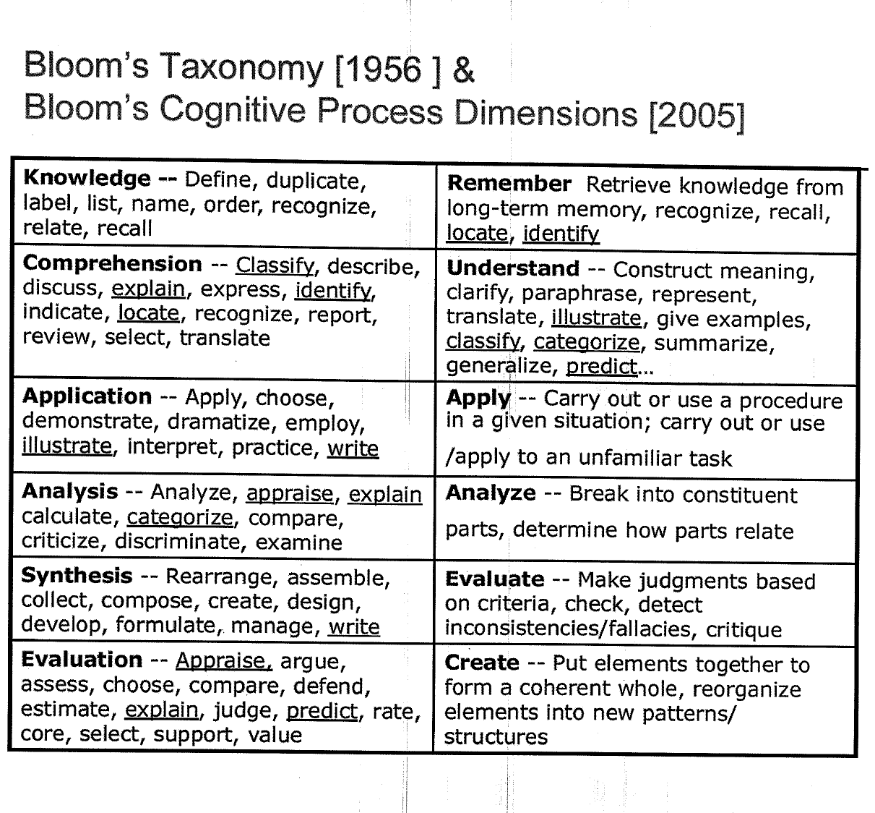
Notes:
What changed? How did the taxonomy evolve?
“Bloom (1956) developed a classification of levels of intellectual behavior important and learning.”
“The taxonomy was created to enable categorization of the levels of abstraction of questions that commonly occur in educational settings.”
“Bloom found that over 95% of test questions students encountered at the college level required them to think only at the lowest possible level: the recall of information.”
This led to the identification of a hierarchy of six levels that increased in complexity and abstraction.
“While educators have found such verb cues of Bloom’s Taxonomy levels to be useful in guiding teacher questioning, verbs often appear at more that one level in the taxonomy and often the verb alone is inadequate for determining the actual cognitive demand required to understand the content addressed in a test question or learning activity.”
Column 2:
“In 2001, Anderson, Krathwohl, et al. presented a structure for rethinking Bloom’s Taxonomy.”
The revised taxonomy applied 2 dimensions – “cognitive processes and knowledge.”
“Placement on the continuum has changed slightly.”
Descriptions have been expanded and better differentiated for analyzing educational objectives.”
“This restructuring of the original taxonomy recognized the importance of the interaction between the content taught-characterized by factual, conceptual, procedural, and metacognitive knowledge – and the thought processes used to demonstrate learning.”
Hess, K, et.al., What exactly do “fewer, clearer, an higher standards” really look like in the classroom. 2009
Guided Notes:
Bloom’s Taxonomy [1956] &
Bloom’s Cognitive Process Dimensions [2005]

Slide 11
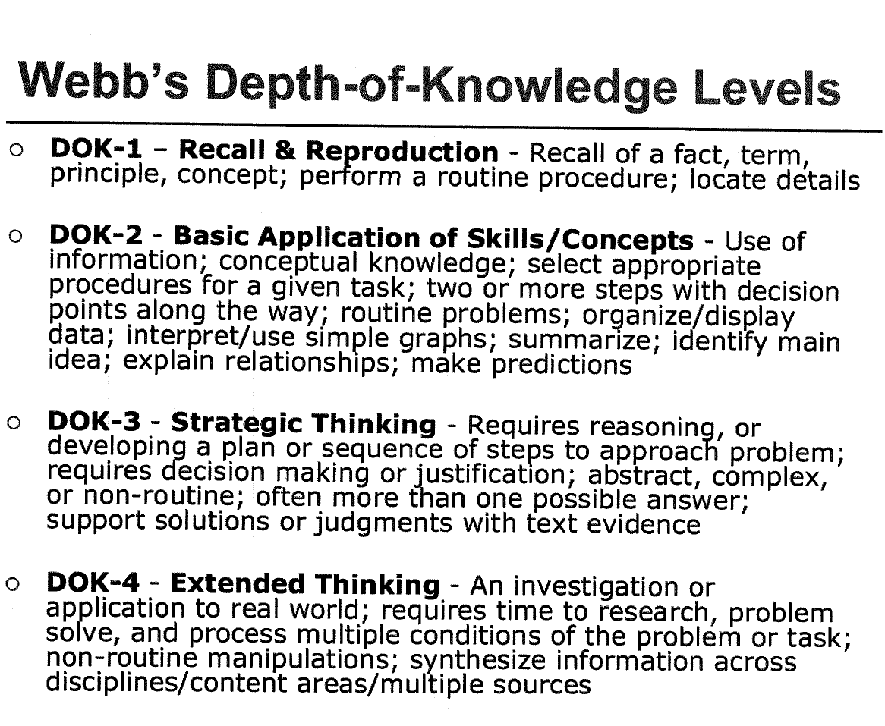
Karin K. Hess, Ed.D., Senior Associate
National Center for Assessment, Dove, NH
khess@nciea.org
Notes:
Presenter Notes: DOK 1 & 2 are usually “a right answer” questions level.
“Depth of knowledge forms another important perspective of cognitive complexity.”
“The best known work in the area of depth of knowledge is that of Norman Webb (1997, 1999).”
“The complexity of both the content (e.g., simple vs. complex data displays; interpreting literal vs. figurative language) and the task required (e.g., solving routine vs. non-routine problems) are used to determine DOK levels.”
“DOK levels describe four different and deeper ways a student might interact with content (2002)”.
Depth of knowledge levels do not necessarily correlate to the commonly understood notion of difficulty.
“For example, a DOK-1 activity might ask student to restate a simple fact or a much more abstract theory, the latter being much more difficult to memorize and restate. Neither of these DOK-1 tasks asks for much depth of understanding of the content. On the other hand, greater depth is required to explain how or why a concept or rule works (DOK 2), to apply it to real-world phenomena with justification or supporting evidence (DOK-3), or to integrate a given concept with other concepts or other perspectives (DOK-4)”
Teachers need to develop the ability to design instruction, and create units of study/curriculum and classroom assessments for a greater range of cognitive demand.
Hess, K, et.al., What exactly do “fewer, clearer, an higher standards” really look like in the classroom. 2009
Guided Notes:
Bloom’s Taxonomy [1956] & Bloom’s Cognitive Process Dimensions [2005]
Slide 79
See Handout

Slide 12
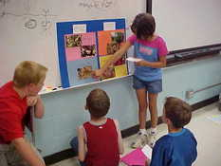
Depth of Knowledge
Does not measure difficulty, rather complexity
Making a question “harder” does not make it more complex or give it a higher DOK number
Notes:
*Use Final Jeopardy example: always DOK 1 (recall) even though the level of difficulty is often quite high.
*Complexity: What does student need to know in order to process complexity of concept (analysis, problem solving,etc.)

Slide 13
Depth of Knowledge (Webb)
Bloom’s Taxonomy
Recall
Skill & Concept
Strategic Thinking
Extended Thinking
Degree of understanding “Cognitive Demand”
Knowledge
Comprehension
Application
Analysis
Evaluate & Create
Progression of the development of intellectual skills
*Verb
Notes:
DOK is NOT determined by VERB, but the context in which the verb is used and the depth of thinking required, whereas Blooms is more about the verb that describes what the child is doing.
*DOK focuses on the degree of understanding a child needs to respond or process an assessment item/standard
*Blooms focuses on the progression of the development of intellectual skills

Slide 14
DOK Level 1 - Recall
Recall of a fact, definition, information, or performance of a simple process or procedure.
  Example: Solve a linear expression
  5(4x+9)
  (DOK Level 1, yet Blooms Level 3)
Notes:
Notice that the verb does not always match high level of DOK/Blooms

Slide 15
DOK Level 2 – Skill & Concept
Use information or conceptual knowledge; two or more steps; make decisions about how to approach in a new situation without support.
  Example: Predict a logical outcome based on information in a new reading selection
Notes:
Without scaffolding

Slide 16
DOK Level 3 – Strategic Thinking
Requires reasoning, developing plan, some complexity, more than one possible answer; generates discussion; requires student to justify answer
  Example: Solve a multi-step problem & provide a mathematical explanation to justifying answer

Slide 17
DOK Level 4 – Extended Thinking
Requires an investigation; high cognitive demand; time to think and process multiple conditions of the problem
  Example: Evaluate and defend multiple perspectives across time periods, events, or cultures

Slide 18
The Hess Cognitive Rigor Matrix
Applying Webb’s Depth-of-Knowledge Levels to Bloom’s Cognitive Process Dimensions-ELA
Karen Hess-Full Version 23 minutes
Karen Hess-Short Version 2.5 minutes
https://vimeo.com/20998609
Karin K. Hess, Ed.D., Senior Associate
National Center for Assessment, Dove, NH
khess@nciea.org
Notes:
Ask Participants to remove all items after the pink sheet from behind this tab.
http://vimeo.com/21111138
http://vimeo.com/20998609

Slide 19
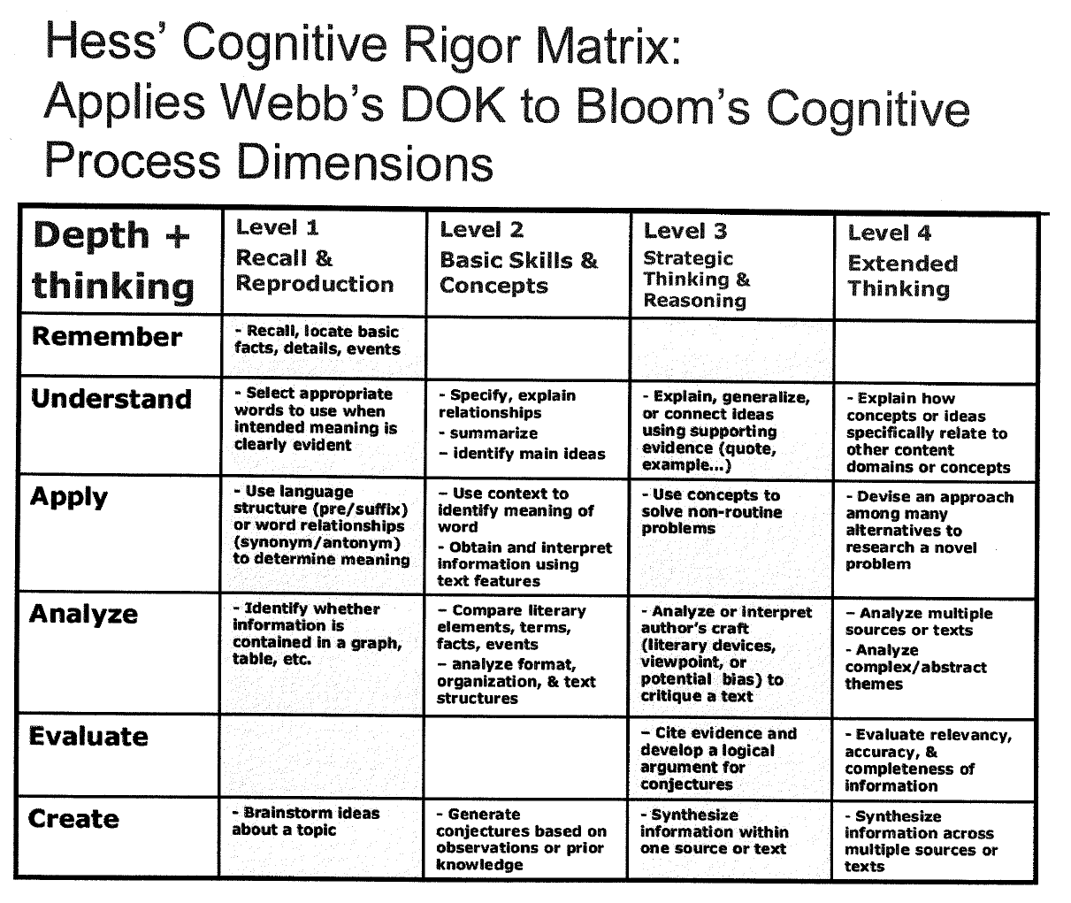
Karin K. Hess, Ed.D., Senior Associate National Center for Assessment, Dove, NH khess@nciea.org
Notes:
Handout!!!
The title in the first column may be confusing. Depth refers to the Depth of Knowledge going across the grid and think refers to Bloom’s Cognitive Process Dimensions (Revised Taxonomy)
Give participants a minute to look over the chart. What looks familiar?

Slide 20
Developing the Cognitive Rigor Matrix
Bloom
  What type of thinking (verbs) is needed to complete a task?
Webb
  How deeply do you have to understand the content to successfully interact with it?
  How complex or abstract is the content?
Karin K. Hess, Ed.D., Senior Associate
National Center for Assessment, Dove, NH
khess@nciea.org
Notes:
Different states/schools/teachers use different models to describe cognitive rigor. Each may address something different.

Slide 21
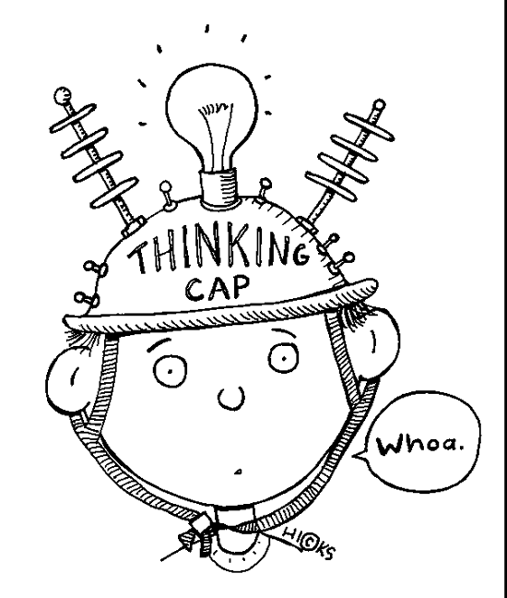
Let’s practice using the CRM
For this activity you will need:
Cognitive Rigor Matrix (CRM)
DOK Wheel and Cards
Karin K. Hess, Ed.D., Senior Associate
National Center for Assessment, Dove, NH
khess@nciea.org
Notes:
CRM is the acronym for Cognitive Rigor Matrix
Cognitive Rigor Matrix
Bloom’s Cognitive Process Dimensions
Presenter will read several of the participants’ Red Riding Hood questions. Using the blank CRM poster, the group will decide where to place the question on the matrix.

Slide 22
DOK Wheel
Number off 1’s & 2’s with a partner
Using Number 1’s packet, quickly discuss what level each card represents
Place your cards over the level you think the description might fit best
You have 1 minute
Notes:
I will provide explicit instructions;

Slide 23
LET’S CHECK!
Notes:
Kathi, this is for you….Check? Czech?

Slide 24
L1 - Recall
List animals that survive by eating other animals
L4
Extended Thinking
L2
Skill & Concept
Write and produce an original play
Compare desert and tropical environments
L3
Strategic Thinking
Propose and evaluate solutions for an economic problem

Slide 25
LET’S PRACTICE
AGAIN!

Slide 26
Hess CRM
With a partner, take turns analyzing the questions you scripted.
For each question, decide where it falls using and Hess’ CRM
On a post-it note, decide how you can increase the rigor using CRM as a guide
We will share out if time allows
Notes:
I will provide explicit instructions;

Slide 27
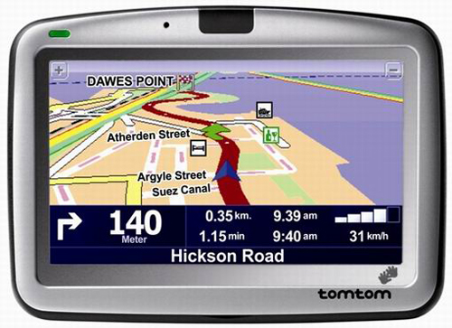
College and Career Ready
High School
Middle School
Elementary
School
Pre-Kindergarten
Arizona State Academic Content Standards
27
Notes:
27

Slide 28
Why Common Core?
College and Career Readiness
Educational Equity Across States
Globally Competitive Students
Notes:
Developed & Adapted in order to: talk about how many states are part of our consortia: 41 states (Race To the Top grant)

Slide 29
Benefits
Progression of increased complexity from grade to grade
Depth in content and application of higher-order skills
Allows collaborative professional development based on best practices
Notes:
Avoid mile wide, inch deep trends; collaboration within consortia

Slide 30
Planning With “End In Mind”
What do I want students to know and be able to do?
What do they need to know in order to be successful?
How canI know if students have achieved the desired result and what do I do if they didn’t?
Notes:
Investigations, which Grijalva adopted, does a great job aligning with common core, UBD/Constructivist Approach

Slide 31
“We cannot always build the future for our youth, but we can build our youth for the future.”
President Franklin D. Roosevelt

Slide 32
Questions/Comments

