Slide 1

The Pythagorean Theorem through the Common Core
Marcus Achord
Elaine Watson

Slide 2
As a high school math teacher what changes can I expect from the CCSS?
Several topics traditionally introduced in high school are now being introduced in middle school mathematics.
By understanding the progression of these topics introduced in earlier grades, high school teachers:
  will be able to focus on the more in-depth high school applications and extensions of these topics
In this presentation, we will focus on how the Pythagorean Theorem and its supporting concepts are first introduced in middle school and how the concept unfolds in high school.

Slide 3
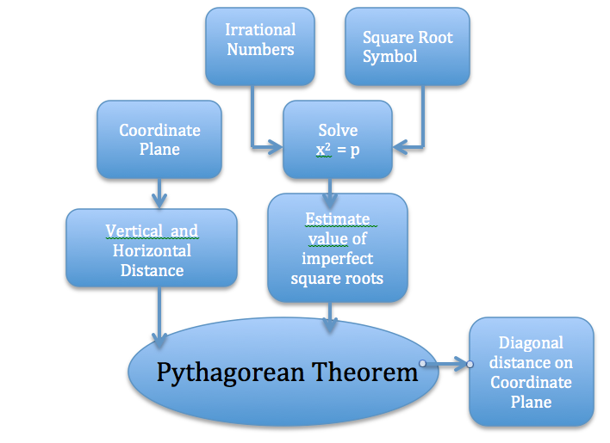

Slide 4
The Progression of Topics Leading to the
Pythagorean Theorem in Grade 8
As a foundation for the introduction to the Pythagorean Theorem, the CCSS introduces the following concepts:
The Coordinate Plane is introduced in Grade 5 (5.G.1)
  Use a pair of perpendicular number lines, called axes, to define a coordinate system, with the intersection of the lines (the origin) arranged to coincide with the 0 on each line and a given point in the plane located by using an ordered pair of numbers, called its coordinates. Understand that the first number indicates how far to travel from the origin in the direction of one axis, and the second number indicates how far to travel in the direction of the second axis, with the convention that the names of the two axes and the coordinates correspond (e.g., x-axis and x-coordinate, y-axis and y-coordinate).

Slide 5
The Progression of Topics Leading to the
Pythagorean Theorem in Grade 8
As a foundation for the introduction to the Pythagorean Theorem, The CCSS introduces the following concepts:
In Grade 6, students learn to find vertical and horizontal distances on the Coordinate Plane.
  6.G.3. Draw polygons in the coordinate plane given coordinates for the vertices; use coordinates to find the length of a side joining points with the same first coordinate or the same second coordinate.

Slide 6
The Progression of Topics Leading to the
Pythagorean Theorem in Grade 8
As a foundation for the introduction to the Pythagorean Theorem, The CCSS introduces the following concepts:
In Grade 7, students learn to draw geometric shapes given specific conditions…focusing on the triangle.
  7.G.2. Draw (freehand, with ruler and protractor, and with technology) geometric shapes with given conditions. Focus on constructing triangles from three measures of angles or sides, noticing when the conditions determine a unique triangle, more than one triangle, or no triangle.

Slide 7
The Progression of Topics Leading to the
Pythagorean Theorem in Grade 8
Before the Pythagorean Theorem is introduced, there are a few more ideas that underlie a full understanding of the Pythagorean Theorem. These ideas are mentioned in the following Grade 8 Standard:
  8.EE.2 Use square root and cube root symbols to represent solutions to equations of the form x² = p and x³ = p, where p is a positive rational number. Evaluate square roots of small perfect squares and cube roots of small perfect cubes. Know that the square root of 2 is irrational.
8.NS.2 Use rational approximations of irrational numbers to compare the size of irrational numbers, locate them approximately on a number line diagram, and estimate the value of expressions (e.g., π²).

Slide 8
Grade 8 CCSS Standards Related to the
Pythagorean Theorem
Below are the three standards that mention the Pythagorean Theorem in Grade 8
8.G.6 Explain a proof of the Pythagorean Theorem and its converse.
8.G.7 Apply the Pythagorean Theorem to determine unknown side lengths in right triangles in real-world and mathematical problems in two and three dimensions.
8.G.8 Apply the Pythagorean Theorem to find the distance between two points in a coordinate system.
In the following slides, we will take a closer look at these standards.

Slide 9
8.G.6 Explain a proof of the Pythagorean Theorem and its converse.
The image is the logo
from the Institute for
Mathematics & Education.
It provides us with an
elegant geometric “proof”
of the Pythagorean
Theorem.
Activity: How does this illustration prove the Pythagorean Theorem?

Slide 10
8.G.6 Explain a proof of the Pythagorean Theorem and its converse.
Given the red right
triangle, prove that the
area of the square of the
hypotenuse is equal to
the sum of the areas of
the squares of the two
legs.
The figure is formed from two large adjacent squares.
Each large square contains four congruent right triangles, one of which is colored red.

Slide 11
8.G.6 Explain a proof of the Pythagorean Theorem and its converse.
The left square contains
two smaller squares.
The smallest square is
the result of the shorter
leg of the red right triangle.
The larger square is the result of the longer leg of the red right triangle.
The largest square at the right is the result of the hypotenuse of the red triangle.

Slide 12
8.G.6 Explain a proof of the Pythagorean Theorem and its converse.
Since both large squares
are equal, we can
subtract the four right
triangles from each
large square and still
have equal areas.
On the left are the squares of the two legs of the red right triangle. On the right is the square of the hypotenuse.
Therefore, in a right triangle, the sum of the squares of the two legs is equal to the square of the hypotenuse.

Slide 13
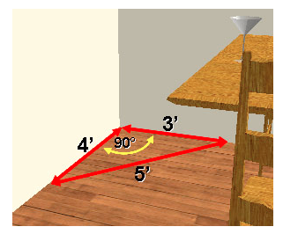
8.G.6 Explain a proof of the Pythagorean Theorem and its converse.
A common application of the converse of the
Pythagorean Theorem is used by carpenters to
make sure a corner that they are constructing forms
a right angle. Here are the steps:
Starting at the corner, measure 3 units along
one direction and make a mark.
2. Measure 4 units along the other direction and make a mark.
3. Measure the distance between the marks.
4. If the length is equal to 5 units, then the corner forms a right angle (90°)
If the length is less than 5 units, then the corner is less than 90°
If the length is greater than 5 units, the corner is greater than 90°
Why? Since 3² + 4² = 5², then the triangle is a right triangle by the converse of the Pythagorean Theorem.

Slide 14
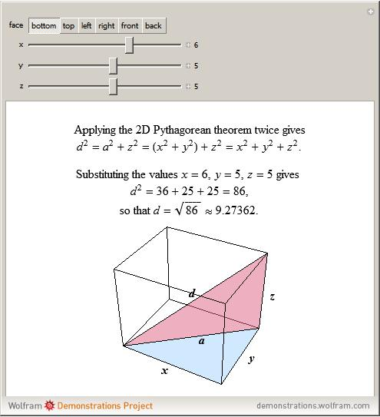
8.G.7 Apply the Pythagorean Theorem to determine unknown side lengths in right triangles in real-world and mathematical problems in two and three dimensions.
At this point students have the opportunity to apply the Pythagorean Theorem.
Good beginning situations can be determining the length of things that can’t be easily measured directly, forming right triangles from shadows of vertical objects (flag pole, height of building), or a ladder leaning against a building.
Expanding into the 3rd dimension the applet to the left is a strong visual to relate two right triangles working together.
http://demonstrations.wolfram.com/PythagoreanTheorem3D/

Slide 15
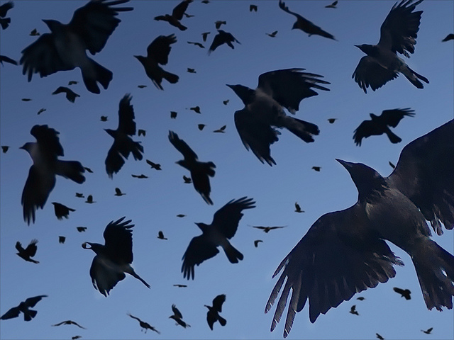
8.G.7 Apply the Pythagorean Theorem to find the distance between two points in a coordinate system.
Activity: As the Crow Flies
Roland went on a hike to visit a cave in the mountains. To begin his hike he faced west and hiked for 3 miles. Then he turned to the south and traveled for 2 miles. After a water break Roland again continued west for 4 miles. Turning North he continued for 3 miles. Next Roland turned left for 2 miles, and then he took a right for another 2 miles. Confused, Roland made a 360 degree turn and continued on his hike for a final 4 miles until he discovered the location of the cave.
As the crow flies, how far is the cave from where Roland started hiking?

Slide 16
As a high school teacher what is my new responsibility under the CCSS?
“…narrowing and deepening the curriculum is not so much a matter of eliminating
topics, as seeing the structure that ties them together. For example, if students see
that the distance formula and the trig identity sin^2(t) +cos^2(t) = 1 are both
manifestations of the Pythagorean theorem, they have an understanding
that helps them reconstruct these formulas rather than memorize them.”
Bill McCallum, in his blog “Tools for the Common Core”
http://commoncoretools.me/2012/02/16/the-structure-is-the-standards

Slide 17
As a high school teacher what is my new responsibility under the CCSS?
The Pythagorean Theorem underlies several formulas and identities that are memorized
by high school students. Related formulas include
The Distance formula
The Law of Cosines
The equation of a Circle
Some trigonometric identities.
Often, students memorize these formulas in isolation, without being aware of their
connection to the Pythagorean Theorem.
High School teachers can help students to make these connections.
This will allow students to be able to memorize one formula, the Pythagorean Theorem,
and recognize its many applications.

Slide 18
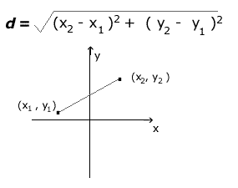
As a high school teacher what is my new responsibility under the CCSS?
Distance Formula
The distance formula is often memorized in the square root form shown below
with no connection to previous learning.
Many students do not make the connection that the distance formula
is simply the Pythagorean Theorem algebraically manipulated
by solving for d, which is the
hypotenuse of a right triangle..

Slide 19
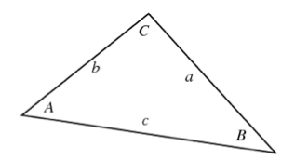
As a high school teacher what is my new responsibility under the CCSS?
Law of Cosines
a² = b² + c² -2bc cos A
b² = a² + c² -2ac cos B
c² = a² + b² -2ab cos C
The link between the Law of Cosines and the Pythagorean Theorem is another example looking at the algebraic structure of the formulas.
The Law of Cosines works on any triangle.
Rather than memorize the formulas in isolation, if students relate it to the Pythagorean Theorem and see the pattern in the structure, they will have an easy time remembering the equations.

Slide 20
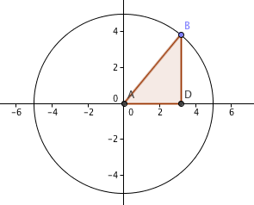
As a high school teacher what is my new responsibility under the CCSS?
Equation of a Circle
A circle is defined as the set of all points that are a given distance (length of radius) from
the center of the circle. If the circle has its center at the origin (0,0), and the length of
the radius is, for example, 5 units, the circle can be defined as the set of all points of the
form (x,y) that are a distance 5 units from the origin. Each point (x,y) a right triangle.
The right triangle has a radius of 5 units.
Each horizontal leg has length x units.
Each vertical leg has length y units.
Therefore, the equation of the circle centered at
the origin with radius 5 units is x² + y² = 5² or x² + y² = 25

Slide 21
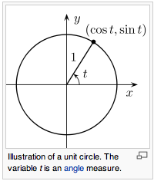
As a high school teacher what is my new responsibility under the CCSS?
The Unit Circle and Trigonometry
The equation of a circle can be extended to the unit circle, which
is a special case of a circle that is used in trigonometry.
The equation of the unit circle is x² + y² = 1, since
The radius is 1 unit. As an angle t rotates around the circle ,
with vertex at the origin, initial side the positive
x-axis, and terminal side going through the
point (x,y) on the circle, the x-coordinate is the
value of cos t and the y-coordinate is the value of sin t.

Slide 22
As a high school teacher what is my new responsibility under the CCSS?
The Unit Circle and Trigonometry
Another application of the Pythagorean
Theorem is the trigonometric identity
cos² t+ sin² t = 1
This identity is derived by starting with the equation of the
unit circle x² + y² = 1 and substituting cos t for x
and sin t for y, where t is the angle whose initial side
Is the positive x-axis and whose terminal side is
the radius through the point (x, y).
This identity is used to generate other trig identities involving tan t,
cot t, csc t, and sec t, which can easily be derived from this basic identity.

Slide 23
As a high school teacher what is my new responsibility under the CCSS?
The Common Core State Standards recognizes that mathematical topics cannot be taught in isolation. Each topic is interconnected with previous concepts and informs the understanding of later concepts.
When students learn mathematics as a coherent whole with a structure that has connections between seemingly disparate topics, they become stronger mathematical thinkers. Rather than depend upon memorizing formulas and procedures that seem unconnected, students who understand the connections are empowered as mathematicians.
So, as a high school teacher what is your new responsibility under the CCSS?
Your responsibility is to empower your students by pointing out the mathematical connections and progressions in your instruction.

