Slide 1
Decomposing What? Kindergarten Numbers 0-19
Rachel McAnallen
Ronald Renken
Patricia Smith

Slide 2
Desired Outcomes
To build knowledge of decomposing and composing numbers so that teachers can deepen their instruction that develop students’ ability to reason abstractly and quantitatively
Notes:
Through this Professional Development teachers will gain a deeper understanding of how teaching decomposing numbers can develop students ability to manipulate numbers

Slide 3
Focus Areas
Common Core Standard K.OA.3
Common Core Standard K.NBT.1
Compose and decompose numbers from 11 to 19 into ten ones and some further ones, e.g., by using objects or drawings, and record each composition or decomposition by a drawing or equation (e.g., 18 = 10 + 8); understand that these numbers are composed of ten ones and one, two, three, four, five, six, seven, eight, or nine ones.
Decompose numbers less than or equal to 10 into pairs in more than one way, e.g., by using objects or drawings, and record each decomposition by a drawing or equation (5=2+3 and 5=4+1)
Notes:
3

Slide 4
Decomposing
(And why is it important to Computational Fluency)?
In reading, we chunk words into small sound parts to decode unknown words
In math, we break numbers into smaller parts, referred to as decomposing numbers into ten ones and some further ones.
Decomposing refers to the idea that numbers can be broken apart to make other numbers, whereas,

Slide 5
Decomposing A Number?
Decomposing refers to the idea that numbers can be broken apart to make other numbers
Decompose numbers less than or equal to 10 into pairs in more than one way, e.g., by using objects or drawings, and record each decomposition by a drawing or equation (5=2+3 and 5=4+1)
7
7=6+1
and
7=5 + 2
5

Slide 6


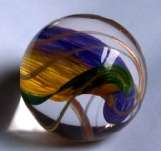
Decomposing A Number?
Decompose numbers less than or equal to 10 into pairs in more than one way, e.g., by using objects or drawings, and record each decomposition by a drawing or equation (5=2+3 and 5=4+1)
7
7=6+1
7=5+2
+
=
7
+
=
7
6

Slide 7
Decomposing A Number?
Decomposing refers to the idea that numbers can be broken apart to make other numbers
Decompose numbers less than or equal to 10 into pairs in more than one way, e.g., by using objects or drawings, and record each decomposition by a drawing or equation (5=2+3 and 5=4+1)
7
7=8-1
=
7=9-2
7

Slide 8
It’s Your Turn
8
With a partner discuss ways you could teach the decomposing of this number into pairs?
8
Notes:
Have participants share with a partner not only the pairs they may teach but also how parts of the lesson might look and sound-what materials they may use. Use recording sheet and manipulatives discuss a lesson on ways to make eight by decomposing the number. Include in the language that decomposing

Slide 9
Ways to make 8 (materials needed) | What are you saying to the students? | What are the students doing?
Notes:
After teachers
9

Slide 10
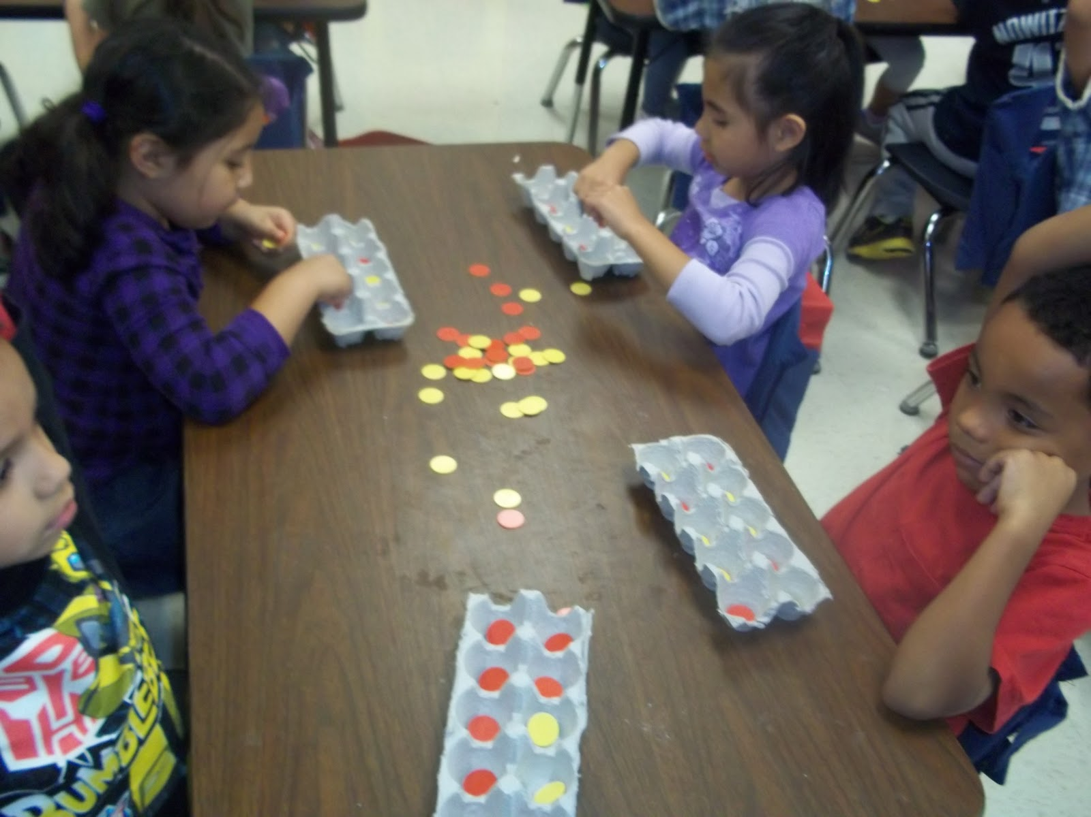
http://singaporemathblog.com/2011/grade-1-student-ten-frame-video/
What do you hear the students being able to do fluently?
Notes:
Show this video that reinforces having students decompose numbers. Ask participants to share one thing that they noticed about the students thinking.

Slide 11
Compose and decompose numbers from 11 to 19 into ten ones and some further ones, e.g., by using objects or drawings, and record each composition or decomposition by a drawing or equation (e.g., 18 = 10 + 8); understand that these numbers are composed of ten ones and one, two, three, four, five, six, seven, eight, or nine ones.
13
10
(Ten ones)
3
(Three ones)
+
11
Notes:
We must help children to “break the code” with numbers so that they can understand how different forms of the number can come together. This allows the student to truly read number. Students will begin their understanding of compositions and decompositions of number.

Slide 12
Compose and decompose numbers from 11 to 19 into ten ones and some further ones, e.g., by using objects or drawings, and record each composition or decomposition by a drawing or equation (e.g., 18 = 10 + 8); understand that these numbers are composed of ten ones and one, two, three, four, five, six, seven, eight, or nine ones.
13
1+1+1
(Three ones)
10
(Ten ones)
+
AND
12
Notes:
We must help children to “break the code” with numbers so that they can understand how different forms of the number can come together. This allows the student to truly read number. Students will begin their understanding of compositions and decompositions of number.

Slide 13
13
Compose and decompose numbers from 11 to 19 into ten ones and some further ones, e.g., by using objects or drawings, and record each composition or decomposition by a drawing or equation (e.g., 18 = 10 + 8); understand that these numbers are composed of ten ones and one, two, three, four, five, six, seven, eight, or nine ones.
1+1+1
(Three ones)
10
(Ten ones)
+
AND
13
Notes:
We must help children to “break the code” with numbers so that they can understand how different forms of the number can come together. This allows the student to truly read number. Students will begin their understanding of compositions and decompositions of number.

Slide 14
Compose and decompose numbers from 11 to 19 into ten ones and some further ones, e.g., by using objects or drawings, and record each composition or decomposition by a drawing or equation (e.g., 18 = 10 + 8); understand that these numbers are composed of ten ones and one, two, three, four, five, six, seven, eight, or nine ones.
13
2 + 1
(Three ones)
+
  5+5
(Ten ones)
+
+
AND
14
Notes:
We must help children to “break the code” with numbers so that they can understand how different forms of the number can come together. This allows the student to truly read number. Students will begin their understanding of compositions and decompositions of number.

Slide 15
Composing refers to the idea that numbers can be put together:
16
7+3=10
+
3+3 =6
1(10) and 6 ones
16
15

Slide 16
Accountable Talk Article
Read the article Teaching Number in the Early Elementary Years
Text mark the article identifying key points, wonderings and new learning
Keep the following questions in mind
  What role does teacher content knowledge play in developing deeper instruction for the students?
  What does strong instruction look like that develops conceptual understanding in math?

Slide 17
Accountable Talk Ground Rules
Actively participate in discussions
Speak to the whole group
Listen attentively to one another
Build upon ideas and each other’s contributions
Make specific reference to text as evidence for claims and assertions
Challenge the quality of each other’s evidence and reasoning
Notes:
Review the accountable talk rules before starting the discussion on the article. If the group is too large break into several small groups. After 20 minutes bring all groups back together to share thinking. Have participants to reflect on the two questions first (making sure that they make specific reference to the text) and then any other parts of the article that they may have marked as a wondering, key points or new learning.

Slide 18
Your Turn
9
Notes:
After reading the article now think about how you could help students develop their ability to reason abstractly and quantitatively. Using the number 9 with a partner consider what instructional practices you may use to develop students ability to compose and decompose the number

Slide 19
Ways to make15 (materials needed) | What are you saying to the students? | What are the students doing?
Notes:
After teachers
19

Slide 20
What is base ten math?
In mathematics the word “base” refers to the number of digits (e.g. 0,1,2,3,4,5,6,7,8,9) used in a particular system of counting.
It also refers to the trading system in which we trade 10 for 1.
The binary system is base 2,( i.e. it uses 2 digits 0, 1), in which we trade 2 for 1.
Notes:
Let’s look at what is base 10. Do the hand activity in which you have participants first identify the number 3 on one hand. Then ask them to show another way to make 3 on that same hand. Then ask them to show 3 using both hands. Then ask participants to make 8 . Then show 8 a different way. Then show 10 on one hand and then 10 on both hands. And then show another way one of making 10 –like 9 and then 1……. This is hopefully will

Slide 21
Using whole numbers only, how many addition math facts are there for 10?
Notes:
42 Revealing that there other combinations than 6+4 7+3 5+5 allow participants to work through this for about 4 minutes

Slide 22
How do you say numbers 1-20 in Chinese?
1= yi 2= er 3=san 4=si 5=wu 6=liu 7=qi (chi) 8=ba 9=jiu 10= shi | 11= shi yi 12= shi er 13= shi san 14=shi si 15=shi wu 16=shi liu 17= shi qi (shi chi) 18=shi ba 19=shi jiu 20=er shi 21=er shi yi
Notes:
Now that you are thinking that there is more than one way to think about numbers, Other cultures continue counting with the number 10- one of the reason our students have difficulty with the numbers 11-19.(i.e inconsistent use of descending/ascending order and numbers 11 & 12 have no value sense) Have teachers play with numbers with counting using their hands.

Slide 23
Numbers in Swahili
one
two
three
four
five
six
seven
eight
nine
ten
moja
mbili
tatu
nne
tano
sita
saba
nane
tisa
kumi
eleven
twelve
thirteen
fourteen
fifteen
sixteen
seventeen
eighteen
nineteen
kumi na moja
kumi na mbili
kumi na tatu
kumi na nne
kumi na tano
kumi na sita
kumi na saba
kumi na nane
kumi na tisa
Notes:
One more culture that continues to count keeping 10 and the number

Slide 24
How can we foster composing and decomposing of numbers?
Group Work with Problem Solving
There were eleven pencils in our classroom pencil box. Five kids each took a pencil. How many pencils were left?
Notes:
Have participants in small groups develop various ways in which they may foster composing and decomposing of numbers by using the word problem. Let participants work on their own first and then share rest of the slide

Slide 25
How can we foster composing and decomposing of numbers?
Group Work with Problem Solving
There were eleven pencils in our classroom pencil box. Five kids each took a pencil. How many pencils were left?
  Counting cubes-takes away five and remainder
  Eleven marks on a piece of paper (crossing out five marks)
  Using a “double” to reason that 10 minus 5 is 5, so 11 minus 5 is one more than that, or 6.
  Relating to idea of tens.
  Counting out loud and using fingers.
  With a tens frame or base ten block take 5 out; 5 left add to the 1 you have 7 left
Notes:
Have participants in small groups develop various ways in which they may foster composing and decomposing of numbers by using the word problem. Let participants work on their own first and then share rest of the slide

Slide 26
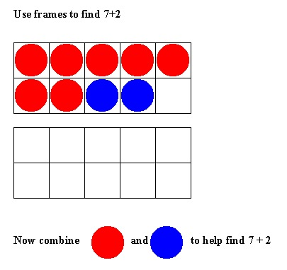
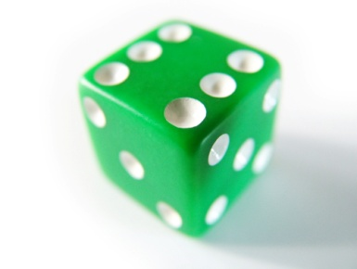
How can I foster this in my students?
Using dice( i.e looking at the arrangement of the dots on the dice to teach the decomposition of number
Using dominoes
Using ten frames activities

Slide 27
How can I foster this in my students?
Bean counters
Fermi word problems (i.e, There are 12 cookies on a plate and 5 children. How many cookies will each child get?)
Games and practice with subitizing so students’ think about number as composed of other numbers.

Slide 28
Help students unlock the key!
Fluency is the key to be able to take numbers apart and put them together as the basis for developing good number sense. (composition and decomposition)
Notes:
Students need many opportunities to discover that numbers can be made from other numbers by taking them apart and putting them together.

