Slide 1
Measurement and Data
Grades K-5
Lynn Heline
Jessica McCreary
Kyle Radcliff

Slide 2
Professional Learning Goals
The professionals will complete a standards trace in the Measurement and Data domain K-5.
The professionals will connect the Practice Standards and the Content Standards to a fifth grade volume task.

Slide 3
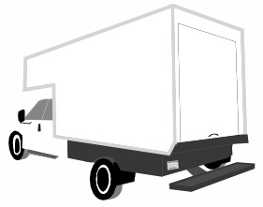
Task
13’
2’
6’
10’
5’
1’
1’
1’
Juan is using the delivery truck to ship iPods he is selling. He is using one cubic foot boxes to ship them. He wants to know how many of these boxes he can fit into the truck.

Slide 4
Discussion
What are the key conceptual ideas in the lesson?
What misconceptions might students have about these concepts?
Which Practice Standards apply to your method of problem solving?
Notes:
Have participants turn to a partner first, then share out in whole group. (Think-Pair-Share)

Slide 5
5.MD.5
Relate volume to the operations of multiplication and addition and solve real world and mathematical problems involving volume.
Notes:
Have participants turn to a partner first, then share out in whole group. (Think-Pair-Share)

Slide 6
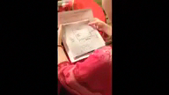
“Kayla’s Problem Solving”

Slide 7
Discussion
What content does Kayla appear to understand? What does Avery appear to understand?
What content is Kayla still working on? Avery?
Which Practice Standards apply to her method of problem solving?
Notes:
Have participants turn to a partner first, then share out in whole group. (Think-Pair-Share) Facilitator may need to prompt participants to think about what concepts the student needs to know before getting to volume, i.e. know length, width.

Slide 8
Progressions
2nd Grade | 3rd Grade | 4th Grade
Domain: NBT Content Cluster: Understand place value Key Ideas from standards: Fluently add and subtract within 100; add and subtract within 1,000 using models | Domain: NBT Content Cluster: Use place value understanding . . Key Ideas from standards: Round whole numbers; fluently add and subtract within 1,000 | Domain: NBT Content Cluster: Use place value understanding . . Standard: 4.NBT.4
Notes:
Tell teachers to stay in the same domain. Direct teachers to look for a related content cluster. Record key words that describe the grade level work with the concept.

Slide 9
Notes:
Tell teachers to stay in the same domain. Direct teachers to look for a related content cluster. Record key words that describe the grade level work with the concept.

Slide 10
Notes:
Next, have participants choose their own grade level, and look at the clusters within other domains and tie the grade level standards at that grade level to the measurement and data. Measurement and Data is not meant to stand in isolation, so now looking at how we can address/support some of the other standards in other domains through the MD domain is a fruitful exercise. There is a template on Dropbox.

Slide 11
“You wanna
love the journey,
and you wanna
love the destination.”
-- Bill McCallum

