Slide 1
Dividing Fractions
Grade 5
Andria Disney, Chandler Unified School District
Stacey Hughes, Consultant
Connie Thompson, NNRPDP Nevada

Slide 2

Bringing Context to Naked Numbers
Notes:
The C²S² represent a shift from the way we use to teach mathematics. In the past we would open our textbook and see one page filled with 50 fraction division problems. We would send several students to the chalkboard and give them one of those problems. The first one finished with the right answer wins a piece of candy. But what happens if we ask winner student to use her understanding of division and fractions to share that piece of candy?

Slide 3
Create a contextual situation for each problem below:
Notes:
Since you probably didn’t get a chance to in school, here are two naked number problems for you to clothe with context.
Have the participants work in groups. Allow approximately 10 – 15 minutes for the groups to generate and record contextual problems on chart paper. Have the groups share the contextual problems with all the participants .

Slide 4
Partitive vs. Quotative (Measurement)
The size of the “group” is not known, and the number of the groups is known.
How many are in each group?
The size of the “group” is known, and the number of the groups is needed.
How many groups are there?
Notes:
Review the difference between the two types of division problems, partitive and quotative (measurement). Have the participants classify the contextual problems they generated.

Slide 5
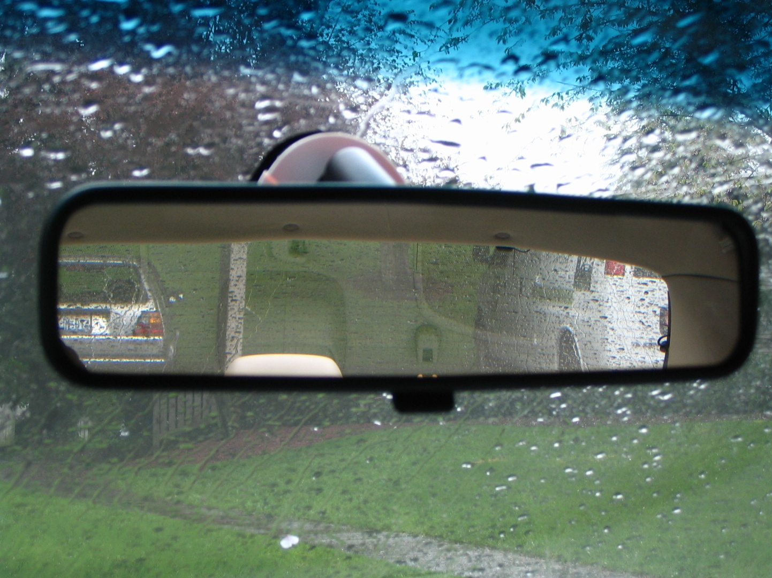
Where Have they Been?
http://www.legalpradvice.com/im-out/
Notes:
The previous problem is an example of how a fifth grade student can demonstrate the understanding of 5.NF 3,4.
Here are the standards that laid the foundation for students to contextualize the problem in grades 3 and 4.

Slide 6
3rd Grade - Developing understandings of Fractions as numbers
3.NF.1. Understand a fraction 1/b as the quantity formed by 1 part when a whole is partitioned into b equal parts; understand a fraction a/b as the quantity formed by a parts of size 1/b.
Notes:
Review fraction progression in third grade.

Slide 7
4th Grade - Building fractions from unit fractions by applying and extending previous understanding of operations on whole numbers.
4.NF.3. Understand a fraction a/b with a > 1 as a sum of fractions 1/b.
Notes:
Review the fraction progression in fourth grade.

Slide 8
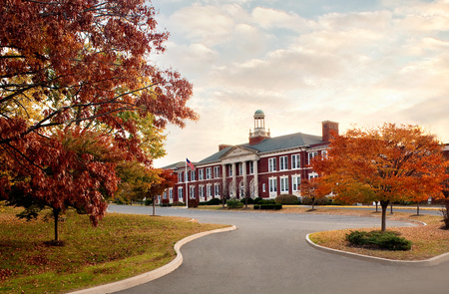
Where they are …
5th Grade
www.westport.k12.ct.us/kings-highway-elementary-school-landing-page/

Slide 9
5th grade - Apply and Extend previous understandings of multiplication and division to multiply and divide fractions.
Notes:
Review the fraction progression in fifth grade.

Slide 10
5.NF.3
Interpret a fraction as division of the numerator by the denominator (a/b = a ÷ b). Solve word problems involving division of whole numbers leading to answers in the form of fractions or mixed numbers, e.g., by using visual fraction models or equations to represent the problem.

Slide 11
5.NF.4
Apply and extend previous understandings of multiplication to multiply a fraction or whole number by a fraction.
  a. Interpret the product (a/b) × q as a parts of a partition of q into b equal parts; equivalently, as the result of a sequence of operations a × q ÷ b.

Slide 12
5.NF.7
Apply and extend previous understandings of division to divide unit fractions by whole numbers and whole numbers by unit fractions.
  Interpret division of a unit fraction by a non-zero whole number, and compute such quotients.
Interpret division of a whole number by a unit fraction, and compute such quotients.
Solve real world problems involving division of unit fractions by non-zero whole numbers and division of whole numbers by unit fractions, e.g., by using visual fraction models and equations to represent the problem.

Slide 13
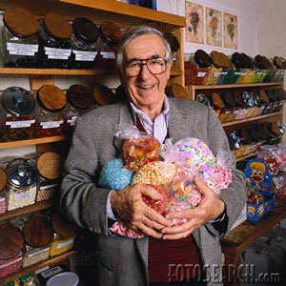
Cleaning out the candy shop …
Notes:
See Cleaning Out the Candy Shop investigation packet.

Slide 14


Strategies
How might it support student understanding?
How might it contribute to student misconceptions?
Notes:
Use these questions to discuss the strategies the teachers generate to solve the Cleaning Out the Candy Shop investigation.
If the standard algorithm for division of fractions is not proposed, say, “I noticed that no one used the standard algorithm as a method to solve the problem. Why might that be?”
By supporting student understanding, we are preparing them for the road that lies ahead.

Slide 15
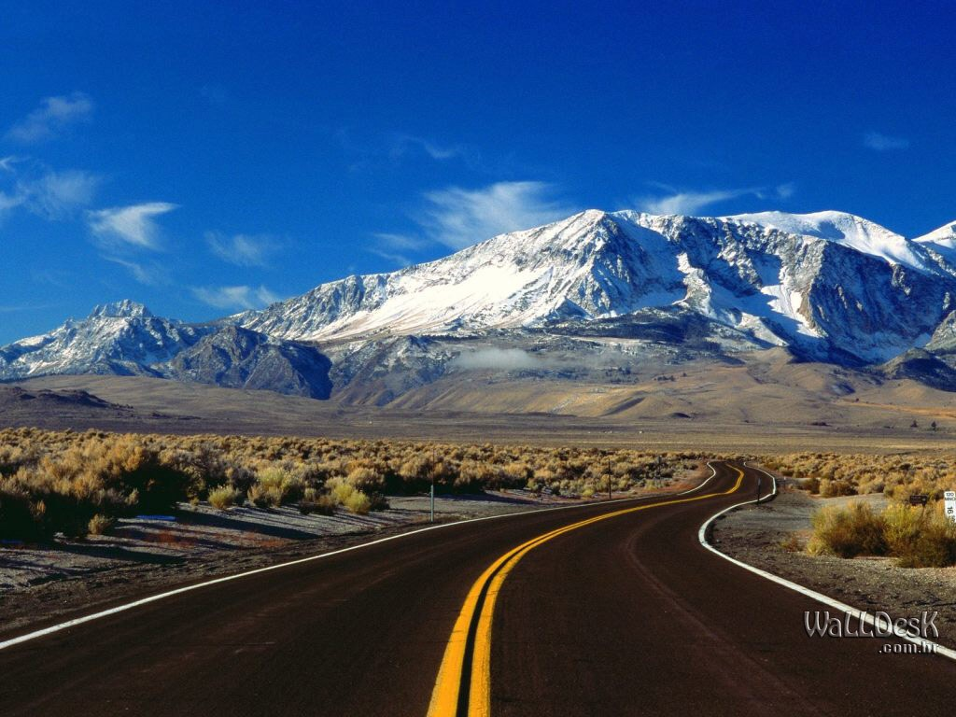
Where they are going …

Slide 16
6th grade - Apply and extend previous understandings of multiplication and division to divide fractions by fractions.
Interpret and compute quotients of fractions and solve word problems involving division of fractions by fractions.

Slide 17
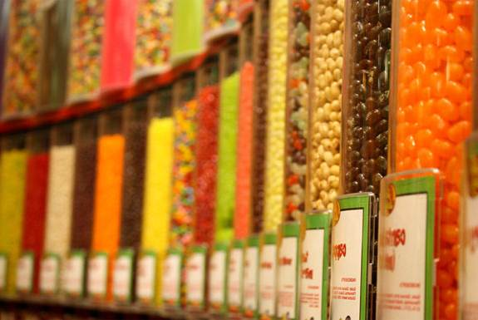
Without conceptual understanding of fractions, students may struggle using and applying fractions in the candy shops found along the road of life.

