Slide 1


High School Algebra II – Exponential Functions
Melissa Hosten, Chandler Unified School District
Adam Spiegler, Loyola University Chicago

Slide 2
In High School, the standards are arranged in conceptual categories, such as Algebra or Functions.
These conceptual categories overlap in many high school courses (traditional or integrated).
In each conceptual category there are domains, such as Creating Equations and Interpreting Functions.

Slide 3
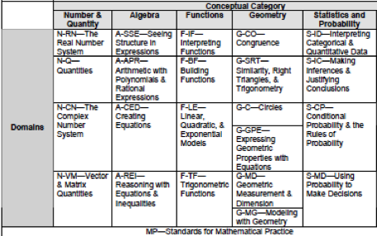
CCSS High School Mathematics

Slide 4
The Standards for Mathematical Practice (MP) describe characteristics and traits that mathematics educators at all levels should seek to develop in their students.
These eight practices can be clustered into the following categories:
  Habits of Mind of a Productive Mathematical Thinker,
  Reasoning and Explaining,
  Modeling and Using Tools, and
  Seeing Structure and Generalizing.

Slide 5
Mathematical Practices

Slide 6
Learning Goals
The Standards targeted by the professional development include 2 domains from the conceptual category, Functions. The domains are Interpreting Functions and Linear, Quadratic, & Exponential Models. There are also Mathematical Practices that would most likely be observed in student work/responses/discourse (but are not required).

Slide 7
Target Standards
HS.F-LE.5 Interpret the parameters in a linear or exponential function in terms of a context
HS.F-IF.8 Write a function defined by an expression in different but equivalent forms to reveal and explain different properties of the function.
  b. Use the properties of exponents to y. interpret expressions for exponential functions. For example, identify percent rate of change in functions such as
    y = (1.02)t, y = (0.97)t, y = (1.01)12t,
    y = (1.2)t/10 , and classify them as representing exponential growth or decay.
MP.3 Construct viable arguments and critique the reasoning of others,
MP.4 Model with mathematics,
MP.7 Look for and make use of structure

Slide 8
Scratching the Surface
AZ is growing 1.6% annually. Currently 6.5 million people call AZ home.
Typically we model this population as a function of time y = a(1+r)t where
  y = amount at time t,
  a is the initial amount,
  r is the growth rate, and
  t is unit of time.
By how many people will the population grow this year?
What will the population of AZ be in 10 years?
When will the population of AZ reach 8 million people?

Slide 9
What the Structure Tells Us
Without making any calculations, describe in words what the following formulas tell you about the amount of medication (in mg) in a patient’s bloodstream in t hours?

Slide 10
Digging Deeper
Consider the information below:
  Iraq has a population of 31 million and grows at a rate of 0.006301% per day.
  Israel has a population of 7.6 million people and grows at a rate of 1.5% per year.
Assuming both countries’ populations continue to grow exponentially, when will Israel’s population catch up to Iraq’s population?
Notes:
Israel will never catch up!
Ideally students will set up equivalent expressions and realize that Istrael’s population will never catch up to Iraq’ because of the lower annual growth rate
Israel: 1.5%
Iraq 2.3%
Initially students will need to ask themselves, “What form of the equation should I use?”
They may anticipate asking, “What does that look like graphically? algebraically?” but then realize once they have made their expressions comparable that they do not need to go any further.

Slide 11
Challenging Students to Think
Students’ classroom time may be better used with investigations that resonate with their interests.
In July 2009,
  Facebook had 70 million active users and was growing by 700,000 users per day.
  the world population was 6.76 billion and was growing by 1.1% per year.

Slide 12
Challenging Students to Think
Graph both population models on the same axes.
What formula did you use to model each situation? Why did you use these?
Using your graphical model, when will the population of Facebook users theoretically exceed the world’s population?
Discuss in groups your thoughts about the last question
What were ideas that your group discussed?
Notes:
Students may consider the Facebook information in terms of a linear model or an exponential model. This will allow for discussion of which model makes sense given what students know about Facebook.

Slide 13
Debriefing With Teachers
How does the scenario look like a basic textbook approach?
How does the scenario differ?
What is the benefit of this approach?
What is needed to implement the investigation?
Notes:
(Students will need to think about the structure to use in order to graph both on the same axes.)
must use equivalent expressions purposefully

Slide 14
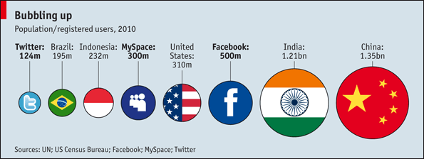
Extending Student Thinking
What questions might you pose to students to extend their thinking about exponential functions and equivalent expressions that expose different attributes of the function?

Slide 15
The Big Idea
The structure of the model should follow from the context, rather than force all contexts to fit into the same structure.

