Slide 1
Number and Operations - Fractions
Grade 3
Jacqueline Burns
Shannon Pasvogel

Slide 2
Norms to Anchor Our Work
Honor time
Be present in the present
Make room
Assume good will
Share wisdom
Technology etiquette
  phones, blackberries, iPads, computers
Notes:
Reference: Developing Essential Understanding of Rational Numbers, 3-5 (NCTM publication)
Develop understanding of fractions as numbers
Number line representation of unit fraction, defining the interval from 0 to 1 as the whole and partitioning into any equal sized parts
The number line provides a context for understanding fractions that is different from, and more versatile than, part-whole models with the fractional parts already subdivided.
Unit fraction – fraction with a numerator of 1

Slide 3
Today’s CCSS Focus
3.NF.2. Understand a fraction as a number on the number line; represent fractions on a number line diagram.
  Represent a fraction 1/b on a number line diagram by defining the interval from 0 to 1 as the whole and partitioning it into b equal parts. Recognize that each part has size 1/b and that the endpoint of the part based at 0 locates the number 1/b on the number line.
  Represent a fraction a/b on a number line diagram by marking off a lengths 1/b from 0. Recognize that the resulting interval has size a/b and that its endpoint locates the number a/b on the number line.

Slide 4
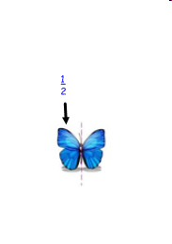
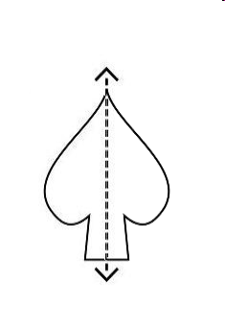
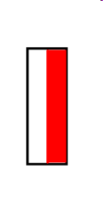
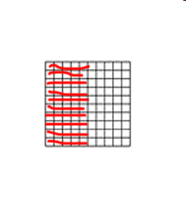
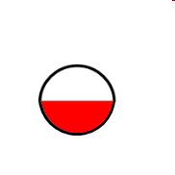
What does ½ traditionally look like?
½ of 20 = 10
½ of 100 = 50

Slide 5
Now what does ½ look like on a number line?

Slide 6
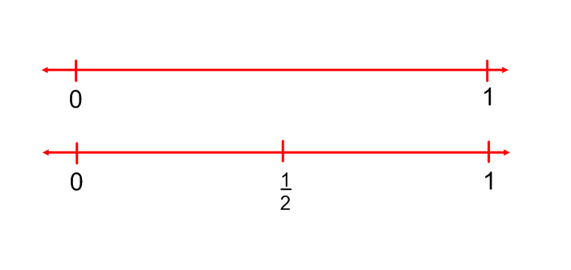
What number is halfway between 0 and 1?
Some students may initially be surprised that there are numbers between 0 and 1.

Slide 7
Questions to help students reason about fractions as numbers
What number is halfway between 0 and one-half?
What other ways might you see one-half expressed?
What number is one-fourth more than one-half? One-sixth more than one-half?
What number is one-sixth less than one?
What number is one-third more than one?
What number is halfway between one-twelfth and three-twelfths?
Which number is closest to 0?
Which number is closest to 1?
What would you call a number halfway between 0 and one-twelfth?

Slide 8
What number is halfway between 0 and ½?
Realizing that ¼ lies between 0 and ½ on the number line reinforces the relationship between halves and fourths.

Slide 9
What other ways might you see ½ expressed?
Students may initially say there are several numbers here: 2/4, 3/6, and 6/12. This is an excellent opportunity to introduce the idea that although these look like different numbers, they are actually different ways to name the number, much like “one hundred” can also be called “ten tens.” This is also an opportunity to discuss hat names for the same number have in common.

Slide 10
What number is ¼ more than ½? 1/6 more than ½?
This question can help students begin to realize about relative value of different fractions and compute without the need or converting to numbers with like units (common denominators).

Slide 11
What number is 1/6 less than 1?
This question encourages students to compare fractions to the unit.

Slide 12
What number is 1/3 more than 1?
This question exposes students to fractions greater than one and can support their understanding that 4/3 is the same as 1 1/3.

Slide 13
What number is halfway between 1/12 and 3/12?
This question provides another chance for students to encounter equivalents. They can also begin to represent why there is no sixth equivalent to 1/12 or 3/12 (or 5/12, 7/12, 9/12, 11/12)

Slide 14
Which number is closest to 0?
This provides another example of when “the larger denominator, the smaller fraction” is true.

Slide 15
Which number is closest to 1?
This can help students see that knowing both a numerator and a denominator is necessary to understanding a fraction’s value. It can also provide a very reliable and frequently sufficient way to compare fractions, without needing to find common denominators and create equivalent fractions.

Slide 16
What would you call a number halfway between 0 and 1/12?
This question asks students to extend their understanding and provides a foundation for helping them reason about fraction multiplication, that is, why does ½ x 1/12 =1/24?

Slide 17
The BIG Ideas of A Unit Fraction
The concept of the unit fraction is the quantity you get when you divide a whole into b equal parts.
The unit fraction is written 1/b
The quantity b is derived from how many equal partitions make the whole
Grade 3 expectations in this domain are limited to fractions with denominators 2, 3, 4, 6, and 8.
(pg 26 of Iowa Common Core. www.corecurriculum.ioaw.gov)
Notes:
Bottom of page 26 of 98 ( denominators 2, 3, 4, 6, and 8 for Grade 3)

Slide 18
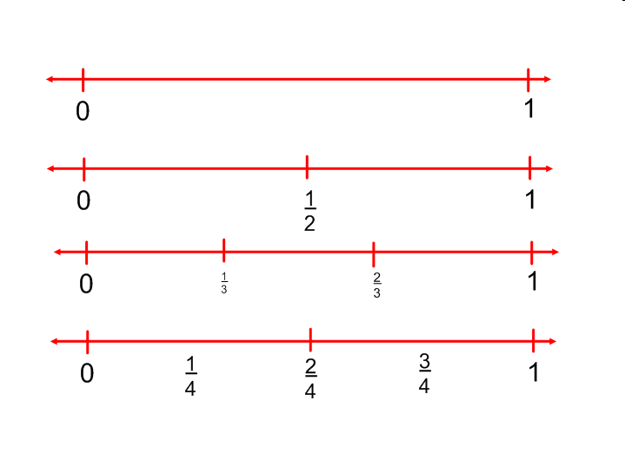
Notes:
Insert denominators of 2,3,4,6, & 8 as unit fractions.

Slide 19
Introducing 3.NF.2b
Represent a fraction a/b on a number line diagram by marking off a lengths 1/b from 0. Recognize that the resulting interval has size a/b and that its endpoint locates the number a/b on the number line.

Slide 20
Indentify the larger fraction
Explain your answer.
5/6 or 7/8
Think, Ink, Pair, Share
Notes:
Think, ink, pair, share with elbow-partner

Slide 21
Circle the large fraction and explain your answer.
5/6 or 7/8
“I know that 5/6 is larger than 7/8 because sixths are bigger than eighths. The smaller denominator means the fraction is larger.”
What do you think of this explanation?
What important idea did this student use to solve the problem?
Does this reasoning make sense? Why or why not?
Notes:
Sample Student Response - Here’s a student’s response to the question. Teacher Talk: What’s being added? What’s being taken away?
Now see if you can explain your answer using a number line diagram.
How does the visual representation using the number line diagram deepen your own understanding?
Do you think using the number line diagram will help your students deepen their own understanding?
Also page 28 in same book. Rules that create misconceptions. (page 29 of Beyond Pizzas book)
What vocabulary should you inherently use throughout instruction?
How do you know if you’re using it correctly?
What are the new no-no’s?

Slide 22
Circle the large fraction and explain your answer.
3/4 or 5/12
“Five is more pieces than 3 pieces so 5/12 is more than ¾.”
What do you think of Sarah’s explanation?
What important idea about fractions did this student use to solve the problem?
Does this student’s reasoning make sense to you? Why or why not?
Notes:
Page 29 in Pizza book
www.wested.org/cs/we/view/pj/81

Slide 23
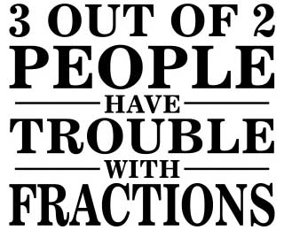
Exploring Misconceptions
The smaller the denominator, the larger the fraction.
The larger the denominator, the smaller the fraction.
You can’t compare fractions with different denominators.
Fractions are always less than 1.
To compare two fractions, you only need to look at the numerators (or denominators).
Finding a common denominator is the only way to compare fractions with different denominators.

Slide 24
Using the Language of the Standard
Listing the language to use
Listing the language not to use in the “no” circle

Slide 25
Resources for Teaching and Learning
http://illuminations.nctm.org/lessondetail.aspx?id=L540
http://wps.ablongman.com/ab_vandewalle_math_6/55/13860/3548322.cw/index.html
http://mathsolutions.com/fractionsoftware

Slide 26
Resource Vetting
Directions given to teachers to explore the resources available for T/L, and use the given document to vet based on the requirement of the standard (using a template to complete p/p or electronically)
Teachers work in pairs, small groups, or grade teams
After designated time, each group share their work
Notes:
IDEAS for Sharing Segment – chart work, carousel share or Gallery Walk for others to comment using post-it notes

Slide 27
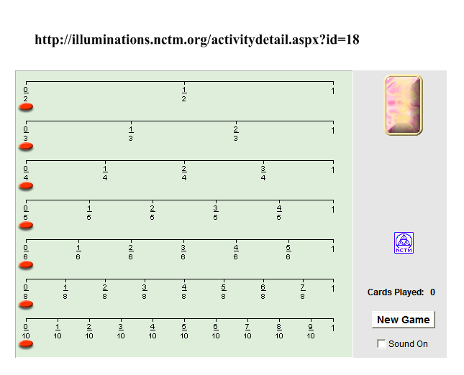
Fraction Track from Illuminations Site

Slide 28
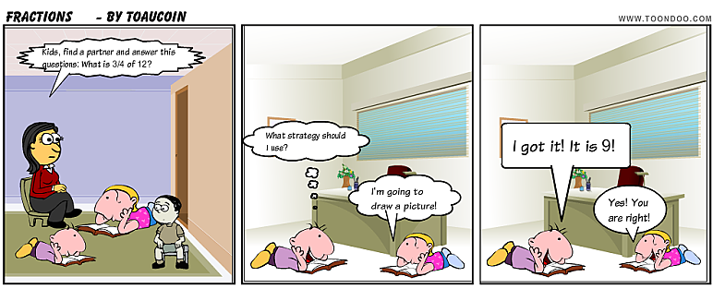
Our Ultimate Goal …
…to develop mathematically proficient students.

Slide 29
http://www.nctm.org/uploadedFiles/Math_Standards/Principles_and_Standards_for_School_Mathematics/E-Examples/Grades_3–5/fraction1_SQTM.mov

Slide 30
