Slide 1
Developing
Mathematical Habits of Mind in Mathematics Teachers

Slide 2
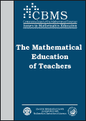
The Mathematical
Education of Teachers
Recommendations
Teachers need mathematics courses that develop a deep understanding of the math they teach.
Mathematics courses should
  focus on a thorough development of basic mathematical ideas.
  develop careful reasoning and mathematical ‘common sense’.
  develop the habits of mind of a mathematical thinker and demonstrate flexible, interactive styles of teaching.
Notes:
Jim

Slide 3
The habits of mind of a mathematical thinker
Have you ever had two students (or do you know two teachers) who appear to know the same “facts” but for whom there is a marked difference in their ability to use that information to answer questions or solve problems?
Why?
Do mathematical thinkers approach problems differently?
And, if so, how do we develop the “habits of mind of a mathematical thinker” in teachers and assist them in cultivating this knowledge among their students?
To study this question, we developed a working definition based on experience and the work of other mathematics educators (e.g., Cuoco, et al., Driscoll)
Notes:
Jim, Ruth

Slide 4
Someone possessing a rich set of mathematical habits of mind:
Understands which tools are appropriate when solving a problem.
Is flexible in their thinking.
Uses precise mathematical definitions.
Understands there exist (therefore encourages) multiple paths to a solution.
Is able to make connections between what they know and the problem.
Knows what information in the problem is crucial to its being solved.
Is able to develop strategies to solve a problem.
Is able to explain solutions to others.
Knows the effectiveness of algorithms within the context of the problem.
Is persistent in their pursuit of a solution.
Displays self-efficacy while doing problems.
Engages in a meta-cognition by monitoring and reflecting on the processes of conjecturing, reasoning, proving, and problem solving.
Notes:
Ruth

Slide 5
Mathematical Habits of Mind Problems
Goals: Give teachers experiences with problems with multiple entry points and solution paths to develop their:
Strategies for solving problems
Flexibility in thinking
An appreciation for the importance of precise mathematical definitions and careful reasoning
Ability to explain solutions to others
Persistence and self-efficacy
Notes:
Jim

Slide 6
The Chicken Nugget Conundrum
There’s a famous fast-food restaurant where you can order chicken nuggets. They come in boxes of various sizes. You can only buy them in a box of 6, a box of 9, or a box of 20. Using these order sizes, you can order, for example, 32 pieces of chicken if you wanted. You’d order a box of 20 and two boxes of 6. Here’s the question: What is the largest number of chicken pieces that you cannot order? For example, if you wanted, say 31 of them, could you get 31? No. Is there a larger number of chicken nuggets that you cannot get? And if there is, what number is it? How do you know your answer is correct?
A complete answer will:
i) Choose a whole number “N” that is your answer to the question.
ii) Explain why it is not possible to have a combination of “boxes of 6” and “boxes of 9” and “boxes of 20” chicken nuggets that add to exactly N pieces of chicken.
iii) Explain why it is possible to have a combination that equals any number larger than N.
Notes:
Jim

Slide 7
Problematic Answers
Explain why it is not possible to order exactly 43 pieces.
Argument #1: You can not have any combination that adds to 43 because it can’t evenly divide by 6, 9, or 20. It is not a multiple of 15 and it can’t be evenly divided in half.
Argument #2: You are not able to get the number 43 because none of the numbers add equally into that number.
Explain why it is possible to have a combination that equals any number larger than N.
Argument: It’s possible to have a combination greater then 43. This is because you can buy all the multiples of the numbers. For example, if you buy 18, you can buy 36 and 70. Or if you by 20 you can buy 40, 60, 80, 100, etc.

Slide 8
The Triangle Game
(Paul Sally, U. Chicago) Consider an equilateral triangle with points located at each vertex and at each midpoint of a side. The problem uses the set of numbers {1, 2, 3, 4, 5, 6}. Find a way to put one of the numbers on each point so that the sum of the numbers along any side is equal to the sum of the numbers along each of the two other sides. (Call this an Equal Side Sum Solution.)
  Is it possible to have two different Equal Side Sum Solutions?
  Which Equal Side Sum Solutions are possible?
  How can you generalize this game?

Slide 9
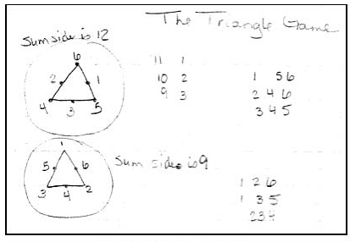
Student A’s work on The Triangle Game

Slide 10
Student B’s work on The Triangle Game
The text below represents a portion of the work of an eighth grade teacher with secondary certification. Here, Student B offers a justification of the fact that 9 is the smallest Side Sum and 12 is the largest Side Sum.
To get the “side sum” with the SMALLEST value for the sums, you would have to put the 3 smallest #s at the vertices. The 3 larger #s would then be put at the midpoints by placing the largest (6) between the smallest (1 & 2), the next largest (5) between the next smallest (1 & 3). That leaves only one place for the 4 to go (between the 2 & 3). This creates a side sum of 9.
To get a larger side sum, reverse that process. Place the 3 largest (4, 5, & 6) at the vertices. Then, the midpoints would be placed with the smallest (1) between the largest pair (6 & 5), then (2) between (6 & 4) and finally the largest of the smaller #s (3) between the smallest sum of the larger #s (5 & 4) to create sums of 12.

Slide 11
The Rice Problem
A humble servant who was also a chess master taught his king to play chess. The king became fascinated by the game and offered the servant gold or jewels in payment.
The servant replied that he only wanted rice—one grain for the first square of the chess board, two on the second, four on the third, and so on with each square receiving twice as much as the previous square. The king quickly agreed.
How much rice does the king owe the chess master?
Suppose it was your job to pick up the rice. What might you use to collect the rice, a grocery sack, a wheelbarrow, or perhaps a Mac truck?
Where might you store the rice?

Slide 12
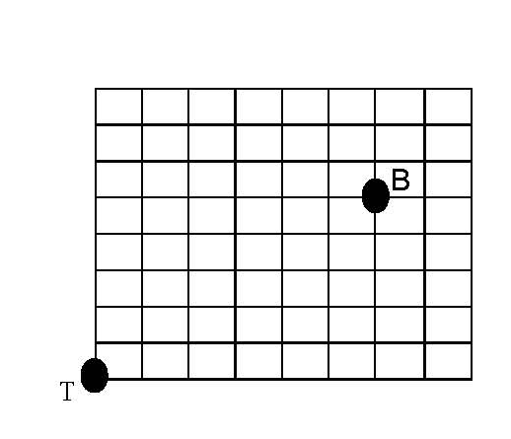
Mathville
Mathville is laid out as a square grid of North-South streets and East-West streets (See diagram).
Your apartment is located at the Southwest corner of Mathville. (Point T.) Your math classroom is in a building that is 6 blocks East and five blocks North of your apartment. (Point B)
It is an 11 block walk to math class and that there are no short cuts. Your roommate, Curious Georgia, asks how many different paths (of length 11 blocks – you don’t want backtrack or go out of your way) could you take to get from your apartment to the math class.
Solve Curious Georgia’s math problem and give a careful explanation as to why your answer is correct.

Slide 13
Pens
A version of this problem was asked on the NPR program Car Talk:
Wendy went to the store to purchase ink pens for three classes of teachers in our summer programs. She found three kinds of pens. The first cost $4 each; the price of the second kind was 4 for $1; and the cost for the third kind was 2 for $1.
The Challenge: For each class, is it possible to make a purchase so that the cost of the pens (in dollars) equals the number of pens purchased and with the restriction that she purchases at least one pen of each type?
Elementary – The “Number” course needs 20 pens for 20 teachers.
Middle Level – Concepts of Calculus needs 15 pens for 15 teachers.
High School – Algebra for Algebra Teachers needs 33 pens for 33 teachers.

Slide 14
Mind over Mathematics
Jim Lewis claims to have the ability to read your mind.
Choose a six-digit whole number “n” that repeats the first three digits – e.g. 725725 or 109109 or 226226. Write your number in the following space: My number is: n = ___________________.
Without knowing what number you choose, Jim can guess a factor of your number (i.e. a number “d” chosen so that n/d is a whole number. (Jim will not guess the number 1 nor will he guess the number n.) After you pick your number, Jim will choose a number d that divides your number.
Your assignment is to expose Jim’s mind reading scam as just good mathematics. On the line below, predict what number Jim will choose as a factor of n. You are permitted a maximum of 7 different choices. Then explain his “mind-reading” trick.

Slide 15
The Triangle Game - Revisited
Recall “The Triangle Game” which was used in the first course in the Math in the Middle master’s program.
Teachers in the Math in the Middle who earn an MAT degree must write an expository paper for their peers on a topic they learn about on their own.
One 5th grade teacher was asked to return to The Triangle Game and write a paper about The Polygon Game.

Slide 16
Side Sum Solutions for Hexagons
Side Sum 17: 3, 8, 6, 4, 7, 9, 1, 11, 5, 10, 2, 12
Side Sum 18: None
Side Sum 19: 6, 2, 11, 5, 3, 9, 7, 4, 8, 10, 1, 12
And 4, 10, 5, 8, 6, 2, 11, 1, 7, 9, 3, 12
And 5, 11, 3, 9, 7, 4, 8, 10, 1, 6, 12, 2
And 3, 9, 7, 11, 1, 10, 8, 6, 5, 2, 12, 4
Side Sum 20: 7, 11, 2, 8, 10, 4, 6, 9, 5, 3, 12, 1
And 9, 3, 8, 5, 7, 11, 2, 12, 6, 4, 10, 1
And 8, 2, 10, 4, 6, 9, 5, 3, 12, 7, 1, 11
And 10, 4, 6, 2, 12, 3, 5, 7, 8, 11, 1, 9
Side Sum 21: None
Side Sum 22: 10, 5, 7, 9, 6, 4, 12, 2, 8, 3, 11, 1

Slide 17
Patterns with Minimums & Maximums
Polygon | Minimum Side Sum | To find the next Minimum | Maximum Side Sum | To find the next Maximum
Triangle | 9 | +3 | 12 | +3
Square | 12 | +2 | 15 | +4
Pentagon | 14 | +3 | 19 | +3
Hexagon | 17 | +2 | 22 | +4
Heptagon | 19 | +3 | 26 | +3
Octagon | 22 |  | 29

Slide 18
A Solution for an n-sided polygon, n odd
General solution for an n-gon where n = 2k + 1, n odd
For a Heptagon Solution, n = 7; k = 3
To find the vertices begin with 1, move
clockwise by k each time, and reduce
mod n. The midpoints begin with 2n
between 1 and 1+k and move
counterclockwise, subtracting 1 each
time. For a heptagon, the Side Sum = 5k + 4.
1
13
14
5
4
12
8
2
7
11
9
6
10
3

