Slide 1
Chapter 3 Section 3.2
Prepared by Doron Shahar
Properties of a Function’s Graph

Slide 2
Warm-up: page 40
Prepared by Doron Shahar
What is a y-intercept? What is an x-intercept?
What is meant by a zero of a function?
A function f(x) is increasing on an open interval if________
A function f(x) is decreasing on an open interval if________
A function f(x) is constant on an open interval if________
What is a relative minimum? What is a relative maximum?
What is an even function?
What kind of symmetry does the graph of an even function have?
What is an odd function?
What kind of symmetry does the graph of an odd function have?

Slide 3
3.2.3 Evaluating a function graphically
Prepared by Doron Shahar
What is f(0)?
f(0)=1
(0,1)
For what value(s) is f(x)=−2?
For x=3
(3, −2)

Slide 4
3.2.4 Evaluating a function graphically
Prepared by Doron Shahar
(−2, 4)
(A) What is f(3)?
f(3)=−2
(F) For what value(s) is f(x)=4?
(3, −2)
For x=−2

Slide 5
Intercepts and Zeros
Prepared by Doron Shahar
What is a y-intercept?
The point where a function touches the y-axis.
MML Definition: The y-coordinate of such a point.
What is an x-intercept?
The point where a function touches the x-axis.
MML Definition: The x-coordinate of such a point.
What is meant by a zero of a function?
The x-values for which the function is zero.

Slide 6
Extra: Intercepts and Zeros
Prepared by Doron Shahar
What is the y-intercept?
(0,−3)
MML: −3
What is/are the x-intercept(s)?
(−6,0)
MML: −6
(−6,0)
(−2,0)
(1,0)
(−2,0)
MML: −2
(4,0)
(1,0)
MML: 1
(4,0)
MML: 4
What is/are the zeros?
(0,−3)
−6, −2, 1, 4

Slide 7
3.2.4 Intercepts and Zeros
Prepared by Doron Shahar
What is the y-intercept?
(0,2)
MML: 2
(B) What is/are the x-intercept(s)?
(0,2)
(−4,0)
MML: −4
(−4,0)
(1,0)
(4,0)
(1,0)
MML: 1
(4,0)
MML: 4
What is/are the zeros?
−4, 1, 4

Slide 8
3.2.1 Finding Zeros Algebraically
Prepared by Doron Shahar
Determine the zeros of the following function algebraically.
(A)
To find the zeros, set y=0 and solve for x.
Setting y equal to zero
The square root of a number is zero if and only if that number is zero
Solution

Slide 9
3.2.1 Finding Zeros Algebraically
Prepared by Doron Shahar
Determine the zeros of the following function algebraically.
(C)
To find the zeros, set w(x)=0 and solve for x.
Setting w(x) equal to zero
The absolute value of a number is zero if and only if that number is zero
Solutions

Slide 10
Warm-up: Finding Zeros Algebraically
Prepared by Doron Shahar
Determine the zeros of the following function algebraically.
2.(A)
To find the zeros, set y=0 and solve for x.
Setting y equal to zero
Multiply by the denominator
Solution
Warning: Check that your solution is in the domain.

Slide 11
Warm-up: Finding Zeros Algebraically
Prepared by Doron Shahar
Determine the zeros of the following function algebraically.
2.(B)
To find the zeros, set y=0 and solve for x.
Setting y equal to zero
Multiply by the denominator
Solution
Warning: Check that your solution is in the domain.

Slide 12
3.2.1 Finding Zeros Algebraically
Prepared by Doron Shahar
Determine the zeros of the following function algebraically.
(B)
To find the zeros, set p(n)=0 and solve for n.
Setting p(n) equal to zero
Multiply by the denominator
Solutions
Warning: Check that your solution is in the domain.

Slide 13
Warm-up: Finding Zeros Algebraically
Prepared by Doron Shahar
Determine the zeros of the following function algebraically.
2.(C)
To find the zeros, set y=0 and solve for x.
Setting y equal to zero
Multiply by the denominator
Solutions
Warning: Check that your solution is in the domain.

Slide 14
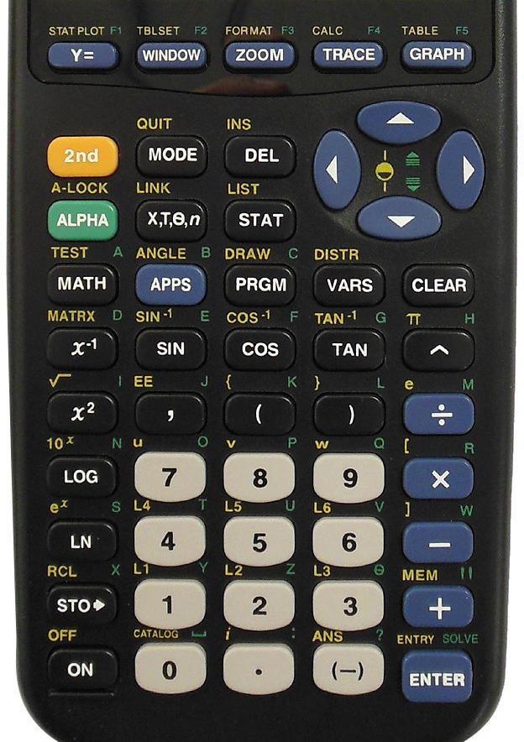
Finding Zeros with a Calculator
Prepared by Doron Shahar
Press Y=
Enter the function (e.g. y=x²−1)
Press GRAPH (If you cannot see the graph, Press ZOOM, then 6)
Press 2nd , then TRACE (CALC)
Scroll down to 2: and press ENTER
Move to the left of a zero and press ENTER
Move to the right of the same zero and press ENTER
Press ENTER again

Slide 15
Increasing, Decreasing, and Constant
Prepared by Doron Shahar
A function f(x) is increasing on an open interval if
___________________________________________
A function f(x) is decreasing on an open interval if
__________________________________________
A function f(x) is constant on an open interval if
___________________________________________

Slide 16
Increasing, Decreasing, and Constant
Prepared by Doron Shahar
On what interval(s) is f(x)…
3.2.3
… constant?
(−2,1)
… increasing?
(3,∞)
… decreasing?
(−4,−2)
(1,3)

Slide 17
Increasing, Decreasing, and Constant
Prepared by Doron Shahar
On what interval(s) is f(x)…
3.2.4 (D)
… constant?
(2,3)
… increasing?
(−4,−2)
(3,4)
… decreasing?
(−2,2)

Slide 18
Increasing Decreasing and constant
Prepared by Doron Shahar
Sketch the graph of a function that has the properties described.
3.2.5 (1st)(A)
A function whose range is (0, ∞) which is increasing on the interval
(−3,5) and decreasing on the intervals (−∞, −3) and (5, ∞).
3.2.5 (1st)(B)
A function whose domain is [− 4,4) and range is [2, ∞) that is
decreasing on the interval (− 4, − 2) and increasing on the interval (− 2,4)
Tell joke about mathematician with a can of food on a deserted island.

Slide 19
Relative Minima and Maxima
Prepared by Doron Shahar
What is a relative maximum?
What is a relative minimum?

Slide 20
Extra: Relative Minima and Maxima
Prepared by Doron Shahar
What are the relative maxima?
2 and 3
The function obtains a
relative maximum of 2 at x=−5
The function obtains a
relative maximum of 3 at x=−3
What are the relative minima?
1 and 0
The function obtains a
relative minimum of 1 at x=−4
The function obtains a
relative minimum of 0 at x=4

Slide 21
3.2.4(E) Relative maxima and minima
Prepared by Doron Shahar
What are the relative maxima?
4
The function obtains a
relative maximum of 4 at x=−2
What are the relative minima?
There are no relative minima.

Slide 22
3.2.3 Relative maxima and minima
Prepared by Doron Shahar
What are the relative maxima?
There are no relative maxima.
What are the relative minima?
−2
The function obtains a
relative minimum of −2 at x=3

Slide 23
Find Minima/Maxima on a Calculator
Prepared by Doron Shahar
Press Y=
Enter the function (e.g. y=x²−1)
Press GRAPH (If you cannot see the graph, Press ZOOM, then 6)
Press 2nd , then TRACE (CALC)
Scroll down to 3: (for minima) or 4: (for maxima) and press ENTER
Move to the left of a minima/maxima and press ENTER
Move to the right of the same minima/maxima and press ENTER
Press ENTER again

Slide 24
Even and Odd Functions
Prepared by Doron Shahar
What is an even function?
What kind of symmetry does the graph of an even function have?
What is an odd function?
What kind of symmetry does the graph of an odd function have?

Slide 25
3.2.5(2nd) Even and Odd functions
Prepared by Doron Shahar
Determine if the function graphed below is even, odd, or neither?
3.2.5 (B)
What type of symmetry
does the function have?
The function is symmetric
about the y-axis.
The function is even.

Slide 26
3.2.5(2nd) Even and Odd functions
Prepared by Doron Shahar
Determine if the function graphed below is even, odd, or neither?
3.2.5 (C)
What type of symmetry
does the function have?
The function is symmetric
about the origin.
The function is odd.

Slide 27
3.2.5(2nd) Even and Odd functions
Prepared by Doron Shahar
Determine if the function graphed below is even, odd, or neither?
3.2.5 (A)
What type of symmetry
does the function have?
Neither symmetric about the
y-axis nor about the origin.
The function is neither even nor odd.

Slide 28
3.2.6 Even and Odd functions
Prepared by Doron Shahar
Complete the graph for negative values of x if the function is
(A) Even
(B) Odd

Slide 29
3.2.7 Even and odd functions
Prepared by Doron Shahar
Complete the table if the function is
(A) Even
x | −2 | −1 | 0 | 1 | 2
f(x) | 5 |  | 1 | −3
−3
5
(B) Odd
x | -2 | -1 | 0 | 1 | 2
f(x) | 5 |  |  | -3
3
0
−5

Slide 30
3.2.8 Even and odd functions
Prepared by Doron Shahar
Determine if the function represented below is even, odd, or neither?
(B)
First evaluate g(−x).
g(−x) = g(x)
Therefore, the function is even.

Slide 31
3.2.8 Even and odd functions
Prepared by Doron Shahar
Determine if the function represented below is even, odd, or neither?
(C)
First evaluate h(−x).
h(−x) = −h(x)
Therefore, the function is odd.

Slide 32
3.2.8 Even and odd functions
Prepared by Doron Shahar
Determine if the function represented below is even, odd, or neither?
(A)
First evaluate f(−x).
f(−x)≠ f(x) and f(−x)≠ −f(x)
Therefore, the function is neither even nor odd.

