Slide 1
Chapter 2 Section 2.4
Prepared by Doron Shahar
Parallel and Perpendicular lines

Slide 2
Warm-up: page 29
Prepared by Doron Shahar
Two lines are parallel if _____________________.
If two lines are parallel, then their slopes, m₁ and m₂, are
related by the following equation _________
Two lines are perpendicular if _________________________
If two lines are perpendicular, then their slopes, m₁ and m₂
are related by the following equation __________
Exception: Verticals lines
Exception: Horizontal and Verticals lines

Slide 3
Parallel line to a horizontal line
Prepared by Doron Shahar
Extra 1: Determine the equation of the line that passes
through the point (2, 5) and is parallel to the line y=−2.
What type of line is given by the equation y=−2?
A horizontal line
What type of line is parallel to a horizontal line?
A horizontal line
What is the equation of the horizontal line
that passes through the point (2,5)?

Slide 4
Perpendicular line to a horizontal line
Prepared by Doron Shahar
2.4.4 Determine the equation of the line that passes
through the point (3, 9) and is perpendicular to the line
passing through the points (6, 2) and (−1, 2).
What type of line passes through the points (6, 2) and (−1, 2)?
A horizontal line
What type of line is perpendicular to a horizontal line?
A vertical line
What is the equation of the vertical line
that passes through the point (3,9)?

Slide 5
Parallel line to a vertical line
Prepared by Doron Shahar
2.4.3 Determine the equation of the line that passes
through the point (−4, −3) and is parallel to the line 3x+4=0.
What type of line is given by the equation 3x+4=0?
A vertical line
What type of line is parallel to a vertical line?
A vertical line
What is the equation of the vertical line
that passes through the point (−4,−3)?

Slide 6
Perpendicular line to a vertical line
Prepared by Doron Shahar
2.4.5 Determine the equation of the line that passes through
the point (3, −2) and is perpendicular to the line 2x+3=0.
What type of line is given by the equation 2x+3=0?
A vertical line
What type of line is perpendicular to a vertical line?
A horizontal line
What is the equation of the horizontal line
that passes through the point (3, −2)?

Slide 7
Slopes of Parallel and
Perpendicular lines
Prepared by Doron Shahar
If two lines are parallel, then their slopes, m₁ and m₂, are
related by the following equation _________
If two lines are perpendicular, then their slopes, m₁ and m₂
are related by the following equation __________
Exception: Verticals lines
Exception: Horizontal and Verticals lines

Slide 8
Parallel and perpendicular lines
Prepared by Doron Shahar
Warm-up 1: Determine the equation of the line that passes through
the point (−5, −2/3) and is parallel to a line with a slope of m₂= 3.
What is the slope of the parallel line?
m₁ = 3
What is the equation of the line that passes through
the point (−5, −2/3) and has a slope of m₁ = 3?
Solution

Slide 9
Parallel and perpendicular lines
Prepared by Doron Shahar
Warm-up 1: Determine the equation of the line that passes through
the point (−5, −2/3) and is perpendicular to a line with a slope of m₂= 3.
What is the slope of the perpendicular line?
m₁ = −1/3
m₁ is the opposite reciprocal of m₂.
What is the equation of the line that passes through
the point (−5, −2/3) and has a slope of m₁ = −1/3?
Solution

Slide 10
Parallel and perpendicular lines
Prepared by Doron Shahar
Warm-up 2: Determine the equation of the line whose
y-intercept is (0, 4) and is parallel to the line that passes
through the points (7, −1) and (−2,−3).
What is the slope of the given line?
What is the slope of the parallel line?
m₁ = 2/9
What is the equation of the line whose
y-intercept is (0, 4) and has a slope of m₁ = 2/9?
Solution

Slide 11
Parallel and perpendicular lines
Prepared by Doron Shahar
Warm-up 2: Determine the equation of the line whose
y-intercept is (0, 4) and is perpendicular to the line that
passes through the points (7, −1) and (−2,−3).
What is the slope of the given line?
What is the slope of the perpendicular line?
What is the equation of the line whose
y-intercept is (0, 4) and has a slope of m₁ = −9/2?
Solution

Slide 12
Parallel and perpendicular lines
Prepared by Doron Shahar
2.4.1: Determine the equation of the line that passes
through the point (3, 0) and is parallel to the line 2x+3y=5.
What is the slope of the given line?
What is the slope of the parallel line?
What is the equation of the line that passes
through the point (3, 0) and has a slope of m₁ = −2/3?
Solution

Slide 13
Parallel and perpendicular lines
Prepared by Doron Shahar
2.4.2: Determine the equation of the line that passes through
the point (−6, 5) and is perpendicular to the line x/2+y/3+1=0.
What is the slope of the given line?
What is the slope of the perpendicular line?
What is the equation of the line that passes
through the point (−6, 5) and has a slope of m₁ = 2/3?
Solution

Slide 14
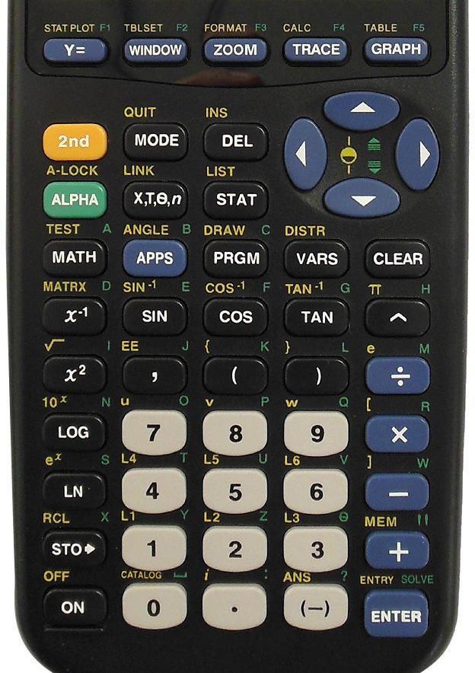
Graphing Lines with a Calculator
Prepared by Doron Shahar
Press Y=
Enter the equations of the line(s) (e.g. y₁=2x+1, y₂=−1/2x)
Press GRAPH
Note: For the lines to appear perpendicular you will need to press ZOOM, then 4 or 5)

