Slide 1
Chapter 1 Section 1.1
Prepared by Doron Shahar
Linear Equations

Slide 2
Warm-up
Prepared by Doron Shahar
A linear equation in one variable is an equation that can be written in the form __________ where a and b are constants and a ≠ 0.
Solve for x in the following equations.

Slide 3
A simple linear equation
Prepared by Doron Shahar
Starting Equation
Divide both sides of the equation by 3
Solution

Slide 4
General method for solving equations of the form
Prepared by Doron Shahar
Starting Equation
eg.
Divide both sides of the equation by
eg.
Solution
eg.

Slide 5
Example 1
Prepared by Doron Shahar
Starting Equation
Divide both sides of the equation by 2
Solution

Slide 6
Example 2
Prepared by Doron Shahar
Starting Equation
Divide both sides of the equation by −1
Solution

Slide 7
Grouping like terms
Prepared by Doron Shahar
Starting Equation
Divide both sides of the equation by 2
Solution

Slide 8
Grouping like terms
Prepared by Doron Shahar
The idea behind “grouping like terms” is to get all of the
terms involving x on one side of the equation and all of the constants on the other side of the equation.
Take the previous problem as an example.
Starting Equation
Grouping like terms
Term involving
Constant

Slide 9
Prepared by Doron Shahar
Example: Grouping like terms
Starting Equation
Group like terms
Divide both sides of the equation by −2
Solution

Slide 10
Solving Linear Equations Using Distribution
Prepared by Doron Shahar
Starting Equation
Distribute
Group like terms
Divide both sides of the equation by −8
Solution

Slide 11
1.1.2(A)
Prepared by Doron Shahar
Starting Equation
Distribute
Groups like terms
Divide both sides by −2
Solution

Slide 12
Overview
Prepared by Doron Shahar
Our method of solving linear equations involves repeated simplification. Each step is designed to reduce the problem to a form that we already now how to solve.
Steps:
Distributing: Results in only needing to group like terms
2. Grouping like terms: Results in the form
3. Dividing: Results in a solution

Slide 13
Reducing to a previously solved problem
Prepared by Doron Shahar
TELL JOKE NOW!!
Next, we will learn how to solve linear equations with
Decimals
Fractions
Variables in the denominator.
Rather than solving such problems, I will teach you how to
reduce them to previously solved problems. That is, I will
show you how to convert such problems into the form we
just learned how to solve.

Slide 14
Linear equations with Decimals
Prepared by Doron Shahar
If a linear equation has decimals, we multiply both sides of the equation by a power of 10 (i.e., 10, 100, 1000, etc) to get rid of the decimals. This is not necessary, but it can help if you don’t like working with decimals.
Example:
If our problem has the decimals 0.1, 0.2, and −0.8, we multiply both sides of the equation by 10. Our decimals then become 10×0.1=1, 10 ×0.2=2, and 10 ×(−0.8)= −8

Slide 15
1.1.2(C) Linear equation with decimals
Prepared by Doron Shahar
Starting Equation
Multiply by 10 to
get rid of decimals
Distribute the 10
The problem is now in a form you can solve.

Slide 16
Prepared by Doron Shahar
Example: Linear equation with decimals
Starting Equation
Multiply by 100 to
get rid of decimals
Distribute the 100
The problem is now in a form you can solve.

Slide 17
Linear equations with Fractions
Prepared by Doron Shahar
If a linear equation has fractions, we multiply both sides of the equation by a common denominator to get rid of the fractions. Ideally, we should multiply by the least common denominator. This is not necessary, but it can help if you don’t like working with fractions.
Example:
If our problem has the fractions 1/4, 1/2, and 1/8, we multiply both sides of the equation by 8. Our fractions then become 8×1/4=2, 8 ×1/2=4, and 8 ×1/8= 1.

Slide 18
1.1.2(B) Linear equation with fractions
Prepared by Doron Shahar
Starting Equation
Multiply by 8 to
get rid of fractions
Distribute the 8
The problem is now in a form you can solve.

Slide 19
Example: Linear equation with fractions
Prepared by Doron Shahar
Starting Equation
Multiply by 15 to
get rid of fractions
Distribute the 15
The problem is now in a form you can solve.

Slide 20
Variables in the denominators
Prepared by Doron Shahar
If an equation has variables in the denominators, it is NOT a linear equation. Such equations, however, can lead to linear equations.
We treat such equations like those with fractions. That is, we multiply both sides of the equation by a common denominator to get rid of the variables in the dominators. Ideally, we should multiply by the least common denominator.
Example:
If our problem has x−3 in the denominator of one term, and x−3 in the denominator of another term, we multiply both sides of the equation by x−3. After the multiplication, the terms will have no variables in the denominators.

Slide 21
1.1.2(D) Variables in the denominators
Prepared by Doron Shahar
Starting Equation
Multiply both sides by (x −3)
Distribute the (x−3)
The problem is now in a form you can solve.

Slide 22
Example: With variables in in the denominators
Prepared by Doron Shahar
Starting Equation
Multiply both sides by (x −1)(x+2)
Distribute the (x−1)(x+2)
The problem is now in a form you can solve.

Slide 23
Example: With variables in in the denominators
Prepared by Doron Shahar
Starting Equation
The denominator x²+x−2 on the right-hand-side of the equation
is not factored. That makes it difficult to find the least common
denominator. Therefore, we first factor x²+x−2.
Equation after factoring
That is the starting equation on the previous slide.

Slide 24
Extraneous Solutions
Prepared by Doron Shahar
Starting Equation
Multiply both sides by (x−1)
Distribute the (x−1)
Extraneous Solution
Plugging in 1 for x in the original equation would result in dividing by zero. Thus, x=1 is not a solution. It is called an extraneous solution.

Slide 25
Variables in the denominators
Prepared by Doron Shahar
There are two key differences between equations with
variables in the denominators and those with fractions.
If an equation has variables in the denominators, it is important to first factor the expressions in the denominators. This makes it easier to find a least common denominator.
An equation with variables in the denominator may have extraneous solutions. Therefore, it is important to check that the solution you get does not make any of the denominators zero.

Slide 26
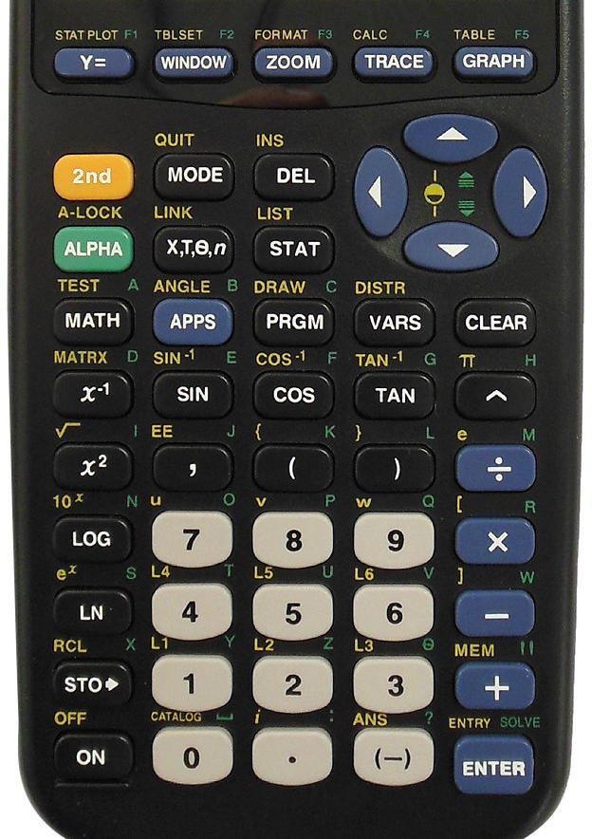
Checking answers on a Calculator
Type in your answer. (e.g. 4)
Press STO→, X,T,Ѳ,n , and press ENTER
Enter the original equation. (e.g. 2x+1=9) (Use X,T,Ѳ,n to type x. Press 2nd, then MATH (TEST), then ENTER to type =.)
Press ENTER. If a 1 appears your answer is right. If a 0 appears your answer is wrong.

Slide 27
Identifying Linear equations
Prepared by Doron Shahar
A linear equation in one variable is an equation that can be written in the form __________ where a and b are constants and a ≠ 0.
To decide if an equation is linear, we try and get it in this form.
To do this, simply try to solve it. But instead of actually solving it,
stop short to try and get it in this form. If it cannot be written in
this form, then the equation is not linear.
Note: When trying to get the equation into this form, you cannot multiply or divide by an expression with a variable.

Slide 28
Example: Identifying linear equations
Prepared by Doron Shahar
Starting Equation
Equation in the
form
The equation is linear.

Slide 29
Prepared by Doron Shahar
1.1.1(B) Identifying linear equations
Starting Equation
Equation in the
form
1
The equation is linear.

Slide 30
1.1.1(D) Identifying linear equations
Prepared by Doron Shahar
Starting Equation
Note: When trying to get the equation into the form ax+b=0, you cannot multiply or divide by an expression with a variable.
We would have to multiply by x to get the equation into the from
ax+b=0. Therefore, the equation is non-linear.
It does, however, lead to the linear equation −6x−1=0.
The equation is non-linear.

Slide 31
1.1.1(C) Identifying linear equations
Prepared by Doron Shahar
Starting Equation
Note: When trying to get the equation into the form ax+b=0, you cannot multiply or divide by an expression with a variable.
We would have to multiply by x to get the equation into the from
ax+b=0. Therefore, the equation is non-linear.
It also does NOT lead to a linear equation.
The equation is non-linear.

Slide 32
1.1.1(A) Identifying linear equations
Prepared by Doron Shahar
Starting Equation
The equation cannot be written in the form
The equation is non-linear.

Slide 33
Quadratic equations
Prepared by Doron Shahar
An equation in the form ax²+bx+c=0 where a≠0 is called a
quadratic equation. The equation −4x²+3x+2=0 from the
previous slide is an example of a quadratic equation.
All quadratic equations are non-linear. You may simply
assume this fact. Although a mathematician would want
you to prove it.
JOKE:
An argument is needed to convince a reasonable person.
A proof is needed to convince and unreasonable one.

Slide 34
Systems of equations
Prepared by Doron Shahar
So far we have learned to solve for one variable given a single
equation. Next we shall try and solve for multiple variables given
multiple equations.
Examples:
There are two methods for solving systems of equations: Substitution and Elimination. Both work by combining the equations into a single equation with one variable.

Slide 35
Substitution
Prepared by Doron Shahar
Starting Equations
Substitute 2y for x in the second equation
Solution for y
Plug in 1/42 for y in the first equation to get the solution for x

Slide 36
1.1.3 Substitution
Prepared by Doron Shahar
Starting Equations
Solve for x in the second equation
Substitute −2y−8 for x in the first equation
Solution for y
Plug in −5 for y in the second equation to get an equation for x

Slide 37
1.1.3 Elimination
Prepared by Doron Shahar
Starting Equations
Add the two equations together
Solution for x
Plug in 2 for x in one of the original equations to get an equation for y
Now solve for y

Slide 38
1.1.4 Elimination
Prepared by Doron Shahar
Starting Equations
Multiply the first equation by −2
Add the latter two equations together
We chose to multiply the first equation by −2, so that when we
would add the two equations together the terms with A would
cancel leaving us with an equation that has just one variable.

Slide 39
Substitution and elimination
Prepared by Doron Shahar
Both substitution of elimination work by combining the equations into a
single equation with one variable.
Substitution accomplishes this by substituting one variable by an equivalent expression that is written in terms of another variable.
Elimination works by multiplying the equations by appropriate constants, so that when added together one of the variables will be eliminated.
The resulting equation with one variable is then solved. The solution to
this equation is plugged into one of the original equations . That
produces an equation in the second variable, which may then be solved.

