Slide 1
Isoperimetric characteristics of domains and variational inequalities of mathematical physics
Ilnar Shafigullin
(Kazan State University)

Slide 2

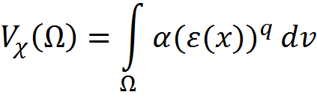
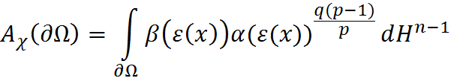


Basic concepts by V.M.Miklyukov and M.-K.Vuorinen.
Let be an n-dimensional connected noncompact Riemannian С²-manifold without boundary. For
where

Slide 3




Isoperimetric profile

Slide 4
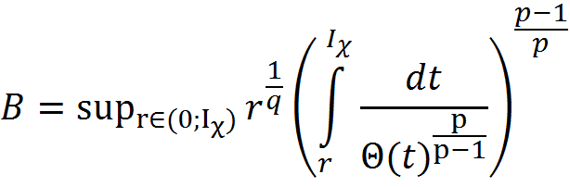
The constant which characterizes isoperimetric profile

Slide 5




Theorem (V.M.Miklyukov and M.-K.Vuorinen, 1999)
Let . If has an isoperimetric profile with B<∞, then for any function

Slide 6



S.T. Yau result (1975)
Let be Riemannian manifold, with Gaussian curvature K and k=const<0.

Slide 7



Case when the domain is the strip on the plane

Slide 8

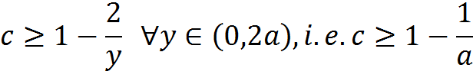

Case when the domain is the strip on the plane

Slide 9

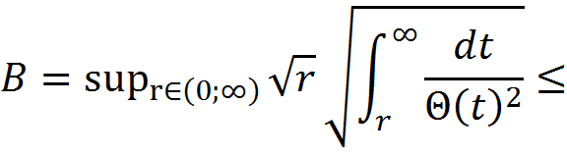

Case when the domain is the strip on the plane

Slide 10


Hardy inequality for the strip

Slide 11


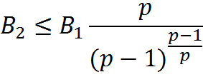
Comparison of constants B in some special cases when p=q

Slide 12
References
Ф.Г. Авхадиев, Неравенства для интегральных характеристик областей, Учебное пособие, Казань, КГУ, 2006 – 142 с.
V.M.Miklyukov, M.K.Vuorinen, Hardy’s inequality for -functions on riemanian manifolds // Proc. Amer. Math. Soc. 127, №9 (1999) 2145-2154.
F.G. Avkhadiev, K.J. Wirths, Unified Poincare and Hardy inequality sharp constants for convex domains, Z.Angev.Math.Meth. 87, No 8-9, 632-642 (2007)
S.T.Yau, Isoperimetric constants and the first eigenvalue of a compact Riemanian manifold, Ann.Sci. Ecole Norm. Sup. (4) 8 (1975), 487-507.
В.М.Миклюков, Неравенство Харди для функций с обобщенными производными на римановых многообразиях. Trudy IPMM NAN Ukrainy. v. 3. 1998. c. 158-172.

